Slide 1

Terrestrial/Atmospheric Characterization and Observation of Satellites & Uranus
Team IG4
Final Design Review
Senior Design Spring 2023
Notes:
Speakers:
Zion: start(1-11)
Jerry: timeline, orbit, etc…(12-18)
Zion-prop, attitude, telemetry(19-30)
Matthew-structures, science/payload, thermal(31-42)
Michael-power(rtg, batt, program management, power budget, mass)(43-49)
Cameron-cost(50-53)
Zion-major risks, facts, questions(54-57)

Slide 2
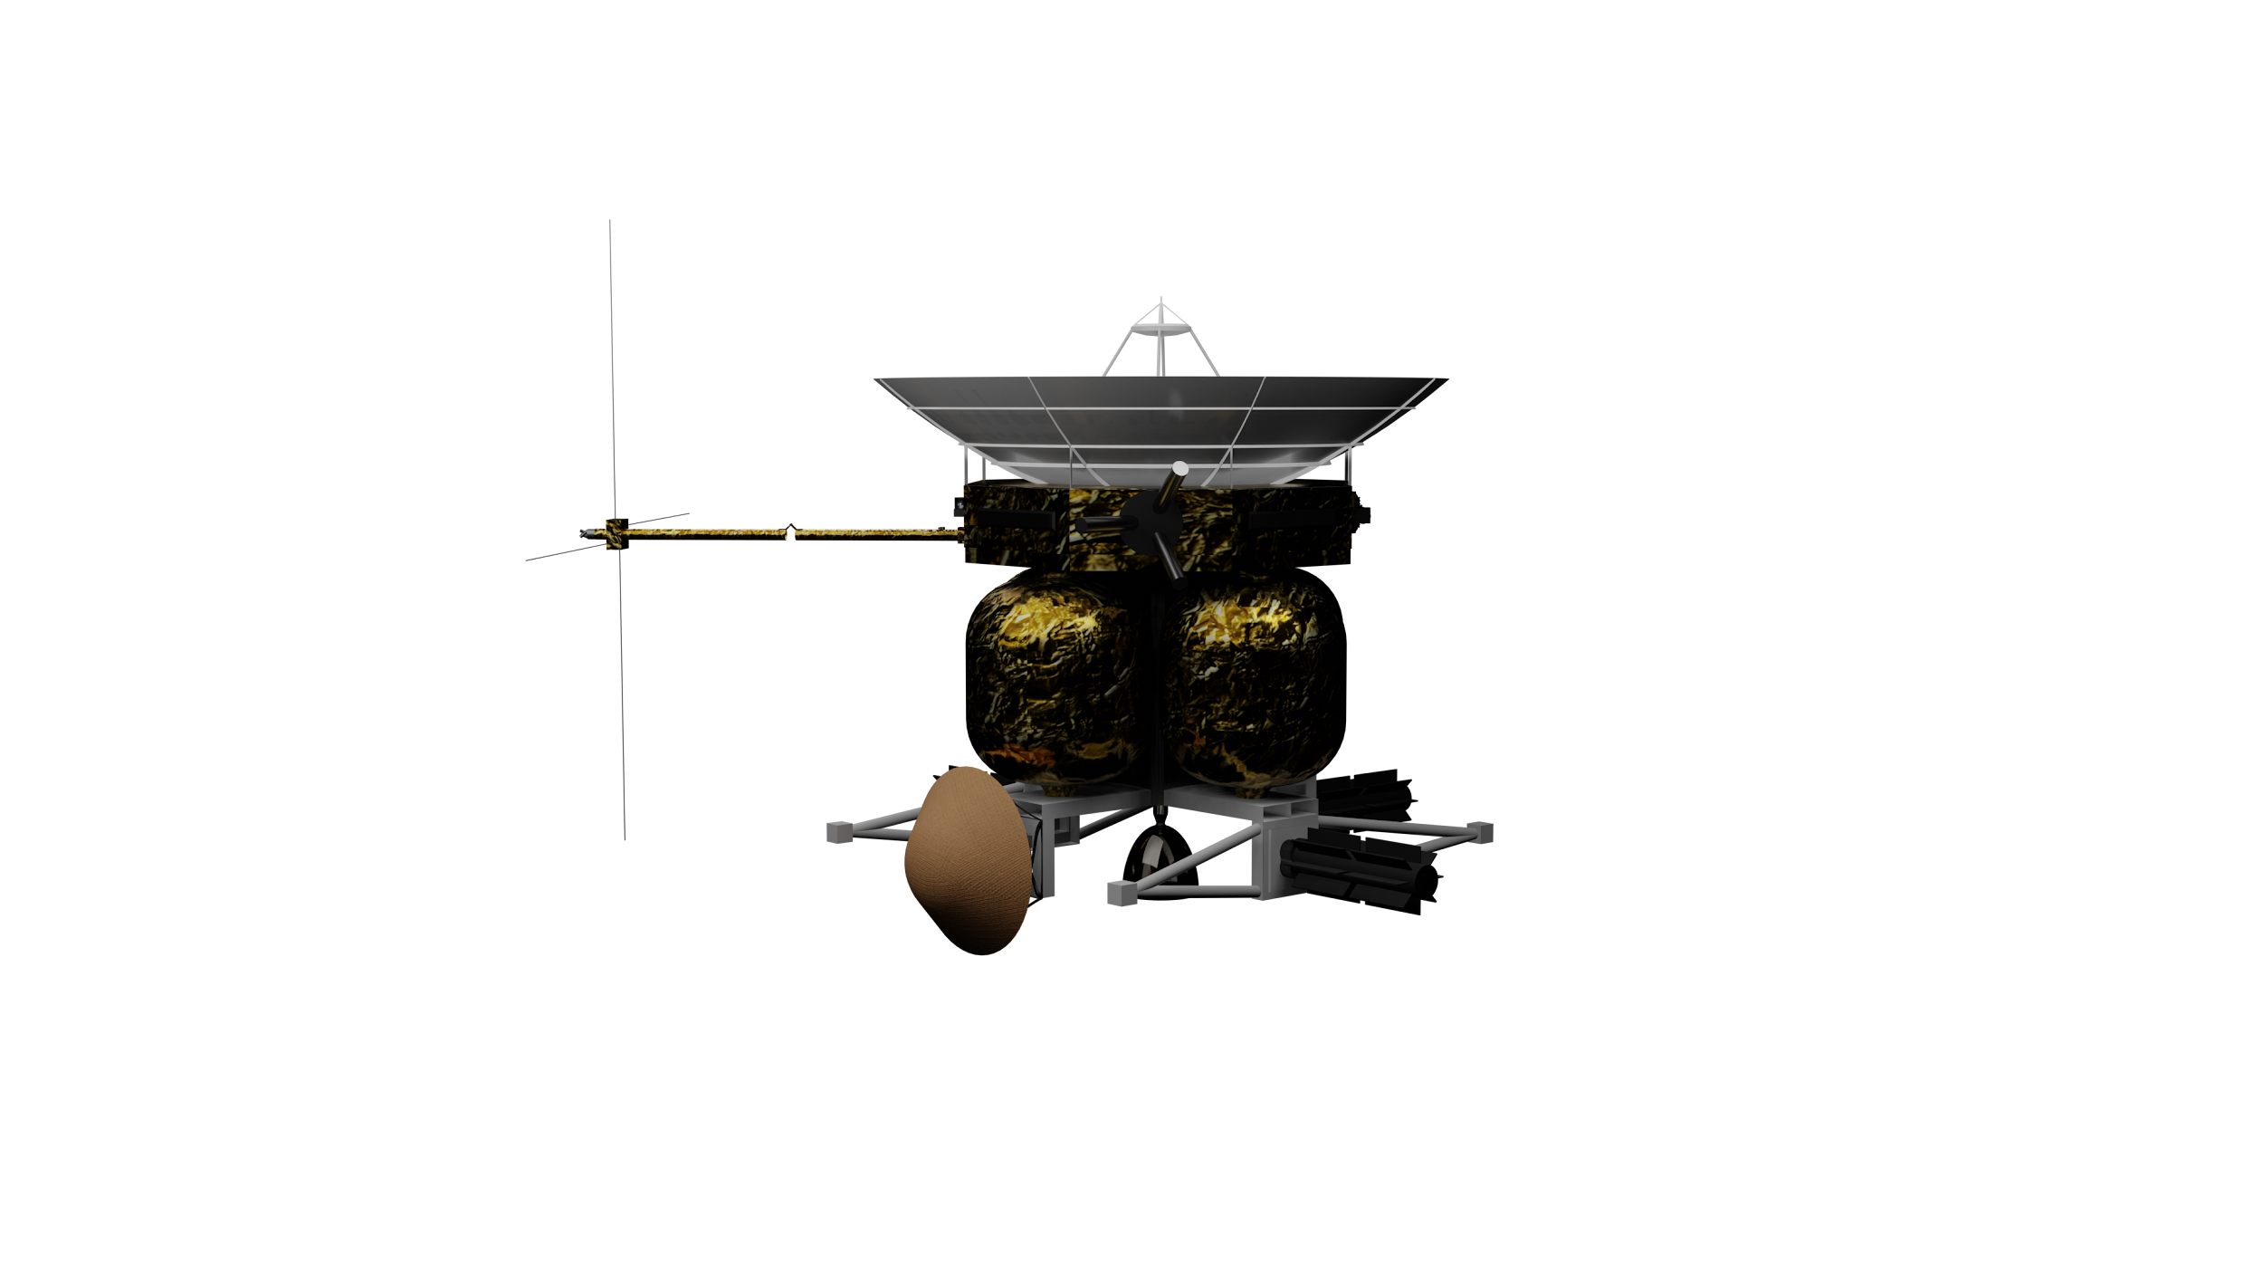
Overview
Mission Concept
  Motivation & Purpose
  Top-Level Requirements
Mission Design
  Concept of Operations
  Timeline
Subsystems
Program Management
  Budgets
  Cost & Scheduling
  Risks
Acknowledgements & Questions

Slide 3
Team Members
Systems Engineers:
Megan Rush
Michael Thomas
Telemetry:
David Hickey
Tyler Wisniewski
Project Manager:
Zion Moss
Propulsion:
Chris Bermack
Deep Datta
Adelaide Johnson
Cost & Schedule:
Cole Zimmermann
Cameron Baxley
Attitude Determination and Control:
Brady Beck
Aaron Schwarz
Trajectory:
Griffin Carpiniello
Simon Cohen
Jerry Varghese
Science & Structures:
Matthew Glimcher
Space Environment:
Erik Zabalegui Lopez
Notes:
Our team this semester consisted of 17 members that we separated into 8 different groups, each focusing on one subsystem.
I’m Zion Moss, the Project Manager, and presenting with me today is
Jerry Varghese from the Trajectory team,
Michael Thomas from the Systems Engineering team,
and Cameron Baxley from the Cost and Scheduling team.

Slide 4

Mission Concept
Zion Moss

Slide 5
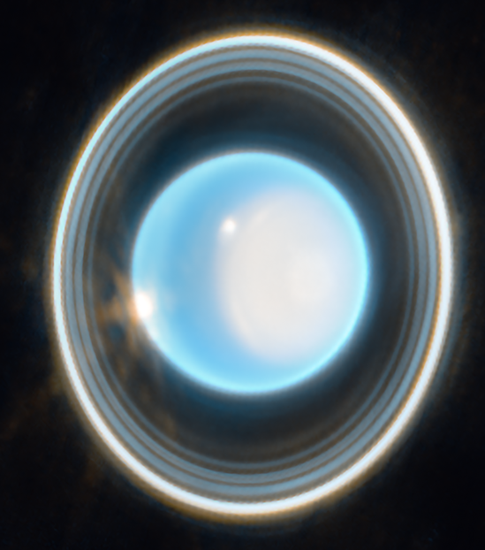
Motivation: Why Uranus?
Only visited once by Voyager 2
Unique characteristics:
  Extreme axial tilt
  Complex magnetic dynamo
  Low surface temperature
  Extremely dark inner moons and rings
Large icy moons
  Potential subsurface oceans
Analog for most common exoplanet size class
Notes:
James Webb Telescope, 2023

Slide 6
Purpose
To conduct a pioneering deep space scientific exploration of Uranus, leveraging the latest advances in technology and engineering to study this mysterious and little-understood planet. By deploying an orbiter and a probe, we aim to gather new insights into the composition, atmosphere, and magnetic field of Uranus, as well as its moons and ring system.

Slide 7
Mission Drivers
Task: Conduct a scientific investigation of Uranus & its moons
Baselines:
Return data on
  Atmospheric composition & weather patterns
  Internal structure & magnetic field
  Moon composition (potential subsurface oceans)
  Ring composition & formation
1+ lunar flyby
Demonstration of new technology at TRL 4 or 5
Launch between 2023-2038
Budget: $2.5 billion
Notes:
Our task is to conduct a scientific investigation of Uranus and its moons.
At a minimum we must: [list baselines]

Slide 8
Scientific Questions & Objectives
Rings & Small Satellites
R1. What processes sculpted the ice giant rings and small moons into their current configuration?
R2. What are the compositions, origins and history of the Uranian rings and inner small moons?
Atmosphere
Interiors
Magnetosphere
Large Satellites & Ocean Worlds
A1. How does atmospheric circulation function, from interior to thermosphere, in an ice giant?
A2. What is the 3D atmospheric structure in the weather layer?
A3/I1. When, where, and how did Uranus form, and how did it evolve both thermally and spatially, including migration?
I2. What is the bulk composition and its depth dependence?
I3. Does Uranus have discrete layers or fuzzy core, and can this be tied to its formation and tilt?
I4. What is the true rotation rate of Uranus, does it rotate uniformly, and how deep are the winds?
M1. What dynamo process produces Uranus's complex magnetic field?
M2. What are the plasma sources & dynamics of Uranus' magnetosphere and how does it interact with the solar wind?
M3. How does the magnetosphere interact with Uranus's upper atmosphere and satellite surfaces?
S1. What are the internal structures and rock-to-ice ratios of the large Uranian moons? Which ones possess substantial internal heat sources or possible oceans?
S2. How do the compositions and properties of the Uranian moons and ring system constrain their formation and evolution?
S3. What geological history and processes do the surfaces record and how can they inform outer solar system impactor populations?
S4. What evidence of exogenic interactions do the surfaces contain?
Notes:
Per the Decadal Survey, there are 15 questions that scientists would like answered during an Orbiter Probe mission to Uranus. They broke the questions up into different topics, including: atmospheric conditions, interior composition and formation, the magnetosphere, rings, satellites, and ocean worlds.
Atmosphere: What can uranus’ atmospheric composition tell us about its formation and why is it’s surface temperature so low?
Interiors: Does Uranus Have Discrete or Fuzzy layers?
Magnetosphere: How is Uranus’ Tilted magnetic Field generated?
Rings and Small Satellites: Why are Uranus’ Rings and inner moons so dark and how did they evolve?
Large Satellites and Ocean Worlds: What are the interior structures
These questions have guided our payload selection, as we had to make sure that each were answered with data collection.

Slide 9
Work Breakdown Structure
TACOS-U
1. Orbiter Bus
2. Payload
3. Operations
4. Program Level
5. Aerospace Ground Equipment
Structures
Thermal
ADCS
Power
Propulsion
TT&C
Scientific Instruments (Orbiter)
Scientific Instruments
(Probe)
Communications
Mission Software
Space
Ground
Systems Engineering
Program Management
Testing/Integration
Product Assurance
6. Launch Vehicle
7. Ground Control
and Command
Notes:
In order to fulfill our mission, we broke our group into 7 different subcategories.
On the left, you can see 6 of our subteams listed under Orbiter Bus.
Next is the payload, which includes all scientific instruments each of the orbiter and probe.
Then operations, which includes space and ground ops.
Program level involves systems engineering, program management, testing and integration, and product assurance which involve the cost and scheduling and systems subgroups.
Lastly, our additional thrusts include the aerospace ground equipment we must use, the launch vehicle we contract to take our orbiter to the Ice giant, and the ground control and command.

Slide 10
Top-Level Requirements
MIS-100 | The mission shall target Uranus for scientific study
MIS-200 | The mission shall launch between 2028 and 2038
MIS-300 | The mission shall be completed in no more than 20 years
MIS-400 | The mission shall only employ technologies of at least TRL 6, with the exception of one lower TRL (4-5) technology for flight demonstration
MIS-500 | The cost of the mission shall not exceed $2.5 billion
MIS-600 | The spacecraft shall perform a flyby of at least one Uranian moon
Notes:
Stemming from the system drivers provided by the teaching team at the beginning of the semester, we were able to create formal top level requirements to guide out mission development. [reiterate list]

Slide 11
Mission Design
Jerry Varghese

Slide 12
Mission Design Requirements
TRJ-100 | The spacecraft shall take no more than 16 years to arrive at Uranus
TRJ-200 | All flybys shall have a periapsis of at least 1.1R
TRJ-300 | A Jupiter flyby shall have a periapsis of at least 8R
TRJ-400 | The initial Uranus science orbit shall have a period of at least 28 days
TRJ-500 | The initial science orbit apoapsis shall have a view of Uranus’ day side
TRJ-600 | The moon tour shall take no longer than 3 years
TRJ-700 | The spacecraft shall avoid Uranus’ rings
TRJ-900 | Scientific flybys should have a periapsis no greater than 5R
TRJ-1000 | Probe atmospheric interface should be at least 1.5 hours before the capture burn
TRJ-1100 | Probe atmospheric interface should occur at an angle of 8 degrees below the horizon at 1 Uranian radii

Slide 13
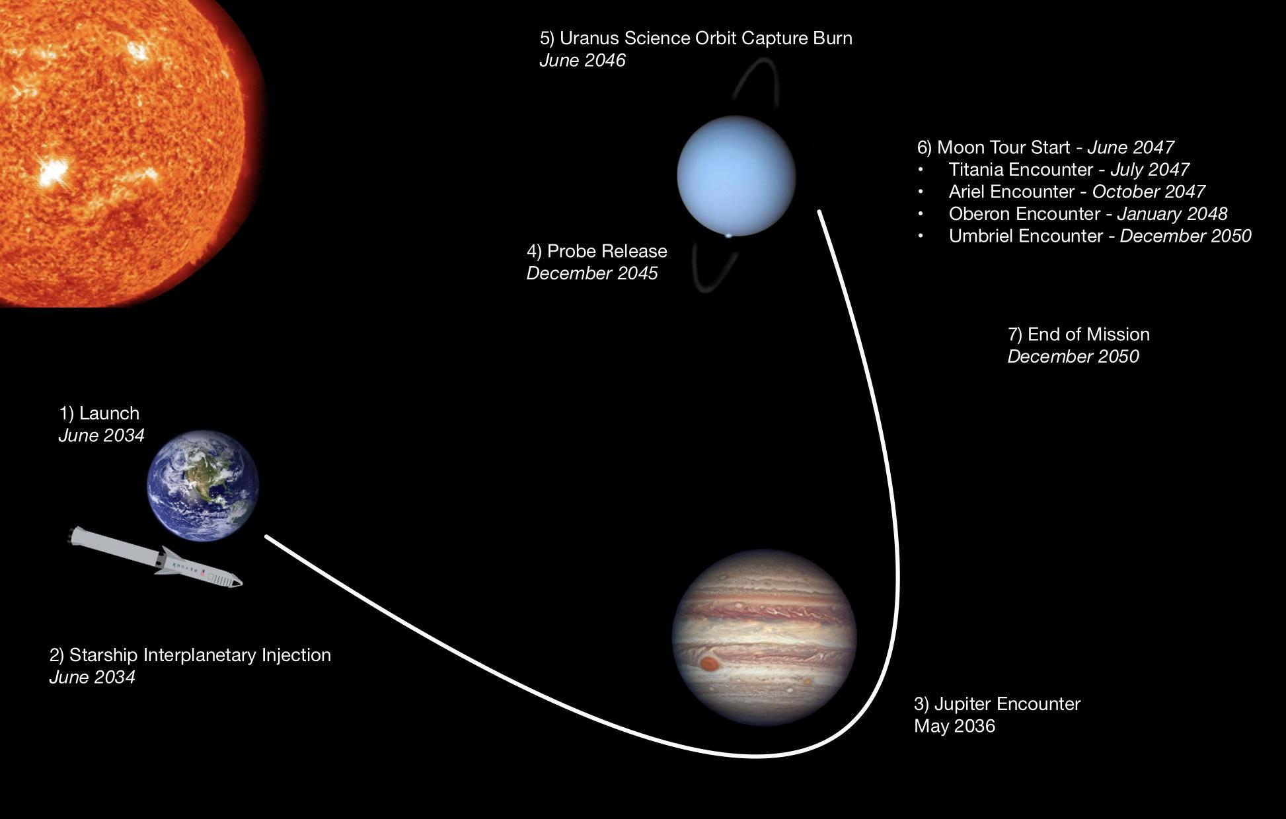
Notes:
Starship launch
Interplanetary trajectory
Probe release
Uranus capture
Moon tour

Slide 14
Mission Timeline
DATE | EVENT | DELTA V (km/s)
 | Launch to LEO | 7.778
Jun 16, 2034 | Starship interplanetary injection | 6.60
May 7, 2036 | Jupiter encounter | 0.00
Dec 14, 2045 | Probe release | 0.44
Jun 12, 2046 | Uranus science orbit capture burn | 0.82
Jun 12, 2046 | Probe entry
Jun 13, 2047 | Moon tour start
Dec 01, 2050 | Moon tour end

Slide 15
Starship Launch
Interplanetary Trajectory
Launch to LEO, refuels in LEO
∆V = 6.6 km/s after LEO
  “For free”
Interplanetary
Video
Chosen sequence: EJU
Depart Earth: June 2034
Jupiter flyby: May 2036
  Nominally ballistic
Uranus arrival: June 2046
Time of flight: 12 years

Slide 16
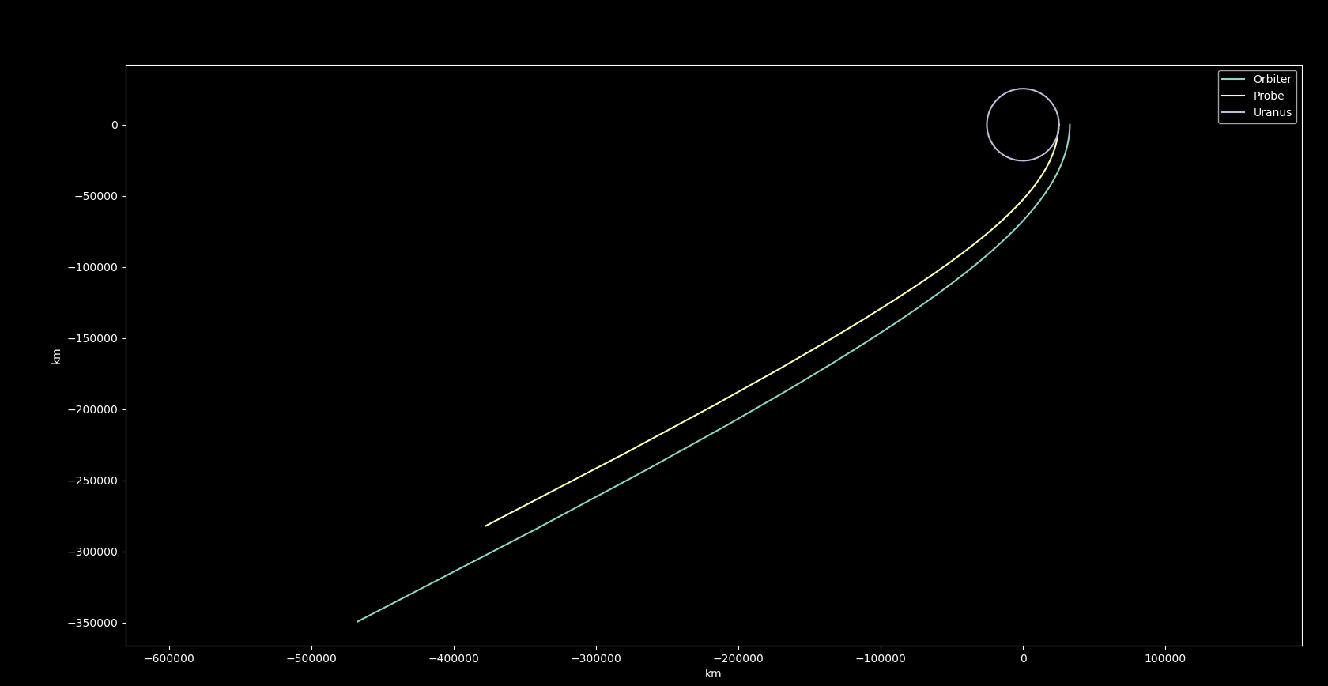
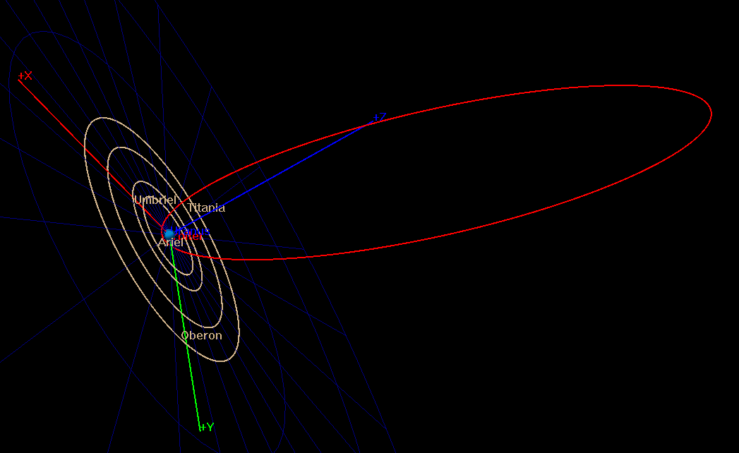
Probe Release
Uranus Capture/Science
Probe release: Dec 14, 2045
Probe entry: June 12, 2046
∆V = 0.44 km/s for periapsis raise
6 month targeting, FPA = -8 (Galileo)
Targeting a highly eccentric inclined orbit
  T = 30 days for TT&C
  R_P = 1.3 R_U for science
∆V = 0.818 km/s

Slide 17
Moon Tour
Start: June 13, 2047
Deep space maneuver scheme
All moons passed at 1.1 moon radii
  Science collection
TAOU sequence
∆V = 1.05 km/s
Cost can get lower, need computational resources
Moon Tour Video

Slide 18
Subsystems
Propulsion
Attitude Determination & Control
Telemetry
Scientific Payload
Structures
Thermal Control
Electric Power System

Slide 19
Propulsion System Requirements
PROP-100 | The propulsion system shall be compatible with overall mission architecture (dV insertion, launch vehicle)
PROP-200 | The propulsion system shall be easily storable with: low inert mass, low toxicity, low freezing point
PROP-300 | The propulsion system shall be low risk: 6+ TRL with low system complexity
PROP-400 | The propulsion system shall have an ISP comparable to commonly used hypergolic propulsion (~300 s)
PROP-500 | The propulsion system shall be cost effective

Slide 20
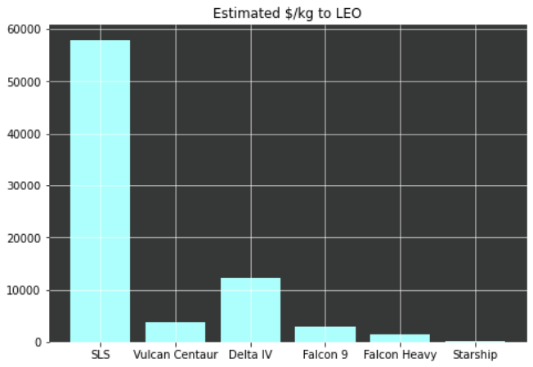
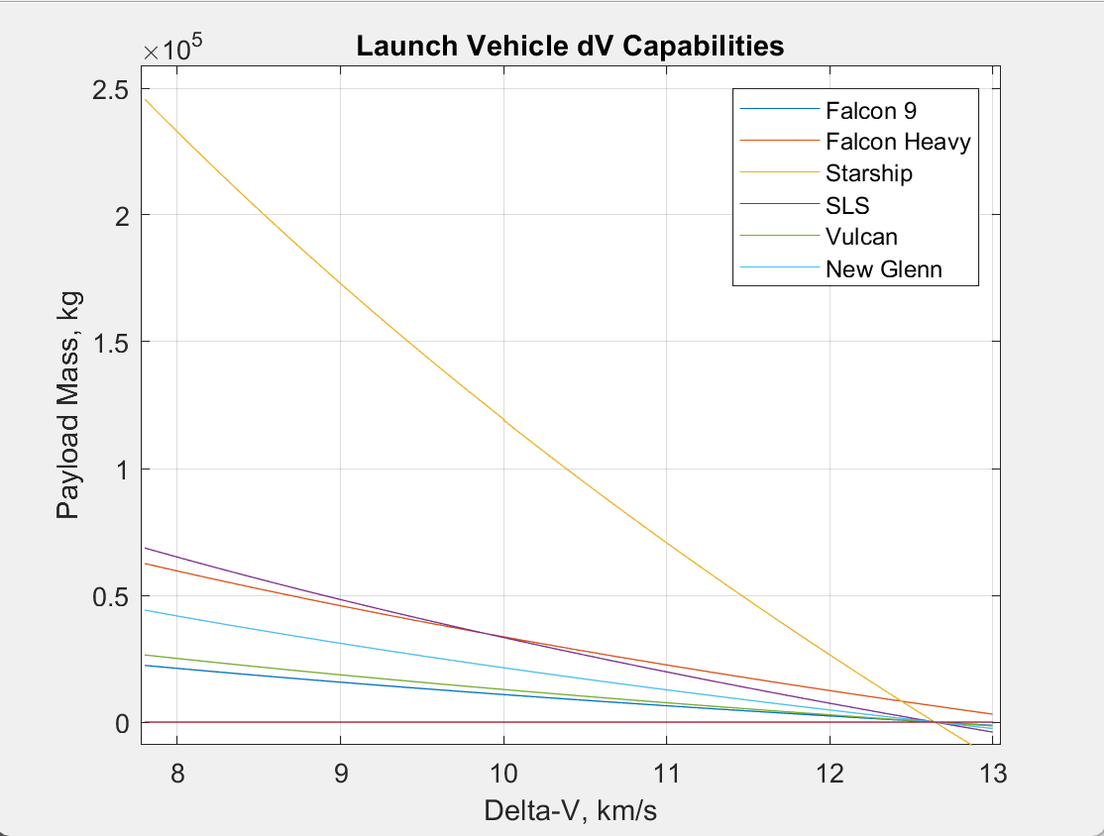
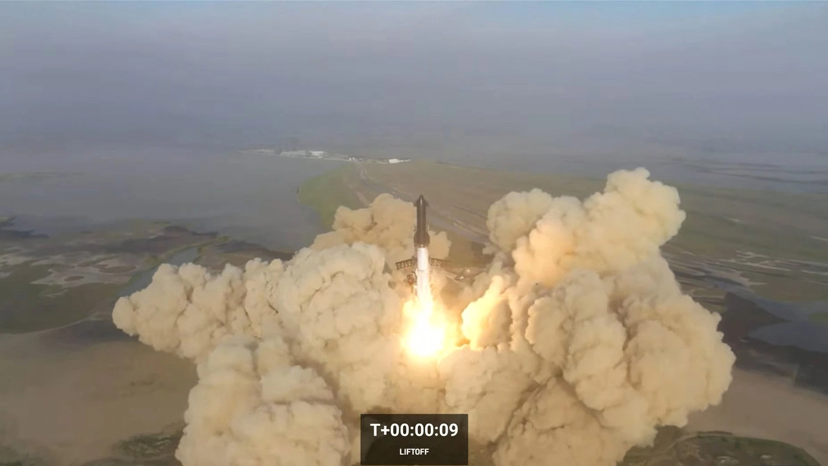
Launch Vehicle: Starship
100-150 tons to LEO
Largest available payload volume (approximately 550 m³)
In orbit refueling and booster performance easily provides 6.6 km/s dV
Notes:
Launch vehicle system:
We can also see that starship is cheaper than other launch providers based on a $/kg analysis
Starship has far more payload mass to orbit, as of the orbital launch test 4/20 , the 150 ton to LEO number hasn’t been revised
Orbiter isn’t volume or mass limited
This performance makes us confident that can Starship can get our mass to orbit and obtain our delta V
Falcon 9: $2,938.6/kg
Falcon Heavy: $1,520.38/kg
ULA Delta IV: $12,340/kg
Starship: $100-$200/kg
SLS: $58,000/kg
Vulcan centaur: $3,676.47/kg
Falcon 9
2938.6
Falcon Heavy
1520.38
Vulcan Centaur
3676.47
Starship
200
SLS
58000
Delta IV
12340

Slide 21
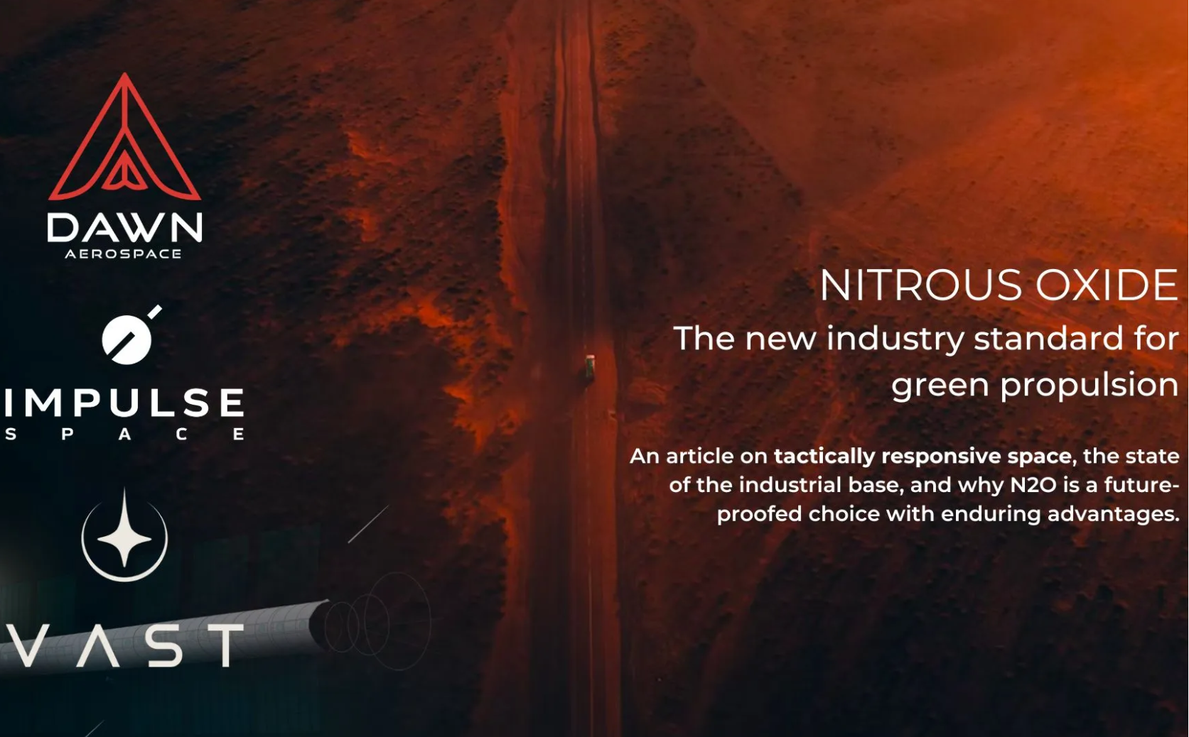
Propulsion
Spacecraft propulsion system: Ethane, Ethylene, Nitrous Oxide
Vacuum Isp of ~310 s
green propellant, low toxicity
Self pressurizing
Matching ox & fuel vapor pressures
Freezing temperatures below -90C
Simple stage prop design
Not cryogenic
TRL of 6
“As of writing, there are 50+ thrusters on orbit on 12 satellites using nitrous bi-propellant, and hundreds more on order from 15+ companies and space agencies.” - Industry Update from Dawn Aerospace Feb. 1, 2023
Notes:
Say this!!!
Ethane Ethylene fuel, nitrous oxide as the oxidizer
Currently under development by the Pioneer Astronautics headed by Robert Zubrin.
Their work puts this propellantat a TRL of 6
Highest performing green propellant
Green prop means that the propellant can be handled without a having to wear expensive and cumbersome PEE
hydrazine , being very toxic, comes with enormous complexity due to handling and compliance with regulations - usually 100k-500k USD per satellite before any hardware is even considered. This fixed cost goes away when u use a green propellant
Our Isp meets our efficiency requirement
This propellant is easily storable. It is not cryogenic and will not degrade over time, meaning it will last throughout our 17 year mission. It has a very, low freezing point, far lower than MMH and NTO. This is important considering the wide temperature gradients we will experience (very warm during launch and in LEO, ver cold around Uranus)
Both fuel and oxidizer are self pressurizing. Therefore no inert gas is needed to keep the propellant tanks pressed. This greatly reduces the complexity of our system and reduces the number of valves and moving parts our system needs. For a 17 year long mission, simple, reliable systems are a must.
Nitrous based propellants are becoming increasingly common within the private space industry.
Launch providers with be accustomed to packaging these prop systems
Hardware for these systems is rapidly developing
extra:
“As of Feb 1 2023, there are 50+ thrusters on orbit on 12 satellites using nitrous bi-propellant and hundreds more on order form 15+ companies and space agencies.” - Dawn aerospace industry update https://www.dawnaerospace.com/latest-news/prevalence-of-nitrous-based-in-space-propellants
“‘Green,’ in this context, does not say anything about the environmental impact or carbon footprint of the propellant. Rather, it imprecisely refers to the idea that you can open a bottle without having to first put on something akin to a spacesuit (a SCAPE suit).” - Dawn industry update
Should nitrous leak, it disperses!!! Very good for rideshare safety!! Provided the payload bay is ventilated, a nitrous leak will not harm any other satellite or cause a pressure rise in the payload bay

Slide 22
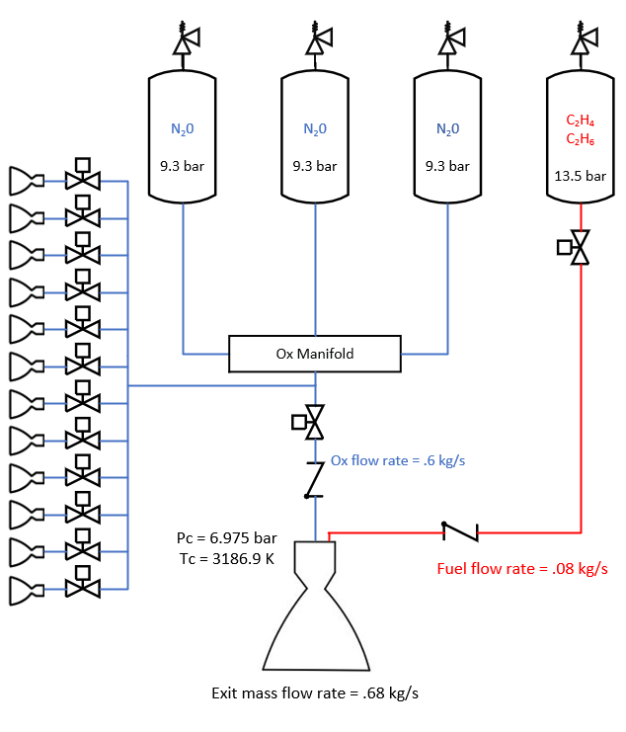
Propulsion
CONOPS:
Prior to launch, prop is loaded as a liquid into 4 titanium lined COPVs (P = 75 bar, T = 24 C)
After launch, temperature and pressure drops
  At T = -40C, P_{fuel} = 13.5 bar, P_{ox} = 9.3 bar
SPECS:
O:F = 7.5, ISP = 310 s, Mass Flow rate = 0.68 kg/s, Pc = 101.16 psi, Tc = 3186.9, E = 200, prop mass = 2088.21 kg, Burn Time = 97 minutes, Thrust = 2067.94 N
Dawn Aerospace thrusters for attitude control
 | Prop Mass | Tank Mass | Tank Volume | Tank Diameter
N2O | 1842.54 kg | 31.43 kg (x3) | 0.772 m³ (x3) | 1 m
C2H4 C2H6 | 245.67 kg | 31.26 kg | 0.763 m³ | 0.993 m
Notes:
Tank length: 1.316
Tank thickness = .0095 m (.37”)
Say this:
In order to reduce the size of our tanks, our propellant will be stored as a liquid
During prop load, propellant will be highly pressured to maintain its liquid state despite the warm weather at the Boca Chica or Cape Canaveral launch location
Temperatures will drop as the satellite travels farther from the sun
Uranus injection burn will occur when the propellant is at -40C
Using the vapor pressure curves of our propellants and pressure loss estimates, our chamber pressure will be around 7 Bar at this temp.
O:F ratio of 7.5 was selected using CEA
Burn time was estimated from the decadal survey
this allows us to determine our prop system performance and sizing

Slide 23
Attitude Determination & Control Requirements
ADC-100 | The ADC system shall have a minimum pointing accuracy of 0.1 deg
ADC-200 | The ADC system shall have an inertial attitude knowledge to 100 arc seconds = 0.03 deg
ADC-300 | The ADC system shall have an uncompensated bias stability 0.005 deg/hr
ADC-400 | The ADC system shall have an integrated angular rate precision of 1 micro-rad/LSB
ADC-500 | The actuators shall perform 180 deg slew in 60 minutes
ADC-600 | The actuators shall provide control torque greater than 50.512 mNm
ADC-700 | The secondary actuators shall be sized for momentum dumping strategy
Notes:
Requirements 1-4: Related to pointing and knowledge requirements, based on science instrument requirements and reference mission
Requirement 4: LSB = least significant bit
Requirement 5: Slew rate requirement: attitude control system shall be able to rotate the orbiter by 180 degrees in under an hour
Requirement 6: Related to expected disturbances from environmental torques and slew maneuver. Environmental torques include gravity gradient, atmospheric drag, magnetic, and solar radiation pressure.
Requirement 7: Requirement for thrusters, must be able to de-tumble and perform momentum dump from reaction wheels

Slide 24
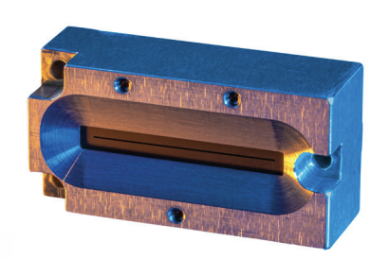
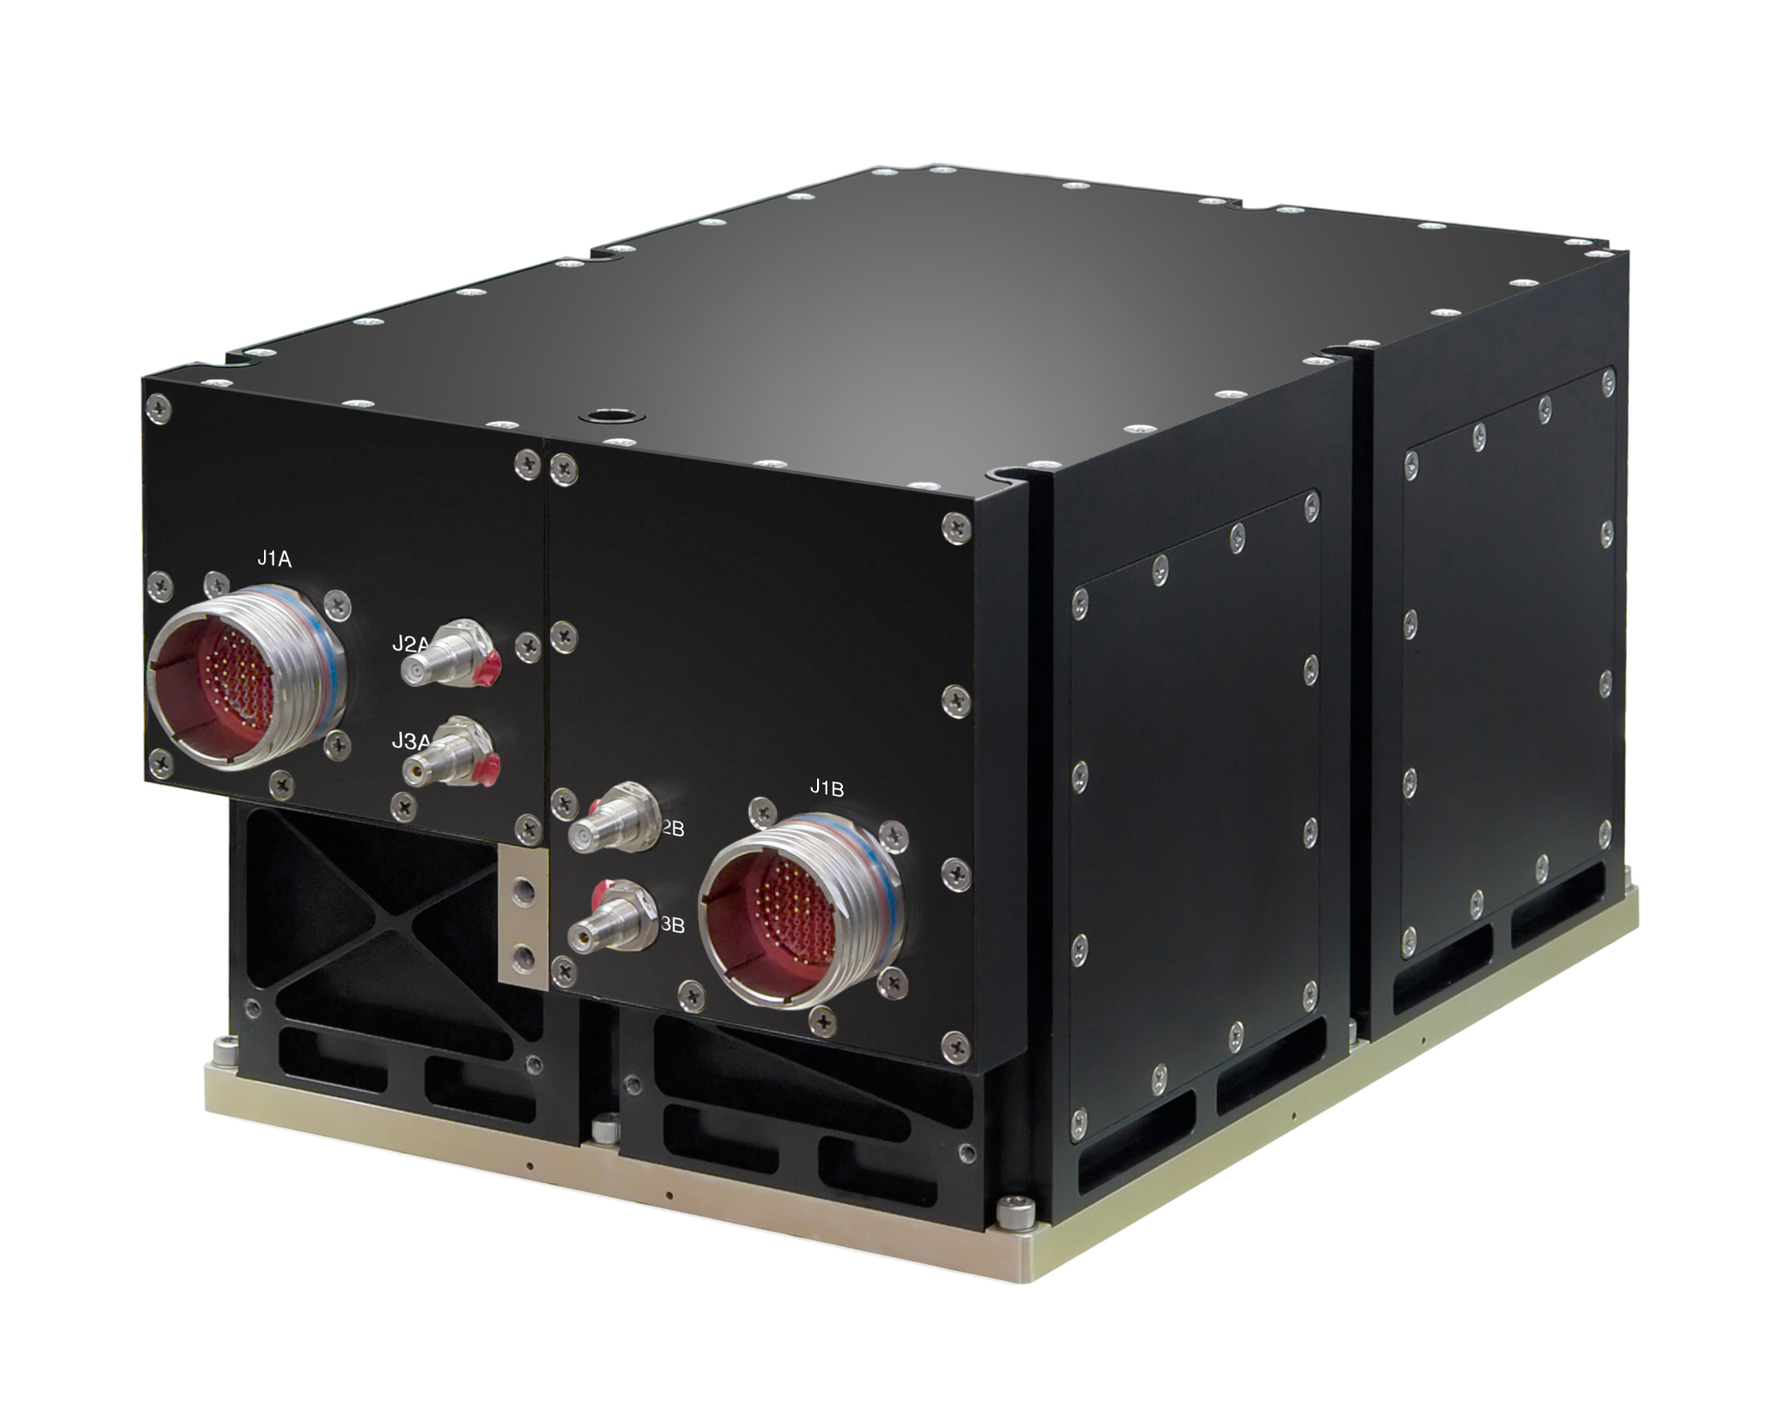
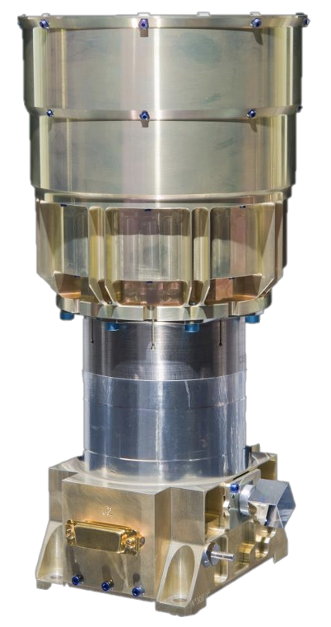
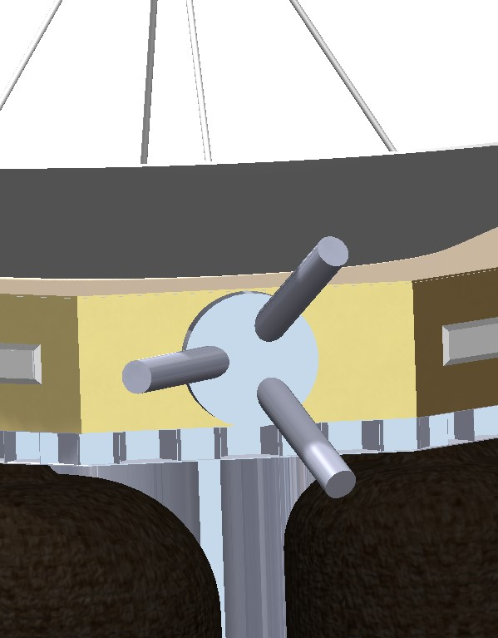
Attitude Determination Sensors
4 Redwire coarse analog sun sensor
Accuracy: 土0.75 deg
Field of view: 土40 degrees
Mounting location: In dish
Mass: 68 g each
Power: up to 100 mW each
2 Sodern Hydra-CP
Field of view: ~22 deg
Mounting location: Between dish and box, 45 degrees from camera
Mass: 1.4 kg each
Power: 0.8-1W each
Accuracy: Worst case bias <11 arc seconds
2 Northrop Grumman scalable SIRU
Mounting location: In box
Mass: 7.1 kg each
Power: 43 W max each
Accuracy: Bias stability <0.0015 deg/hr, low enough gyro noise
3 XNAV X-ray telescopes
CubeX Telescopes
Accuracy: <1 arcminute
Field of view: 1 sq. deg
Mounting location: Zenith face
Mass (MEV): 20.4 kg
Power (MEV): 20.0 W
Notes:
For attitude knowledge sensors, we will include 4 sun sensors, 2 star trackers, 2 inertial reference units, and 3 XNAV telescopes.
We chose 4 sun sensors because they are relatively inexpensive, low mass, and low power draw.
We will be most reliant on the sun sensors during acquisition and safe modes because they can operate in low power, however when we can achieve higher accuracy in higher power operational modes the other hardware is more useful.
They will be mounted in the dish such that they have a clear field of view.
Our chosen SIRUs have a bias stability of less than 0.0015 degrees/hour and small enough gyro noise to meet requirements.
They will be mounted in the box that houses our electronics below the dish.
The Star tracker we chose has a worst case bias of less than 11 arcseconds and low spatial errors to meet attitude knowledge requirements.
They will be mounted between the dish and the electronics box 45 degrees from the imaging system because the orbiter will already be controlled such that the imaging system does not get damaged due to sunlight.
XNAV telescopes were already included in the science payload and according to the NASA Ames research center, the x-ray imaging spectrometer has an accuracy of less than 1 arcminute, but the technology is still developing and will improve.
The spectrometer has a field of view of greater than 1 square degree and mean estimated values of mass and power of 20.4 kg and 20 W respectively.

Slide 25
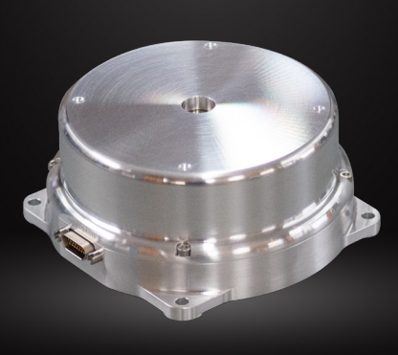
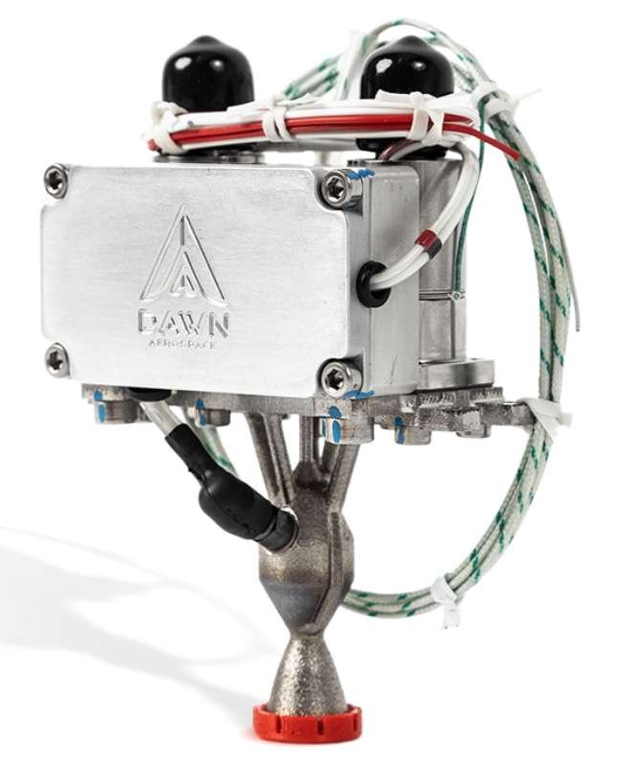
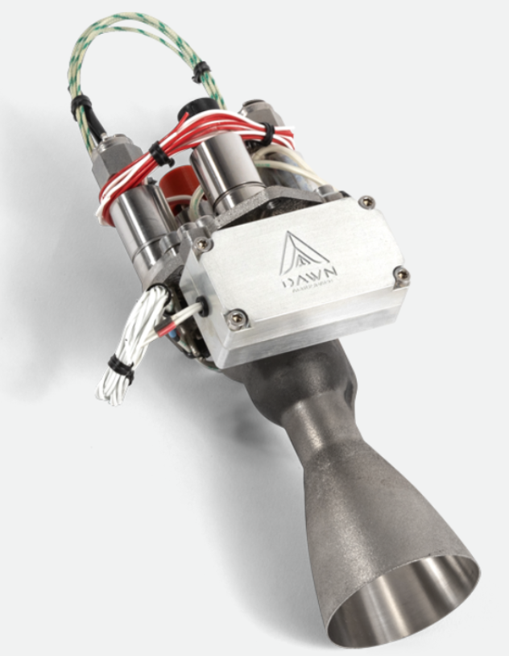
Attitude Control Actuators
Reaction Wheels:
Rocket Lab RW 0.4 (x4)
±100 mNm Torque each
0.6 kg each
Organized in four-wheel pyramid configuration
Control Thrusters:
Dawn Aerospace Thrusters:
  B1: Pitch and Yaw
  B20: Roll
B1: 0.46-1.28 N (x8)
B20: 6.1-16.7 N (x4)
B1
B20
Notes:
Hardware used for attitude control: Reaction wheels and control thrusters
Reaction wheels
From Rocket Lab
Four configured in the standard pyramid configuration
Specific model sized according to the torque from requirement 6.
Control thrusters
From Dawn aerospace
Verified with propulsion team that these models will mesh with current prop scheme
Eight B1 thrusters used to maneuver in pitch and yaw directions
Four B20 thrusters used in roll direction
Selections driven by thrust force required to give 3-axis stabilization and momentum dump
Control Scheme:
Bang-bang control mode to cycle between each operation mode:
Spin stabilization for majority of mission during cruise
3-axis stabilization for pointing adjustments, momentum dumping
Bang-bang not the most efficient for fuel consumption, but known to work for deep space probes
Brady isn’t him

Slide 26
Telemetry Requirements
TEL-100 | The telemetry system shall return science data using a baseline of Ka-Band
TEL-200 | The telemetry system communication baseline shall be conducted with 34m Deep Space Network (DSN)
TEL-300 | Onboard science data shall be returned within two weeks of collection
TEL-400 | The telemetry and tracking system shall be available for all critical events
Notes:
These are the four requirements for our telemetry system as given to us in the initial project outline at the start of the semester. How they are all satisfied:
TEL-100: HGA only transmits in Ka, sends back both science and telemetry. MGA and LGA are used to let ground control know where the s/c is and that it is still operational, not to send large amounts of data back
TEL-200: HGA designed with 34m communication in mind where HGA is the baseline method of linking. MGA and LGA are used during critical events and rely on the 70m to link
TEL-300: 13 day schedule following science collection that transmits the data back in 13, 11 hour transmission periods
TEL-400: MGA and LGA allow for uplinking during burns and safety modes when s/c orientation is unable to point HGA at Earth

Slide 27
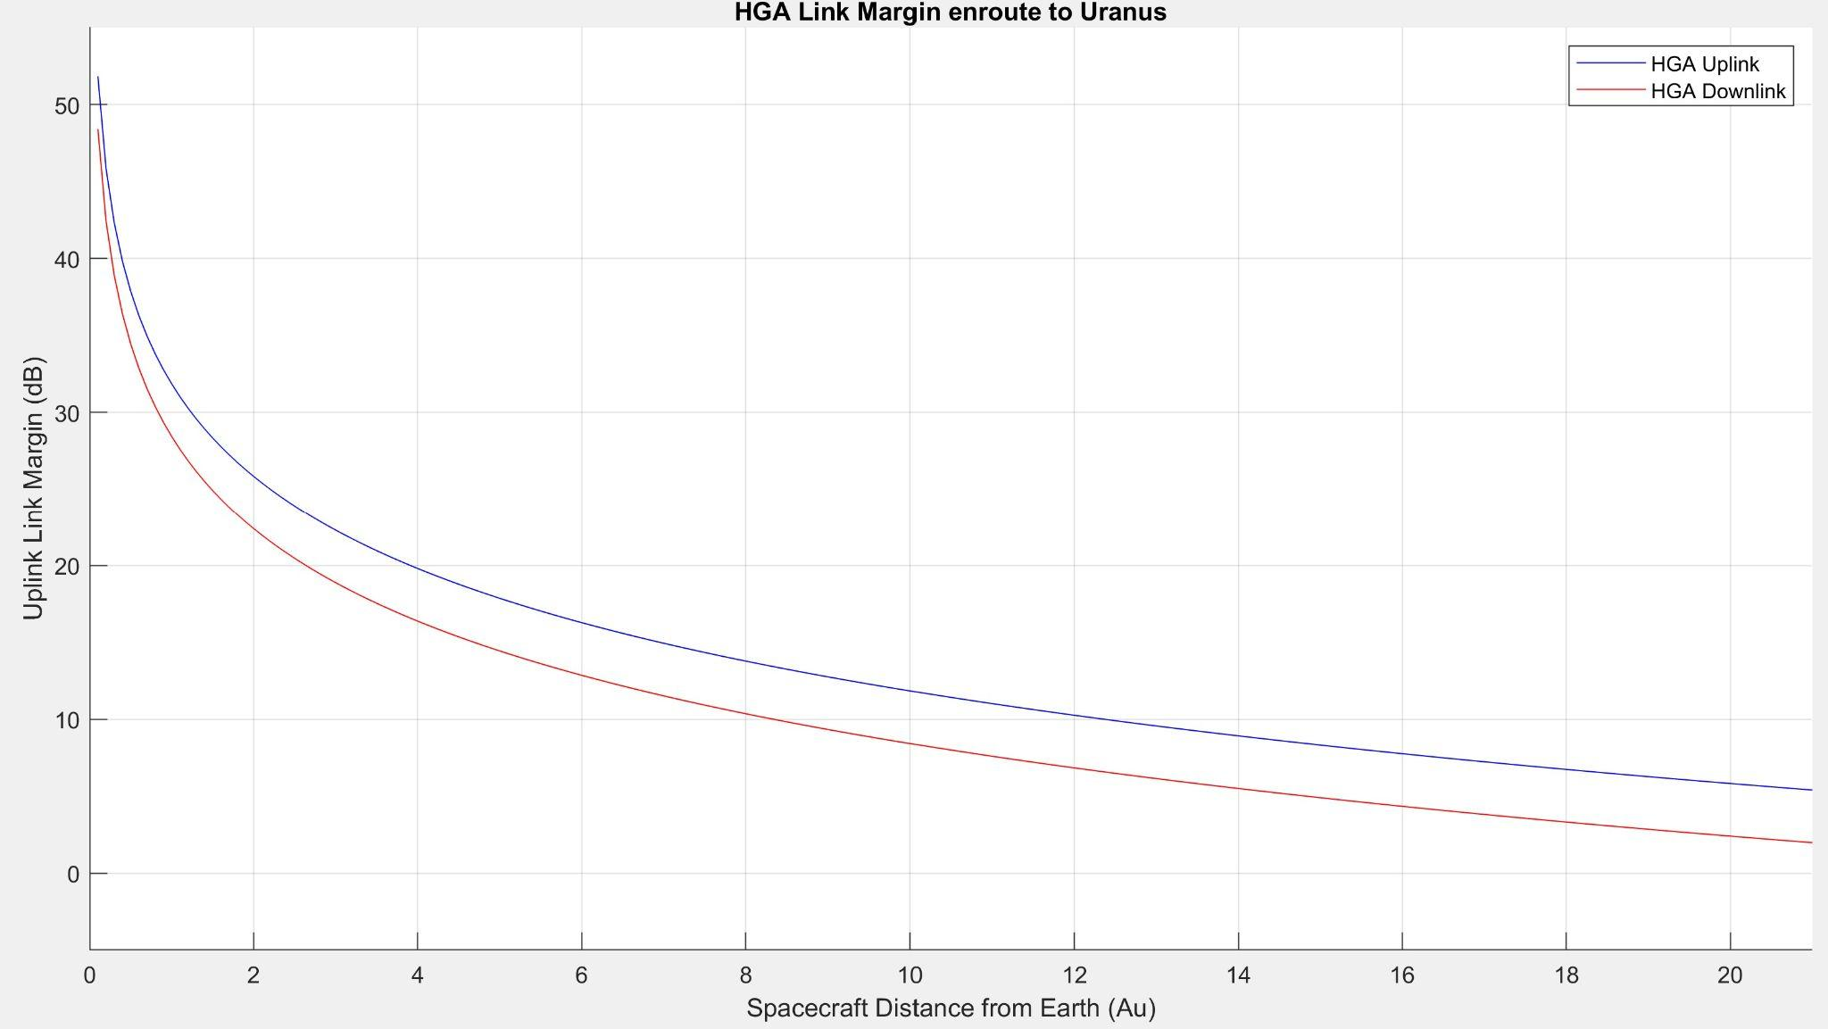
High Gain Antenna Design
Downlink |  | Uplink
21 | Earth Distance (AU) | 21
34.7 | Transmit Frequency (GHz) | 8.5
60.21 | Transmit Gain (dB) | 68.07
78.62 | EIRP (dB) | 109.08
-321.26 | Total Loss (dB) | -305.05
36.02 | Data Rate (dB) | 40.0
4.97 | Eb/no (dB) | 8.39
1.98 | Link Margin (dB) | 5.4033
8.08 *10^-4 | Bit Error Rate | 2.09 *10^-5
Parabolic Dish with 3.8m diameter
Average Power: 110 W
Maximum Power: 150 W (Emergency)
Average 4000 bps, able to reach 6000 bps
Downlink time: 13 days at 11 hrs/day
QPSK Modulation; forward error correction @ 5/9th
Notes:
[LM_uplink, LM_downlink] = LinkBudgetCalculation(3.8, 110, 34.7, 4000, 34, 20, 8.5, 20000)
3.8m Parabolic Dish
Main method of communicating with Earth, especially from Uranus.
4,000 b/s with a 1.98 dB link and 8*10^-4 BER
When downlinking, we are sending science data, trajectory, attitude, status updates

Slide 28
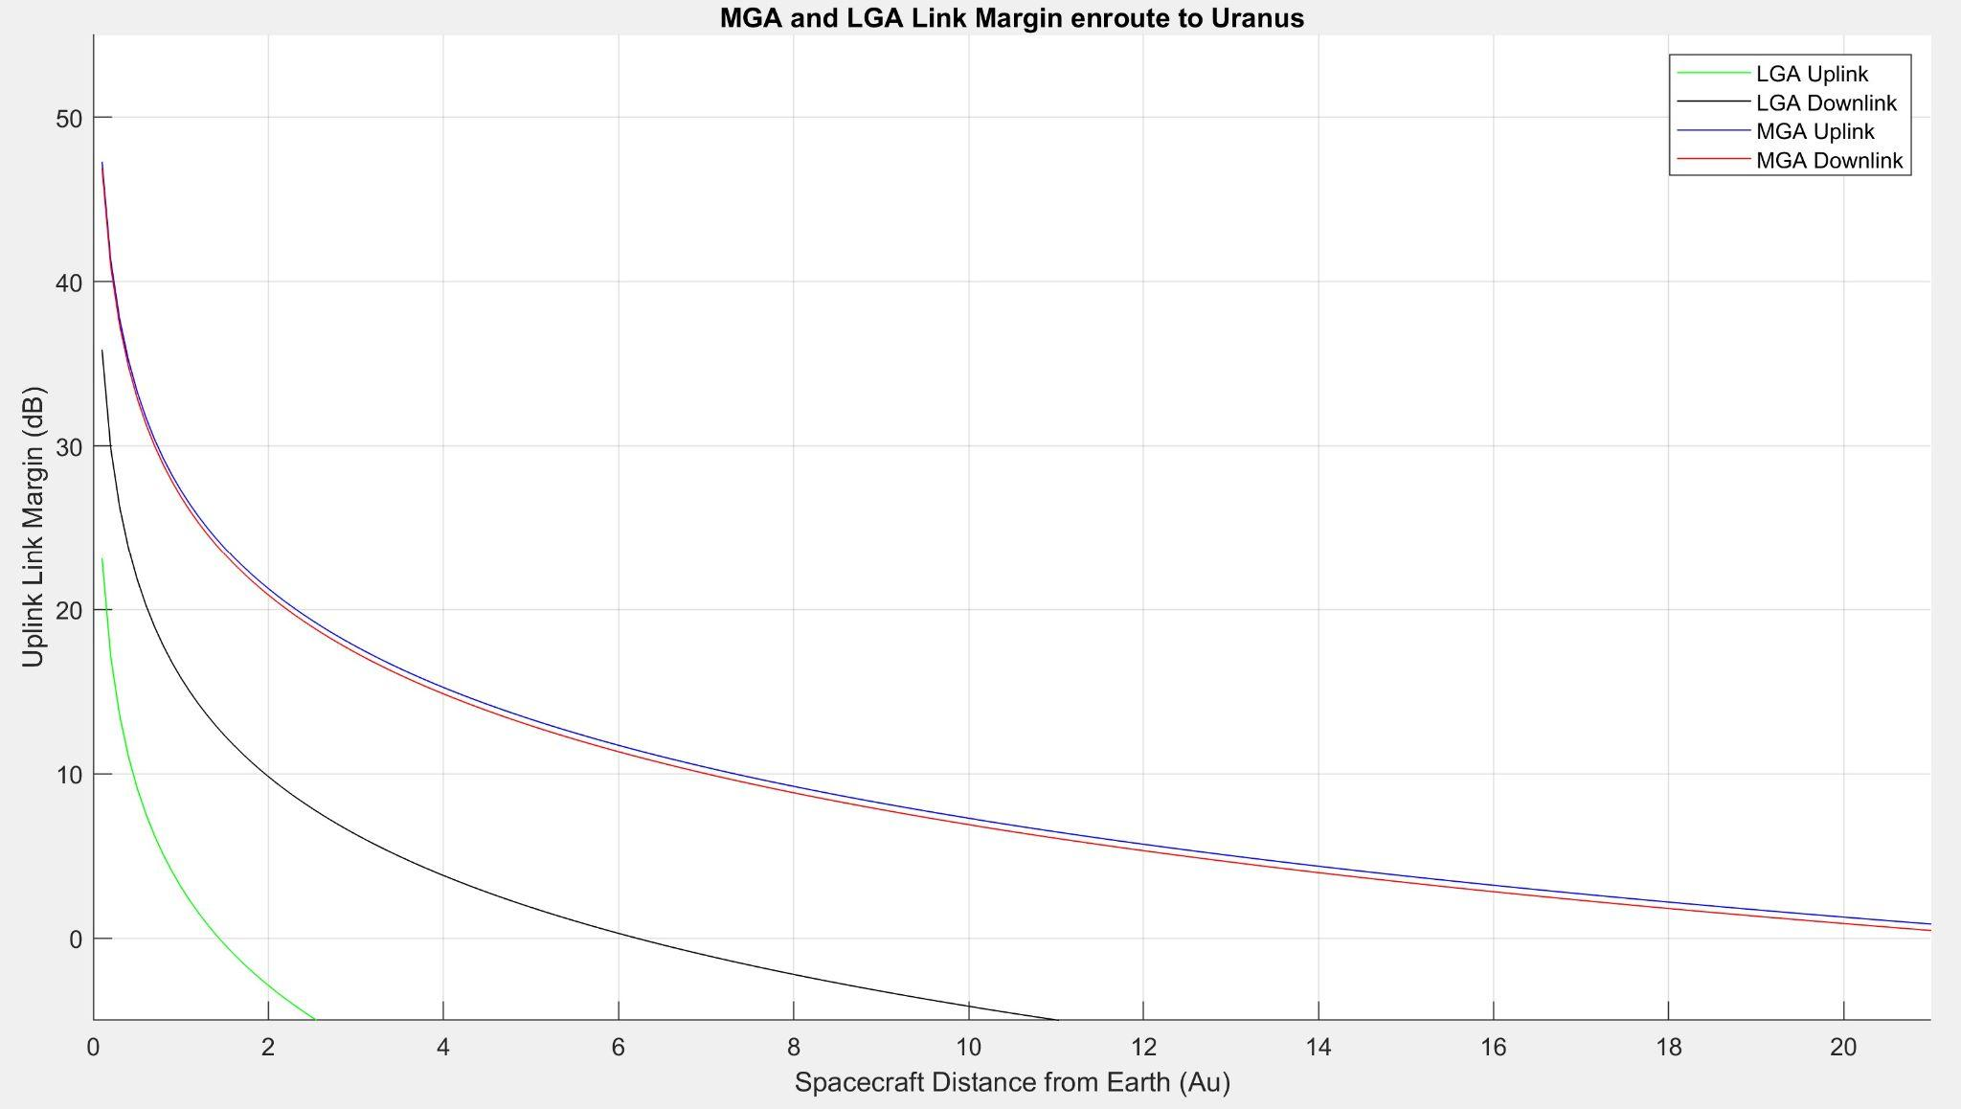
Medium and Low Gain Antenna Designs
MGA Design:
5 b/s using 70m DSN Antenna, for safe mode and communications during engine burns
Bit Error Rate: 3.16*10^-3 at 21 AU
LGA Design:
1 b/s using 70m DSN Antenna, for safe mode and communications up to 11 AU
Bit Error Rate: 2.265*10^-6 at 1 AU
Notes:
Bulletize this: (i.e.):
MGA and LGA were designed for critical event coverage
LGA used for near Earth communication (<2 Au of sun)
MGA used when HGA and LGA can’t
Periods of spacecraft motion when ADCS needs to prioritize other subsystems such as propulsion.
HGA won’t be pointed at Earth during this time
Sending low data rates to allow DSN to maintain connection and know s/c is still working
Why do we have both? (weight, flight heritage, etc.)
Both very low weight so could include both
Flight heritage includes LGA for Earth Communicaiton
Long distance means LGA won’t reach Earth past 10Au, need MGA to perform same role at uranus during orbital manuevers and events that won’t have HGA pointed at Earth
Both are to 70m dish transmitting at x band, DSN send at 200b/s

Slide 29

Average Orbit Link Schedule
Science Period
1 hour of Uplink | 13 Hours of Down Time
11 hours of Downlink
Maintenance Period
1 hour of Uplink | 18 Hours of Down Time
6 hours of Downlink
Science Collection
Science Transmit Time
Science Downtime
Maintenance Transmit Time
Maintenance Downtime
* This “one day” of science collection is assumed to be what is collected during a full orbit, shown here to be collected in the first day
* Science will be collected throughout the entirety of the orbit
Notes:
A simplified schedule of what a normal science orbit should look like.
Three parts to an orbit: data collection, science transmission, and maintenance.
Science Collection:
Scientific instruments record data
Science Period:
Science data and trajectory/housekeeping data sent back in 13 days (TEL-300)
Maintenance Period:
Only trajectory/housekeeping data(attitude, status, trajectory) is generated during this time, sent back in 6 hours
Major note: This is a simplification, data is collected throughout the orbit but the entire amount of data over an entire orbit comes out to 2GB. This chart is to show an ideal schedule were all of this data is collected at once
Since we uplink in X and downlink in Ka, we can do both at the same time

Slide 30
Scientific Requirements
SCI-100 | The mission shall collect data on the atmospheric composition of Uranus
SCI-200 | The mission shall collect data on the weather patterns of Uranus
SCI-300 | The mission shall collect data on the internal structure of Uranus
SCI-400 | The mission shall study the magnetosphere of Uranus
SCI-500 | The mission shall investigate the composition and formation of at least one of Uranus' moons
SCI-600 | The mission shall investigate the composition & formation of Uranus' rings
Notes:
Additionally, we created formal requirements for the scientific data. [reiterate list]

Slide 31
Instrument |  | Mass |  |  | Peak Power |  |  | Duty Cycle
 |  | CBE (kg) | % Cont. | MEV (kg) | CBE (W) | % Cont. | MEV (W)
Orbiter
Imaging Science System |  | 30.00 | 30 | 39.00 | - | - | - | -
 | VIS/NIR/MIR Spectrometer | - | - | - | 20.00 | 30 | 26.00 | Variable
 | Panchromatic VIS | - | - | - | 8.00 | 30 | 10.40 | Variable
 | Pushbroom Color VIS | - | - | - | 8.00 | 30 | 10.40 | Flyby
Gamma Ray Spectrometer |  | 9.20 | 10 | 10.12 | 16.50 | 10 | 18.15 | Flyby
FIELDS Electric Antennas |  | 5.37 | 10 | 5.91 | - | - | - | -
 | Laguimir Probe | - | - | - | 0.50 | 10 | 0.55 | Continuous
 | Dust Detection | - | - | - | 0.50 | 10 | 0.55 | Continuous
 | 10 kHz - 1.7 MHz LFR | - | - | - | 1.50 | 10 | 1.65 | Smart
 | 1.3 MHz - 19.2 MHz HFR | - | - | - | 1.50 | 10 | 1.65 | Smart
Search Coil Magnetometer |  | 0.80 | 10 | 0.88 | 0.60 | 10 | 0.66 | Smart
Fluxgate Magnetometer |  | 1.43 | 10 | 1.57 | 2.00 | 10 | 2.20 | Continuous
2.5m Fields Boom |  | 0.47 | 20 | 0.56 | - | - | - | -
SWEAP SPAN-A/B |  | 2.50 | 10 | 2.75 | 2.00 | 10 | 2.20 | Continuous
EPI-lo |  | 3.50 | 10 | 3.85 | 2.50 | 10 | 2.75 | Continuous
Radio Science Experiment |  | - | - | - | 30.00 | 10 | 33.00 | Variable
XNAV X-Ray Telescopes |  | 17.00 | 20 | 20.40 | 16.67 | 20 | 20.00 | Flyby
Data Processing Computer |  | 0.10 | 3 | 0.10 | 25.00 | 3 | 25.75 | Variable
Totals |  | 70.37 | 13 | 85.15 | 135.27 | 14 | 155.91
 | Peak Flyby Power |  |  |  |  |  | 60.76
Science Payload
Instrument | Mass |  |  | Power
 | CBE (kg) | % Cont. | MEV (kg) | CBE (W) | % Cont. | MEV (W)
Probe
Mass Spectrometer | 16.2 | 10 | 17.82 | 19 | 10 | 20.9
Atmosphere Structure Instrument | 2.5 | 10 | 2.75 | 3.5 | 10 | 3.85
Ortho-Para H2 Sensor | 1 | 30 | 1.3 | 3.5 | 30 | 4.55
Radio Science Experiment | - | - | - | - | - | -
Totals | 19.7 | 17 | 21.87 | 26 | 17 | 29.3
Instrument Heritage By Mission
MESSENGER | Gamma Ray Spectrometer
 | Fluxgate Magnetometer
TRACERS | Search Coil Magnetometer
Parker Solar Probe | FIELDS Electric Antennas
 | SWEAP SPAN-A/B
 | EPI-lo
NICER SEXTANT, Cube-X, & XPNAV-1 | XNAV
Rosetta | Probe Mass Spectrometer
Huygens | Atmosphere Structure Instrument
Perseverance | Ortho-Para H2 Anemometer
New Technology | Imaging Science System
Notes:
Talk about:
imaging science system,
gamma ray spectrometer
XNAV
Ortho-Para H2

Slide 32
Initial Science Orbit Nominal Measurement Plan
Measurement | Base Duration | Quantity | Data (MB)
Uranus Flyby (<5 Ru)
XNAV Flyby Max | 1 hr | 2 | 0.3
Gamma Ray Spectrometer Flyby Max | 10 mins | 9 | 0.3
Pushbroom Imager Max | 10 mins | 9 | 147.3
Continuous E-Antenna RF | 1 hr | 2 | 72.0
Continuous SCM | 1 hr | 2 | 36.0
Doppler Images | 1 min | 10 | 5.0
Subtotal |  |  | 260.9
Close Orbit (±5 Days of Periapsis)
Continuous Instruments Max | 1 day | 10 | 229.5
Smart E-Antenna RF (1 min/hr) | 1 day | 20 | 288.0
Smart SCM (1 min/hr) | 1 day | 20 | 144.0
Full Spectral Images Max | 1 min | 4 | 296.8
MIR Full Spectral Images Max | 1 min | 10 | 82.0
Doppler Images | 1 min | 20 | 10.0
3 Color VIS/NIR Max | 20s | 20 | 2.0
Subtotal |  |  | 1052.3
Distant Orbit (20 days)
Continuous Instruments Min | 1 day | 20 | 205.2
Smart E-Antenna RF (1 min/hr) | 1 day | 20 | 288.0
Smart SCM (1 min/hr) | 1 day | 20 | 144.0
Compressed Sensing Doppler Seismology | 10 min | 120 | 60.0
3 Color VIS/NIR Max | 10 min | 120 | 12.0
DRIZZLE Panchromatic Max | 2 min | 20 | 33.3
DRIZZLE 3 Color Max | 20 min | 10 | 2.8
Subtotal |  |  | 745.3
Total |  |  | 2058.6
Moon Flyby Nominal Measurement Plan
Measurement | Base Duration | Quantity | Data (MB)
XNAV Flyby Max | 1 hr | 1 | 0.2
Gamma Ray Spectrometer Flyby Max | 10 mins | 2 | 0.1
Pushbroom Imager Max | 10 mins | 2 | 32.7
Continuous E-Antenna RF | 1 hr | 1 | 36.0
Continuous SCM | 1 hr | 1 | 18.0
Full Spectral Images Max | 1 min | 4 | 296.8
MIR Full Spectral Images Max | 1 min | 10 | 82.0
DRIZZLE Panchromatic Max | 2 mins | 20 | 33.3
DRIZZLE 3 Color VIS/NIR Max | 20 mins | 20 | 5.6
Totals: |  |  | 504.7
Data Generation Per Observation
Observation Type | Duration (Hours) | Total Data (MB)
 |  | Max | Min
Continuous Instruments | 24 | 23.0 | 10.3
XNAV Flyby | 1 | 0.2 | 0.1
Gamma Ray Spectrometer Flyby | 0.17 | 0.038 | 0.019
Pushbroom Imager | 0.17 | 16.4 | 13.8
Continuous E-Antenna RF | 1 | 36.0
Smart E-Antenna RF (1 min/hr) | 24 | 14.4
Continuous SCM | 1 | 18.0
Smart SCM (1 min/hr) | 24 | 7.2
Doppler Seismology Average | 0.17 | 0.5
Moon Tour Orbit Monthly Nominal Measurement Plan
Measurement | Base Duration | Quantity | Data (MB)
Continuous Instruments Min | 1 day | 30 | 307.8
Smart E-Antenna RF (1 min/hr) | 1 day | 30 | 432.0
Smart E-Antenna RF (1 min/hr) | 1 day | 30 | 216.0
Continuous E-Antenna RF | 1 hr | 8 | 288.0
Full Spectral Images Max | 1 min | 6 | 445.2
DRIZZLE MIR Spectral Image Max | 30 mins | 6 | 30.8
DRIZZLE Panchromatic Max | 2 mins | 20 | 33.3
DRIZZLE 3 Color VIS/NIR Max | 20 mins | 20 | 5.6
Totals: |  |  | 1758.6

Slide 33
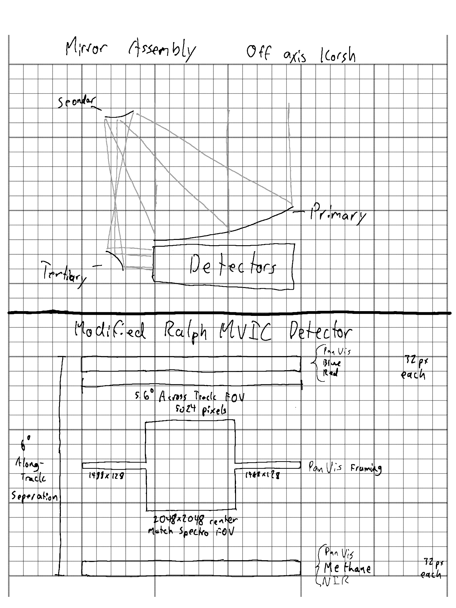
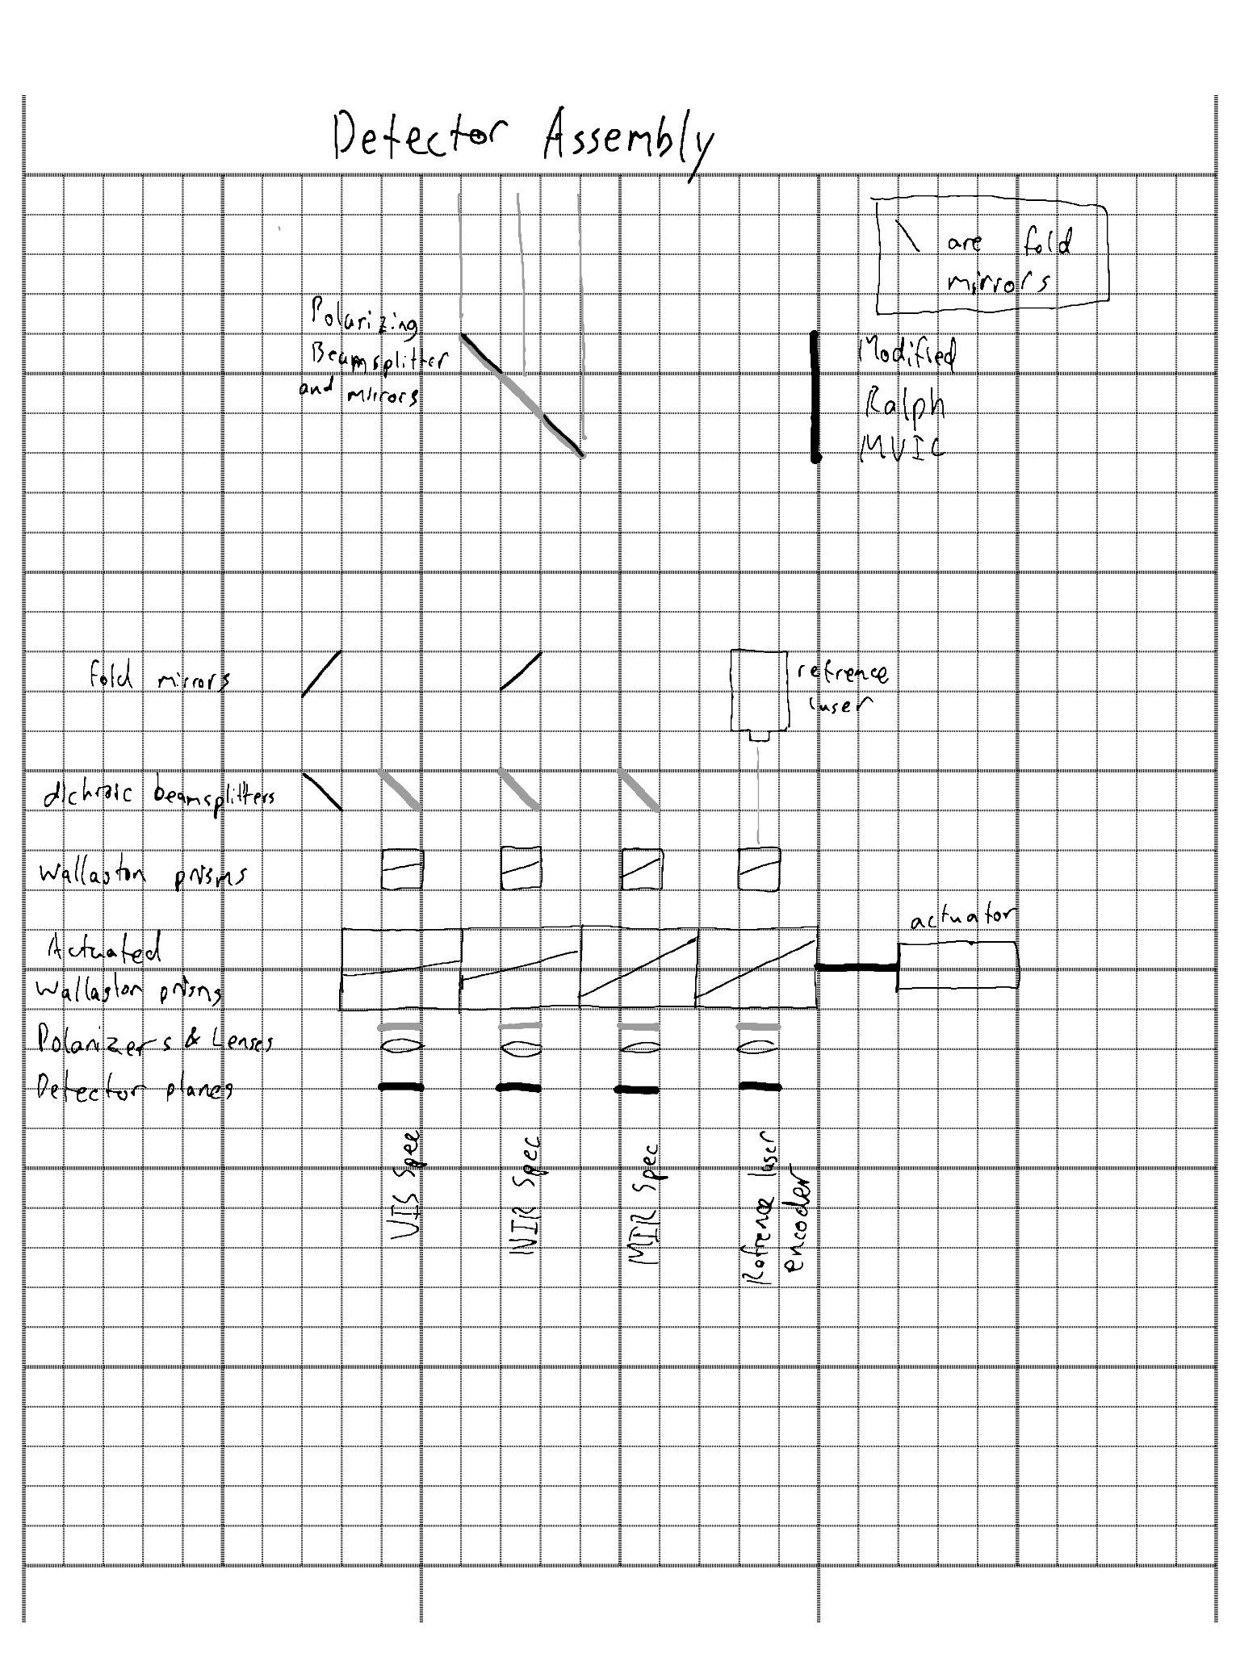
Novel Technology: Imaging Science System
Imaging Science System TRL Assessment
Component | Heritage | Demonstration Level
Strained Layer Superlattice Detector Array | Landsat 9 MWIR | Used on Prior Missions
Visible Light Detector Array (370-950 nm) | Various Missions | Used on Prior Missions
NIR Detector Array (950nm - 2.3 micron) | Various MIssions | Used on Prior Missions
Modified Ralph MVIC | Ralph/L’Ralph | Similar Component on Prior Mission
Birefringent Spectrometer | Commercial Portable FTIR | Comercial Use on Earth
Single Piece off-Axis Korsh Telescope | Ralph/L’Ralph Instruments | Similar Component on Prior Mission
Beralcast Optics | F-35 MIR Telescope Material | Used in Spaceflight Relevant Conditions
Overall TRL Assessment: | TRL 4 | All Components Demonstrated in at Minimum Earth Laboratory Conditions
Wavelength Bands
Component | Range (μm)
VIS Spec | 0.37 - 0.95
NIR Spec | 0.95 - 2.30
MIR Spec | 2.30 - 10.0
PanVIS | 0.37 - 0.95
Blue | 0.40 - 0.55
Red | 0.54 - 0.70
Methane | 0.86 - 0.91
NIR (MVIC) | 0.78 - 0.975
Computational Imaging: utilizes computational power to surpass the limits of the detector array. It is commonly used both in astronomical imaging and in smartphone cameras to improve dynamic range and spatial resolution.
Fourier Transform Spectroscopy: a spectral analysis method common in laboratory equipment and on space missions. Fourier Transform spectroscopy has long integration times, but allows for high spectral resolution in a small instrument.

Slide 34
Structures Requirements
STR-100 | The spacecraft structure shall withstand all loads and accelerations experienced during launch
STR-200 | The spacecraft structure shall withstand all loads and accelerations experienced during transfer and flight to Uranus
STR-300 | The spacecraft structure shall withstand all loads and accelerations experienced during Uranus insertion

Slide 35
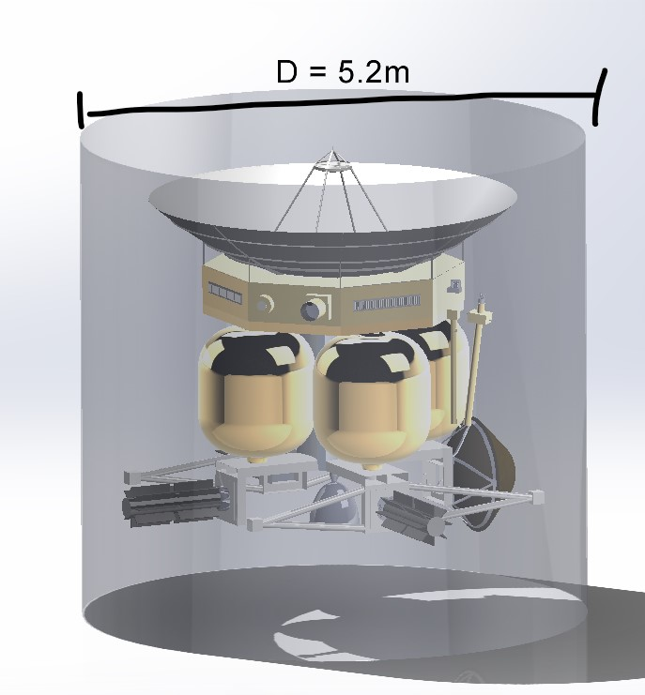
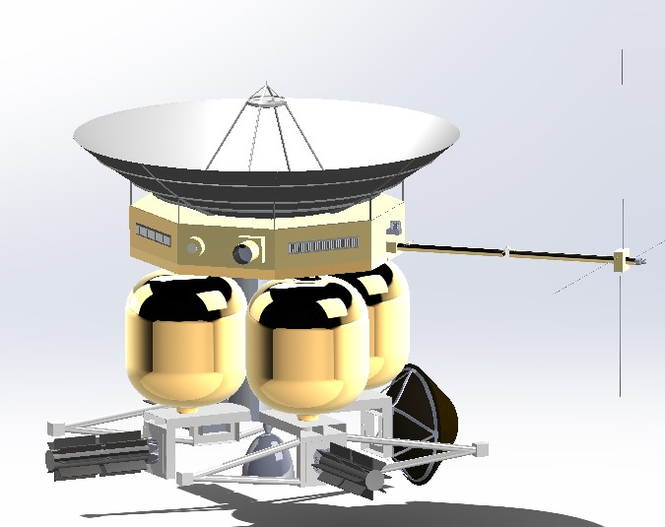
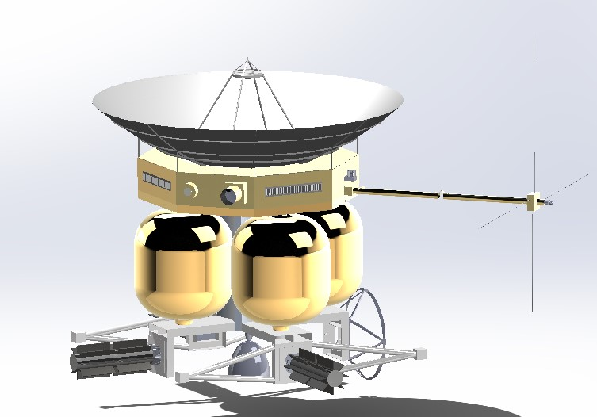
Spacecraft Configuration & Structure
Structural propellent tanks
Central anti-torsion structure (hidden)
Structurally integrated radiation shielding & high gain antenna
Al 8090 Aluminum Lithium structure (2024 replacement)
Friction stir welding for joints on tension faces
Laser beam welding for joints on compression faces
Launch Configuration (Above Left)
Cruise Configuration (Above Right)
Uranus Orbit Configuration (Left)

Slide 36
Spacecraft
Video

Slide 37
Thermal Requirements
TRM-100 | The propellant shall have a temperature of -40ºC to operate and a survival temperature range between -90ºC and 24ºC.
TRM-200 | The avionics boards shall have a temperature range between -30ºC and 50ºC to operate, and a survival temperature range between -40 and 85ºC
TRM-300 | The science instruments shall have a temperature between -15ºC and 40ºC to operate, and a survival temperature range between -40 and 50ºC
* Neglecting individual components of different science instruments, such as optics of spectrometer required to be at 110ºK due to computational constraints
Notes:
These are the operational and survival temperature ranges we are considering.
Near earth, in cruise, as well as in our Uranus cold scenarios we want to be within the survival temperature range,
In our uranus hot scenario, we want to be within operational range
Due to computational constraints, the specific temperature ranges of certain science instruments, such as the optics of the spectrometer have to be neglected, meaning

Slide 38
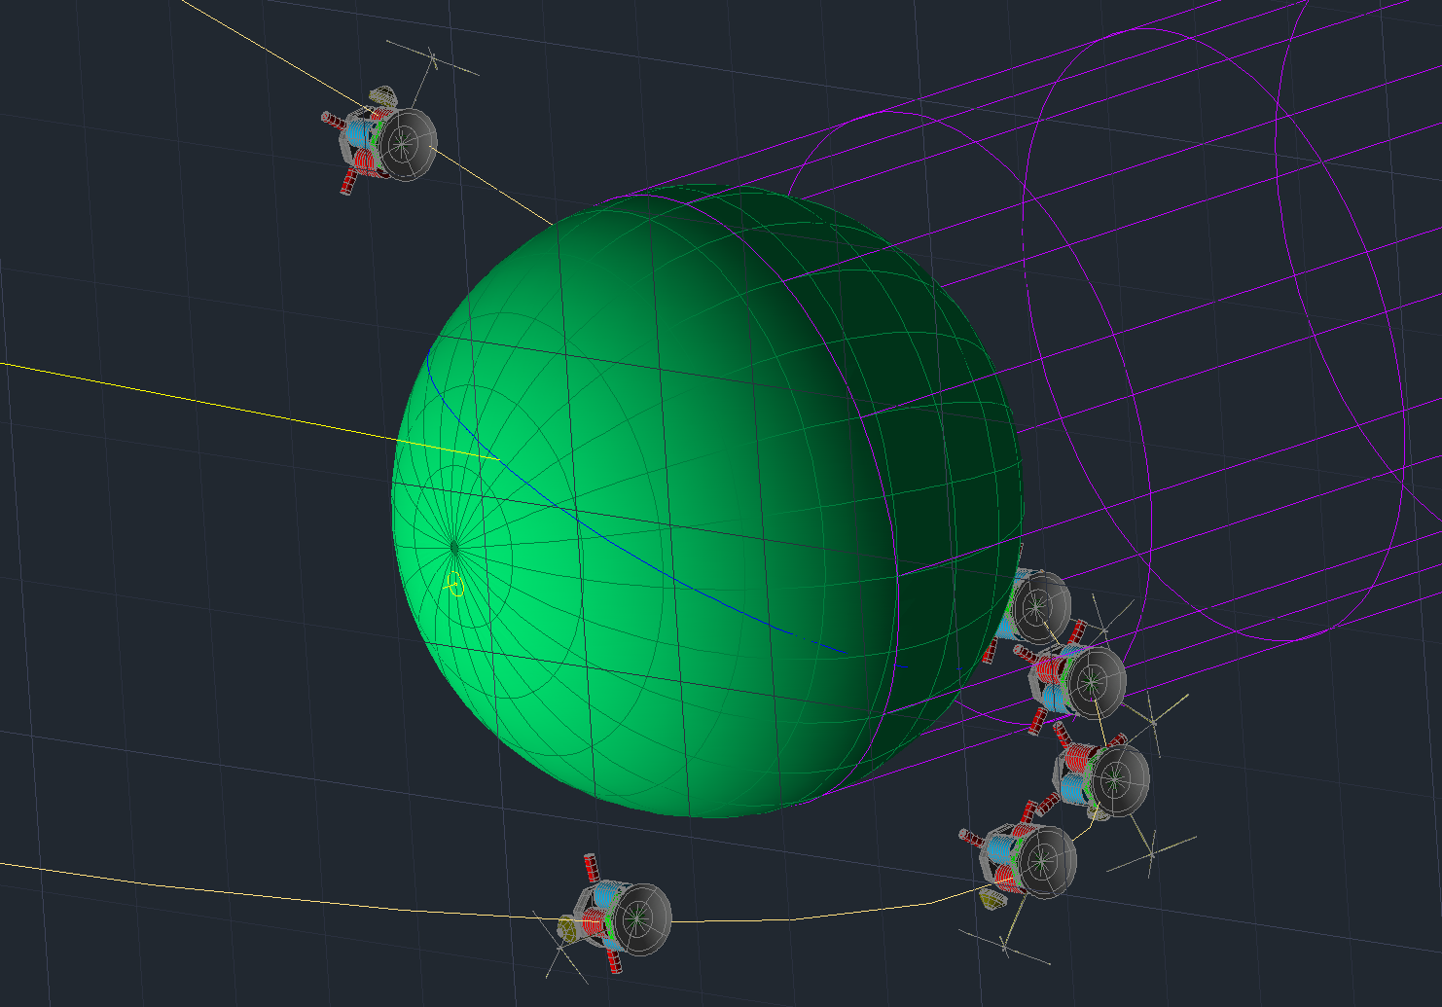
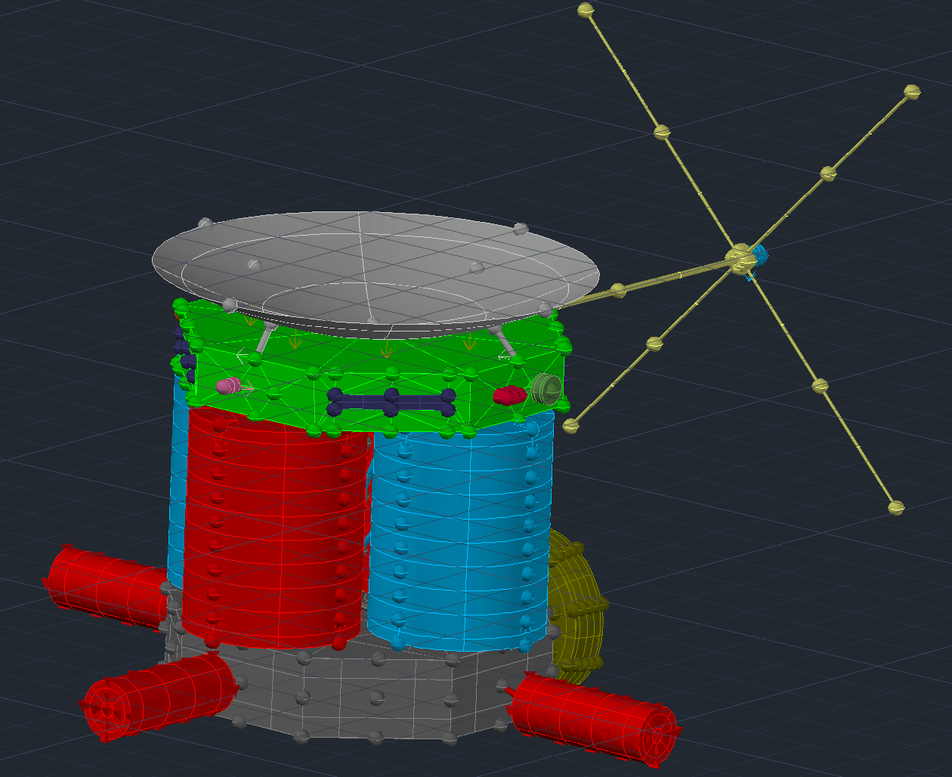
Thermal Modeling & Control
700 node model:
  Steady state and transient solutions
  Includes accurate dimensions, materials for each subsystem, heating environments…
  Temperatures for every subsystem and science instrument obtained
  5 main solutions:
    Earth-hot, Earth-cold
    Uranus-hot/science, Uranus-cold
    5AU/cruise
Notes:
Our thermal model consists of 700 nodes, which makes it significantly more reliable than the other thermal models presented consisting of 1 or 2 nodes. From this model, we have obtained steady state results allowing us to observe temperatures at equilibrium, as well as transient results giving us estimations of the temperature profile in a near earth orbit and our desired orbit at uranus.
The model itself has accurate dimensions and physical and optical properties for most subsystems (with simplifications for certain science instruments), as well as variations in orbital parameters and power loads, which have a significant impact in the results obtained
5 Solutions:
Earth hot: orbital parameters giving us hottest profile, analyzed with open and closed louvers
Earth cold: orbital parameters giving us coldest profile, analyzed with open and closed louvers
Uranus hot: hottest orientation, with science instruments being turned on (less power allocated in the bus since no data transmission)
Uranus cold: coldest orientation, with science instruments being turned off and data communication instruments on (more power allocated in the bus since data transmission)
5AU: cruise mode, coldest scenario in our mission, with the smallest power consumption from all subsystems

Slide 39
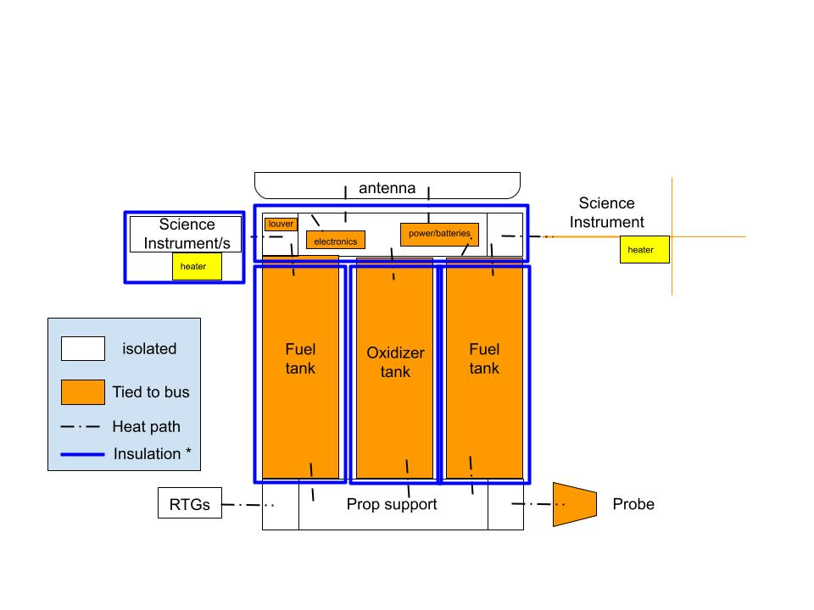
Thermal Setup for Presented Solutions
Outside: 30 layer Gold plating MLI:
e* = 0.006
Inside: White Tedlar
IR emissivity = 0.9
White tedlar
bus
Different insulations due to instrument requirements
Different power for each instrument
Total Heater Power: 49.5 W
30 layer MLI + coating, e* = 0.006
/ bus
White tedlar,
Solar absorptivity = 0.22,
IR emissivity = 0.9
Notes:
General simplified sketch showing main control methods
Different layers on the inside and outside of our bus to retain as much heat as possible during uranus scenarios (Inside of bus white teldar coating due to high reflectivity, outside gold plating due to low emissivity)
Antenna has white tedlar to absorb very little heat and act as a heat shield during near earth scenarios, where its orientation towards the sun allows us to keep the bus cold, this is one of our active control methods
Science instruments isolated from the bus, this allows us to use small amounts of heat to keep them warm. Total heat power required for science instruments: 49.5W. Mostly required on Langmuir probe, since magnetometer (placed at the end of the rod like shape) cannot be insulated.
Due to low freezing point of propellant, MLI seems to be sufficient to keep it within survival range, simulations shown later show that to keep it at the desired burn temperature (-40ºC), small pre-heating prior deltaV maneuvers may be required ONLY IN CRUISE MODE, which is accounted in our power budget.
Prop support with white TEDLAR as well to lower temps near earth, which were high due to RTG proximity.
RTGs modeled as always having a surface temp of 200ºC throughout the mission, where radiation into the spacecraft is included, and heat pipes connecting it to other subsystems can also be included ALTHOUGH NOTE MODELED IN OUR SIMULATIONS, SO WE STILL HAVE A LOT OF FLEXIBILITY IN TERMS OF THE RESULTS OBTAINED TO CONTROL THEM FURTHER IF NEEDED.
RHUs not included at the moment to avoid exceeding max temps near earth (since they can’t be turned off)

Slide 40
Simulation
Video
The transient solution for the cold case near Earth, with louvers open

Slide 41
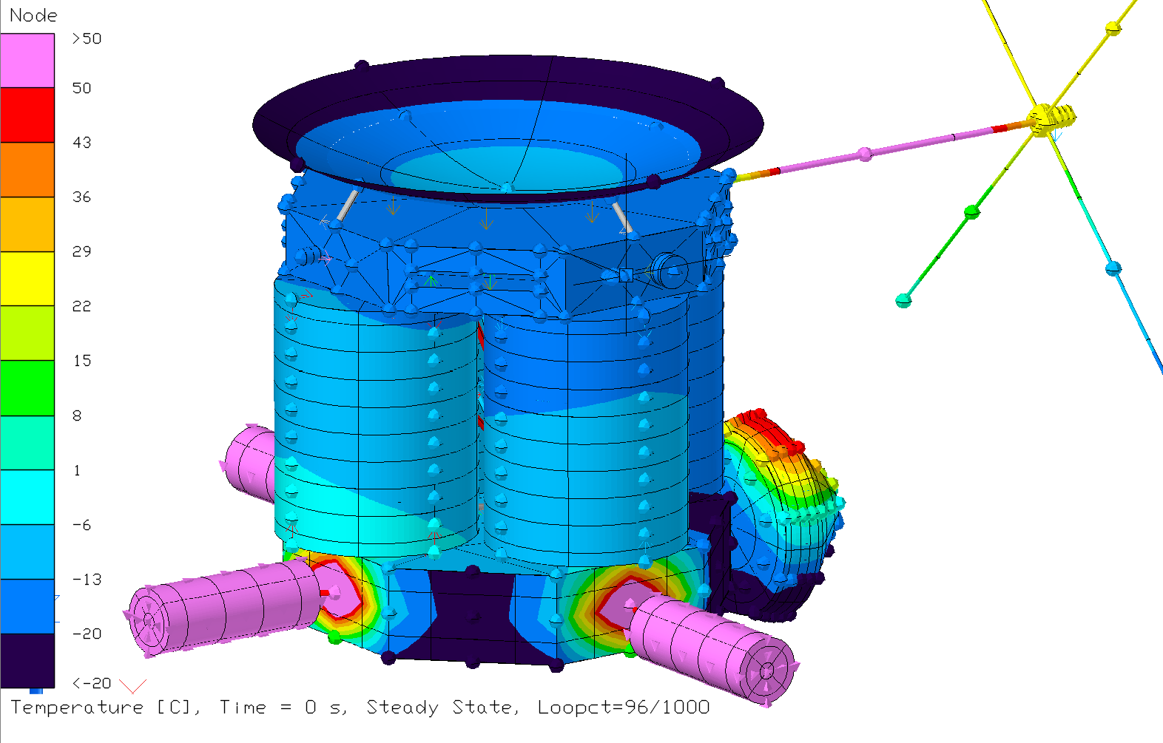
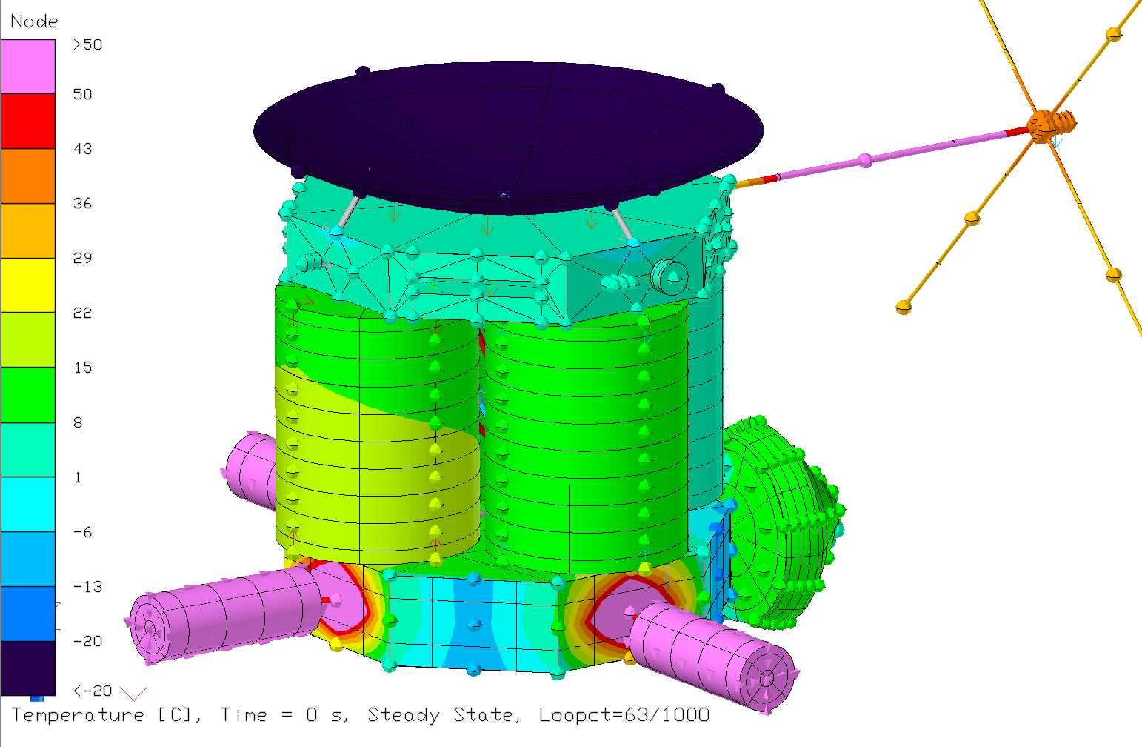
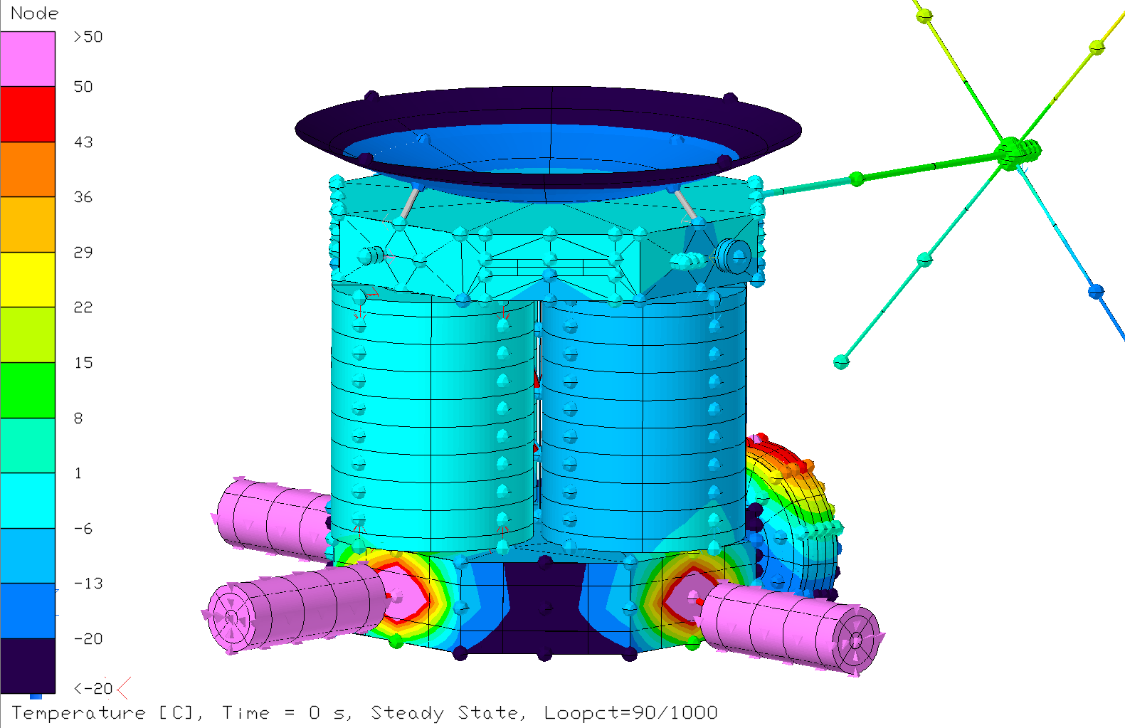
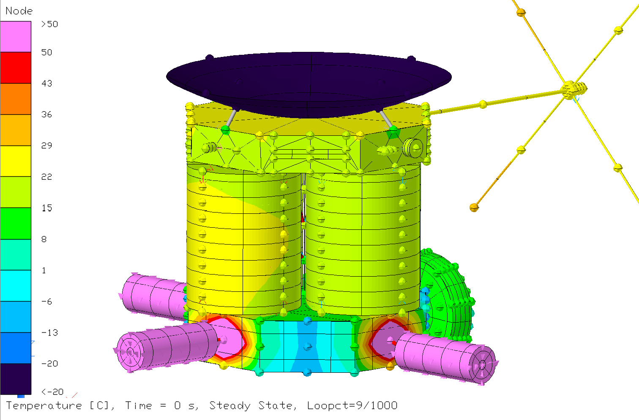
Steady State Results: Near Earth, Open & Closed Louvers
Earth cold open louvers
Earth hot open louvers
Earth cold closed louvers
Earth hot closed louvers
Notes:
SIMULATIONS DONE WITH OPEN AND CLOSED LOUVERS, EVERYTHING WITHIN OUR DEFINED SURVIVAL AND OPERATIONAL RANGE near earth cases.
LOUVERS, which could either be open or closed near earth are extremely useful in our simulations during near earth cases, ALLOWS OUR BUS TO BE WARM DURING COLD NEAR EARTH, AND CHILLED DURING HOT NEAR EARTH
TANKS IN HOT CASE SCENARIO NEAR EARTH WILL BE APPROXIMATELY 20ºC, THE PROPELLANT NODES ARE APPROXIMATELY 10ºC LOWER, so within our ranges AND NOT REQUIRED TO BE OPERATIONAL NEAR EARTH.

Slide 42
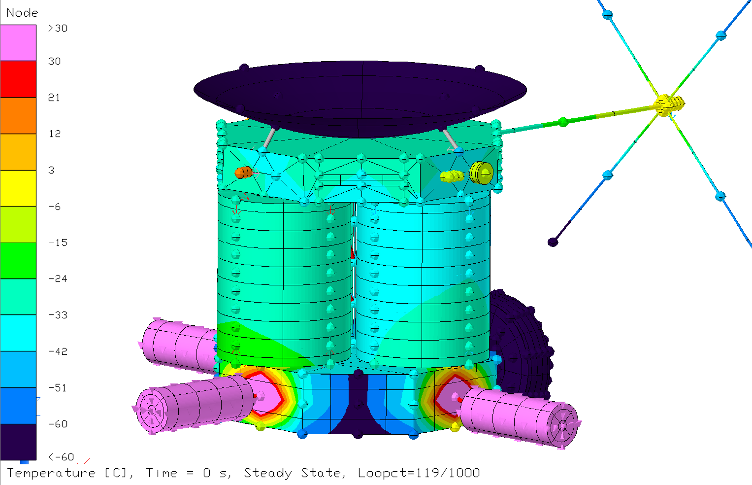
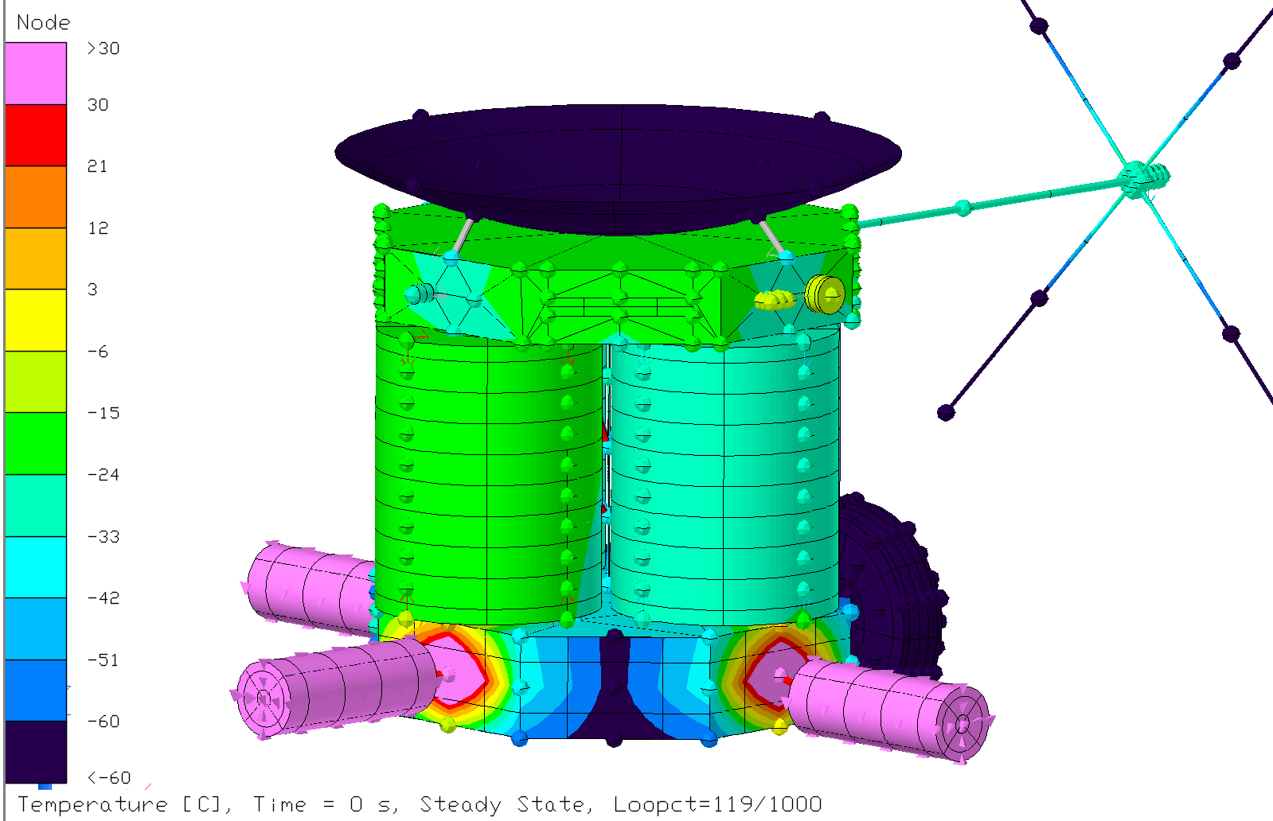
Steady State Results: Near Uranus (Louvers Always Closed)
Uranus hot
Uranus cold
Data collection/Science mode
Data transmission
Notes:
Small differences between hot and cold scenarios near uranus due to small solar flux impact
Main difference between hot and cold case is in the bus and science instruments (when they are on and off), everything in the steady state is within our desired temps
Outside of the probe gets very cold, thick insulation should be enough to keep everything inside warm

Slide 43
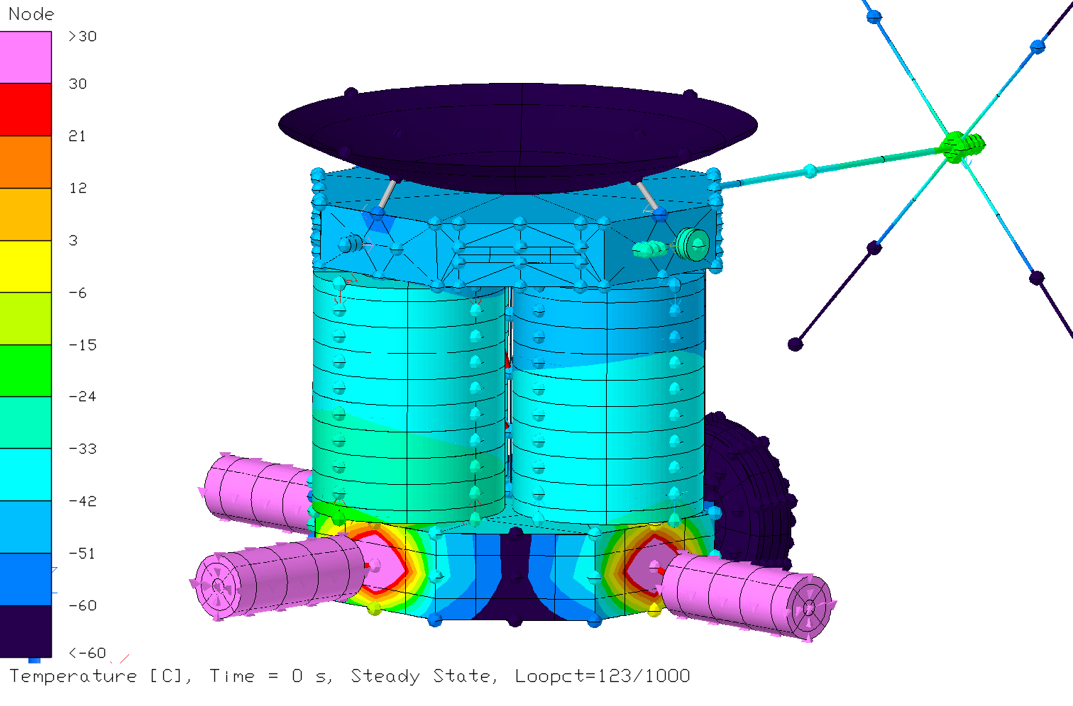
Steady State Results: 5AU Case / Cruise mode
Notes:
In the arbitrary case at 5AU, some science instruments are out of operational range but within survival range, which is where heat pipes could come in, distributing heat from RTG into the bus and science instruments,
We have allocated

Slide 44
Thermal Conclusions
Further Considerations
Louvers have a significant impact on bus temperature, which affects tank temperatures.
All subsystems within survival temperature range, and within operational range when needed.
2 shunts considered dissipating excess power, one outside the bus to reject heat if needed, another inside the bus to use as heat source if needed.
Heat pipes would be considered allowing heat distribution from RTGs into other subsystems, useful for cruise mode.
Shunts near tank for excess heat during Earth Cases, although currently not needed.
Notes:
Read out

Slide 45
Power System Requirements
PWR-100 | The power shall supply at least:
PWR-101 | 250 W of power during launch
PWR-102 | 395 W of power during interplanetary cruise
PWR-103 | 1127 W of power during main engine operation
PWR-104 | 412 W of power during attitude adjustment maneuvers
PWR-105 | 415 W of power during data collection
PWR-106 | 415 W of power during data transmission
PWR-107 | 637 W of power during momentum dump
PWR-108 | 421 W of power during safe mode
PWR-109 | 464 W of power during delta-V preheat
PWR-200 | The batteries shall have a max depth of discharge of 40%

Slide 46
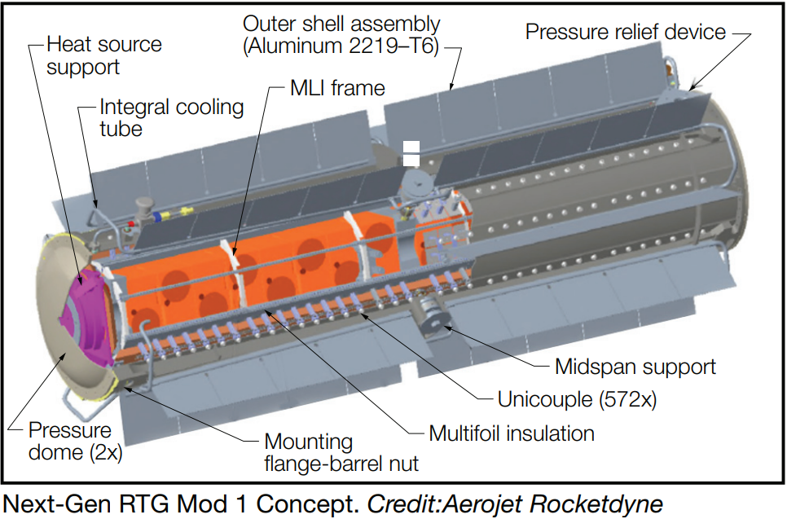
Electric Power System
3 Next-Gen Mod 1 RTGs
Mass | 56 kg
BOL Power | 245 W
EOL Power | 177 W
Degradation | 1.9 %/yr
Design Life | 17 yrs
Availability | 2029
Cost | $70 million

Slide 47
Batteries
Probe:
2 Lithium Thionyl Chloride (LiSOCl2) Primary Batteries
Orbiter:
2 Lithium-Ion Rechargeable Batteries
Configuration | ABSL 56 Ah 8s16p
Energy | 1628 Wh
Mass | 8.5 kg
Voltage Range | 24-33.6V
180-day approach | 468 Ah
1-hr descent | 32 Ah
Notes:
New one: works for 40% DOD
amer-en-fly-absl-8s16p-3.5ah_0421.pdf (enersys.com)

Slide 48
Program Management
Power Budget
Mass Budget
Cost & Scheduling
Major Risks

Slide 49
Power Budget
Phase/Operational Mode | MEV Power Usage [W] (30% Margin)
Launch | 250.11
Cruise | 394.74
Main Engine Burn | 1126.04
Attitude Adjustment | 412.06
Science Data Collection | 414.26
Data Transmission | 412.91
Momentum Dump | 636.70
Safe Mode | 421.06
Delta-V Preheat | 463.96
Total RTG Output (EOL) | 531
Power draw for each phase less than RTG output except Main Engine Burn and Momentum Dump
Batteries will need to be used during these phases

Slide 50
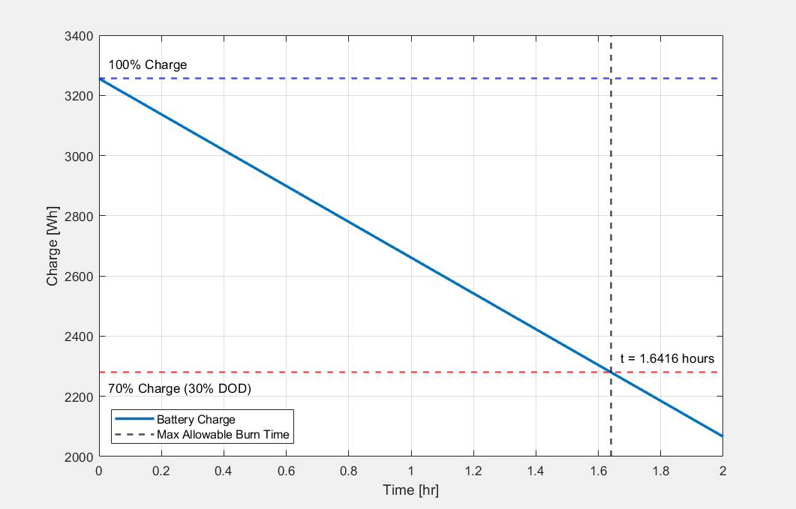
Battery Analysis
Battery Capacity [Wh] | 1628
# Batteries | 2
Total Capacity [Wh] | 3256
30% DOD [Wh] | 976.8
 | Main Engine Burn | Momentum Dump
Power Req [W] | 1126.04 | 636.70
Excess over RTG output [W] | 595.04 | 105.70
Time for 20% DOD [hr] | 1.64 | 9.24

Slide 51
Mass Budget
Subsystem | MEV Mass [kg]
Structures | 527.9
Propulsion | 225.4
Avionics/On-board Processing | 21.3
Power | 245.1
Attitude Determination and Control | 19.7
Thermal Control | 68.6
TT&C | 69.3
Payload | 85.1
Harness | 90.3
Probe | 176.3
Total Dry Mass | 1529.0
Propellant | 2088.2
Total Mass | 3617.2
Total Mass w/ 30% System Margin | 4702.3
Dry mass: 1529.0 kg
Total mass w/ 30% margin: 4702.3 kg
Well within lower bound of Starship launch capability
  100 tons
Reference mission dry mass: 1932.8 kg
Cassini dry mass: 2523 kg

Slide 52
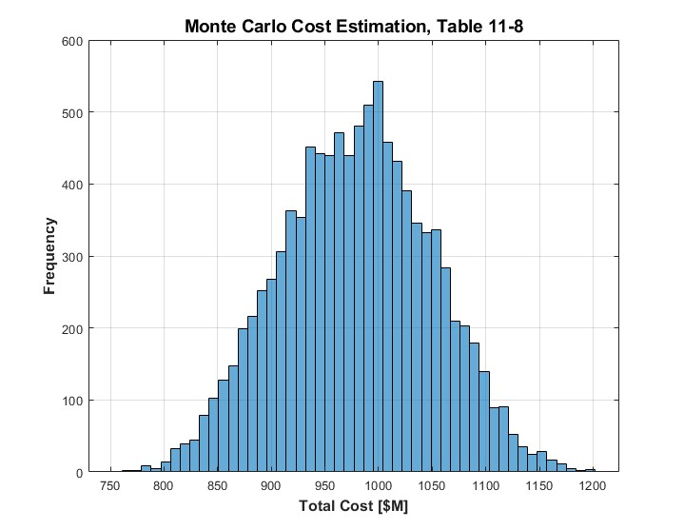
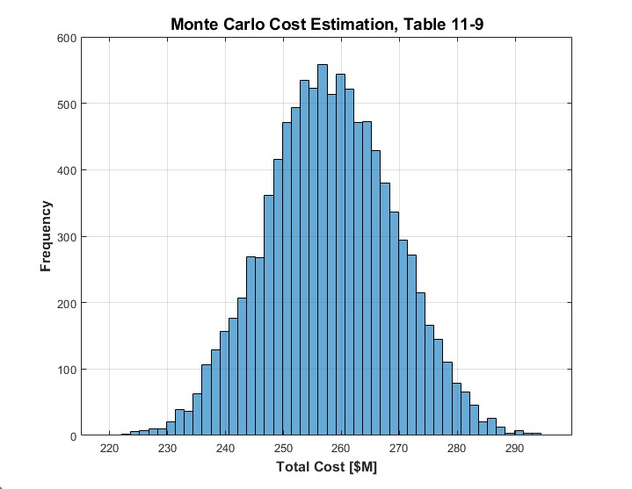
Cost & Scheduling
Non-Recurring Development Cost
Manufacturing Cost of 1st Flight Unit
Total Cost [$M]
Total Cost [$M]
Low: 758 $M, Avg: 979 $M, High: 1202 $M
Low: 220 $M, Avg: 258 $M, High: 296 $M
Notes:
- Monte Carlo estimates generated using 10,000 simulations
- MC is sum of 10,000 simulations of triangular distribution of each subsystem cost from each CER table
- Range of values generated using standard error of estimate (SEE) of each subsystem CER
- Costs impacted by a changing inflation by year using predicted values (a little less than 3%/year)
- Plots in this slide are for USCM8 Non-Recurring (11-8) and Recurring (11-9) S/C costs
- Mention low/avg/high of each

Slide 53
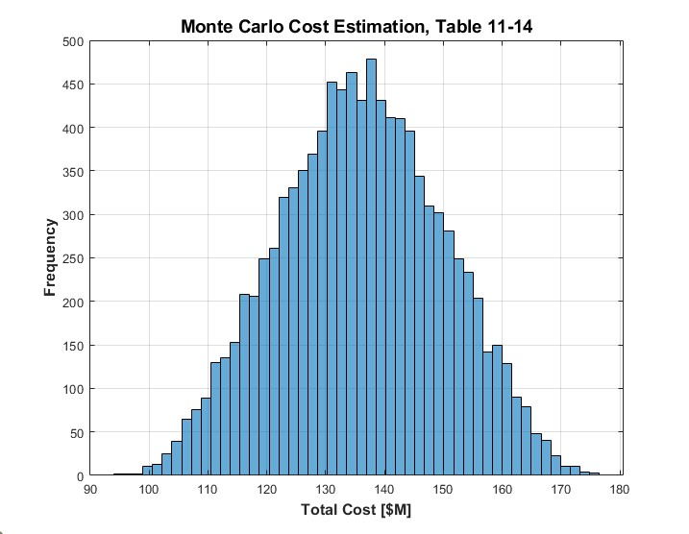
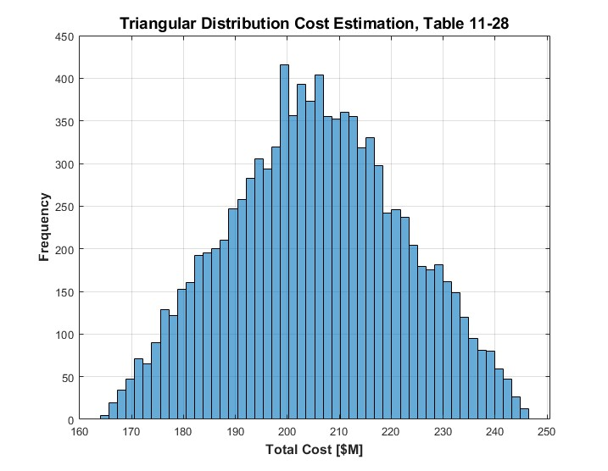
Cost & Scheduling (cont.)
Science Payload Cost
Mission Operations Costs
Total Cost [$M]
Total Cost [$M]
Low: 94 $M, Avg: 136 $M, High: 176 $M
Low: 165 $M, Avg: 206 $M, High: 246 $M
Notes:
- Plots in this slide are for NICM Science Payload Cost (11-14) and Mission Operations Costs (11-28)
- Mission Operations costs are a single triangular distribution with 20% SEE because no SEE was given for individual factors like in the other tables
- Mention low/avg/high of each

Slide 54
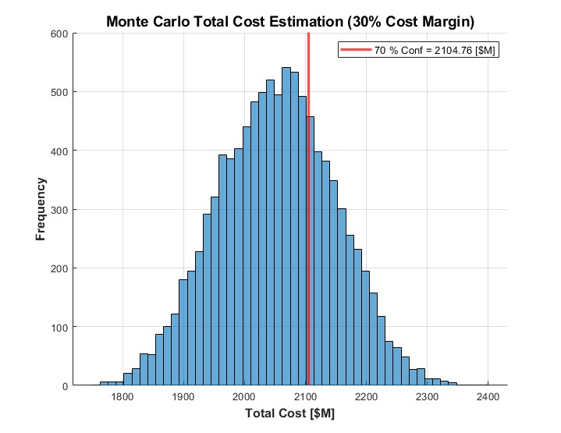
Final Cost Estimation - 30% Margin
 | Cost [$M]
Low | $1,755
Mean | $2,053
High | $2,398
70% Conf. | $2,105
Total Cost [$M]
Notes:
- This histogram is the sum of the previous 4
- Multiplied by a factor of 1.3 to account for cost margin of 30%
- Mention 70% confidence level as our target
- Well below budget of $2.5 billion (including the highest simulated cost of $2.4 billion)

Slide 55
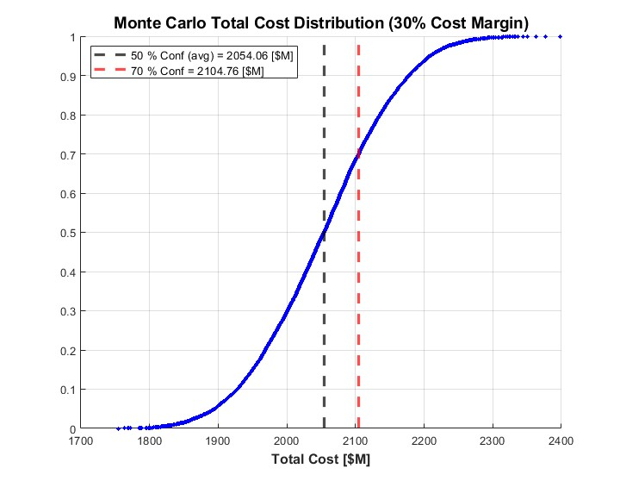
Final Cost Cumulative Distribution Function
Total Cost [$M]
Notes:
- This is a cumulative distribution function of final cost (uses percentiles on y-axis)
- Just another visualization of the plot from the previous slide
- Specifics about CER tables, inflation factors, and cost descriptive statistics in slides at the end
- Will now move on to our major risks

Slide 56
Major Risks
Risk | Type | L | C | Mitigation
IF the oribter encounters communication outages with the DSN, THEN scientific data could be lost or delayed | Technical | 2 | 2 | Storage holds science data Pre-launch compatibility testing
IF the RPS estimated worst-case power output is lower than anticipated, THEN insufficient power to the flight subsystems may result | Technical | 1 | 3 | Look at trade-offs between utilizing an extra RTG versus an extra battery
IF the instrument with TRL 5 or lower is not ready by the launch date, THEN launch could be delayed and/or scientific objectives will not be met | Program (Cost/ Schedule) | 2 | 3 | Look into trade-offs of utilizing other scientific instruments Ensure all mission-ending subsystems are TRL 6+
IF more detailed analysis indicates increased radiation hardness requirements, THEN higher parts cost could be incurred and/or additional shielding could be required | Technical, Safety | 2 | 3 | Conduct detailed radiation modeling and analysis early Increase shielding mass allocations as needed
Notes:
With a deep space mission, of course there are many risks. While there are too many to count and even some “unknown unknowns,” listed here are the top 4 major risks of our mission to Uranus.
First, we identified the risk itself, then we determined the likelihood and the consequence of the risk, with 1 being very unlikely to happen and 5 being definitely will happen, and 1 being no consequences at all and 5 being catastrophic events and mission failure.
For example, the first risk []

Slide 57
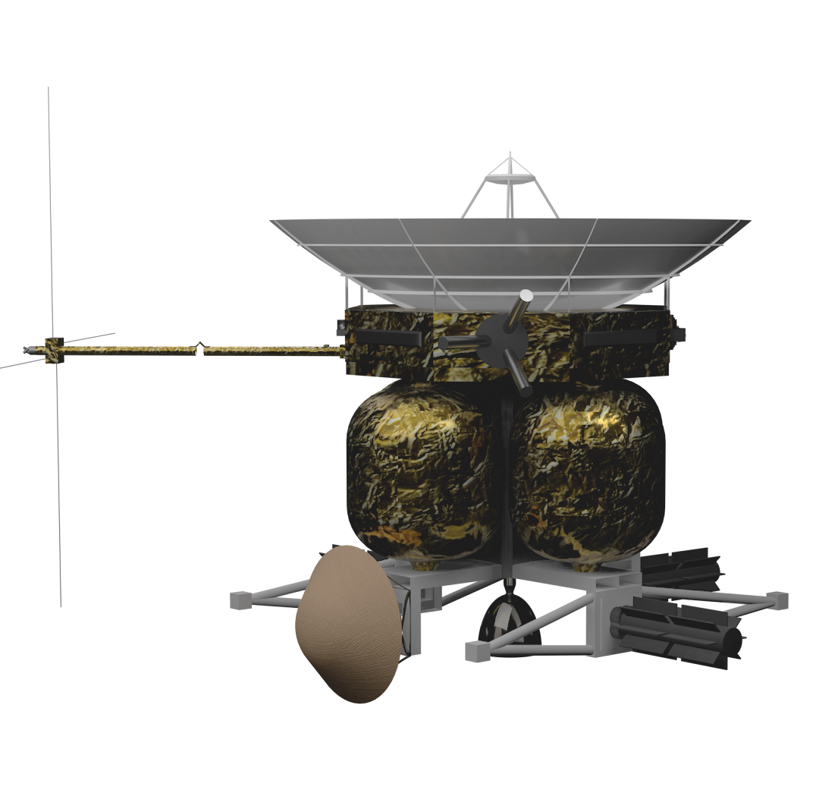
Terrestrial/Atmospheric Characterization and Observation of Satellites & Uranus
Mission Statement:
To conduct a pioneering deep space scientific exploration of Uranus, leveraging the latest advances in technology and engineering to study this mysterious and little-understood planet. By deploying an orbiter and a probe, we aim to gather new insights into the composition, atmosphere, and magnetic field of Uranus, as well as its moons and ring system.
Scientific Payload:
Orbiter
Imaging Science System
Gamma Ray Spectrometer
Parker Solar Probe FIELDS Electric Antennas
Magnetometer
Search Coil Magnetometer
EPI-low
SWEEP Electrostatic Analyzer
Radio Science Experiment
XNAV Gravity Science
Xiphias Q8JS Data Processing Computer
Probe
Double Focus Mass Spectrometer
Atmospheric Structure Instrument
Ortho-Para H2 Detector
Radio Science Experiment
Timeline:
Launch: June 16, 2034
Arrival: June 12, 2046
Design Life: 16 years
Cost: $2.1 billion
Launch Vehicle: Starship
Trajectory: EJU
Propulsion: N2O & C2H4/C2H6
Electric Power: Next-Gen Mod 1 RTGs
Notes:
Fact Sheet Summary

Slide 58
Thank you!
Professor Cunningham
TAs & Teaching Team
Design Reviewers
Students & Team
Purdue University College of Aeronautics & Astronautics
Notes:
Your mom

Slide 59
Q & A

Slide 60
References
[1] Planetary Mission Concept Study for the 2023–2032 Decadal Survey, June 2021
[2] Uranus Orbiter and Probe: Appendix C: Additional Details
[3] SpaceX Starship Data Sheet
[4] Cassini-Huygens Spacecraft, NASA
[5] ABSL Product Data Sheet, Li-ion Rechargeable Battery 8s16p 28V 24Ah
[6] https://descanso.jpl.nasa.gov/monograph/series13/DeepCommo_Chapter2--141029.pdf
[7] https://descanso.jpl.nasa.gov/monograph/series10/02_Reid_chapt2.pdf
[8] https://deepspace.jpl.nasa.gov/dsndocs/810-005/Binder/810-005_Binder_Change44.pdf
[9] https://www.dawnaerospace.com/green-propulsion
[10] https://www.rocketlabusa.com/assets/Uploads/RL-RW-0.4-Data-Sheet.pdf

Slide 61
References
[11] “Pioneer Astronautics Research and Development Contract List.” Pioneer Astronautics, www.pioneerastro.com/research/#Nitrous%20Ethane-Ethylene%20Rocket%20with%20Hypergolic%20Ignition. Accessed 24 Apr. 2023.

Slide 62
Additional Slides

Slide 63
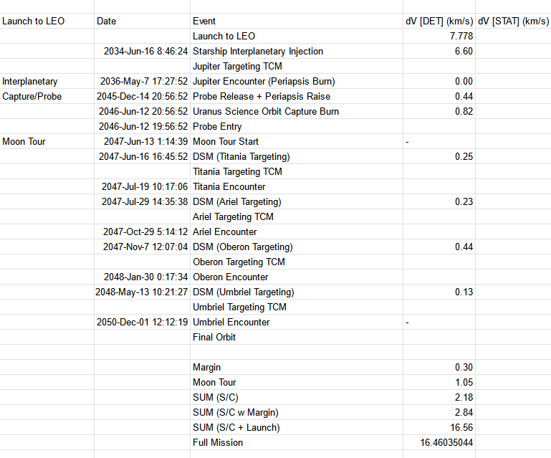
Trajectory Schedule

Slide 64
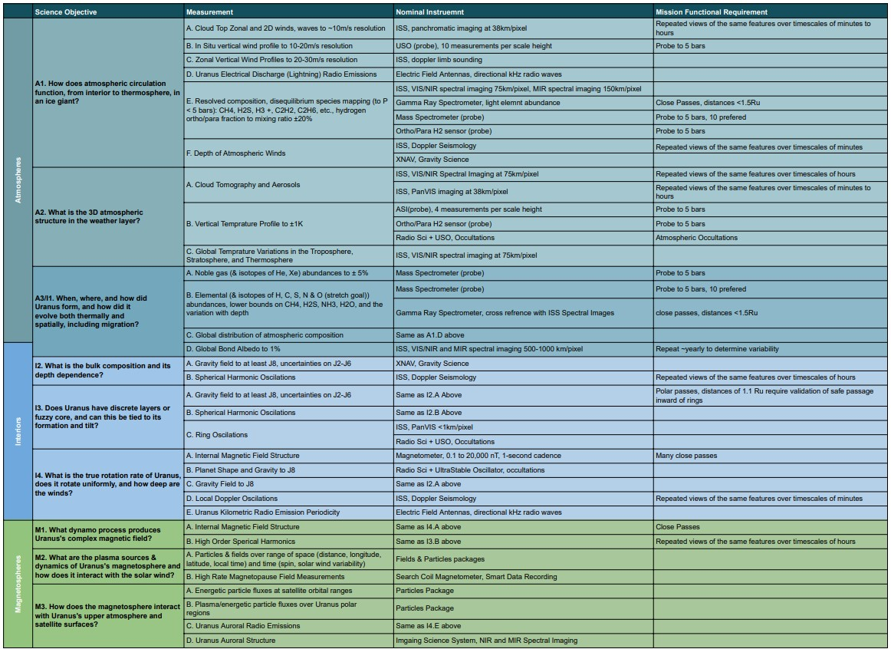
ScientifiC
Traceability
Matrix

Slide 65
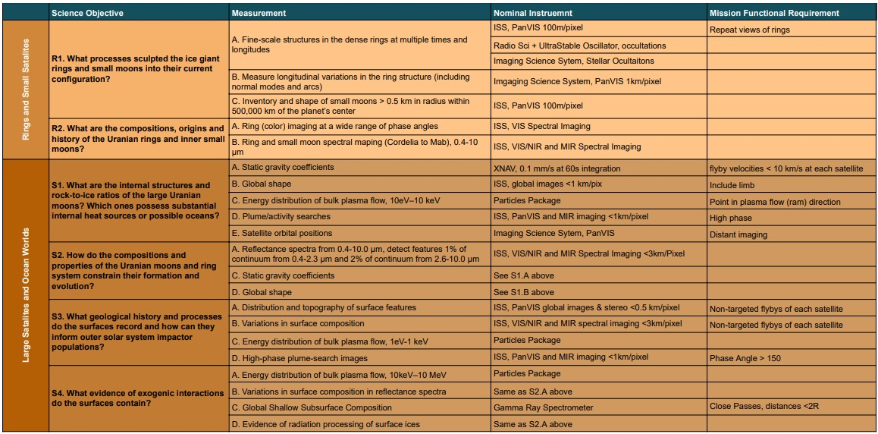

Slide 66
Framing Image Type | Data Per Image (MB) |  | Integration Time (s) | km/pix @ 100Mm ~4Ru
 | Max | Min
Default Resolution Image Data Volume
VIS/NIR Full Spectral | 65.5 | 32.8 | 60 | 2
MIR Full Spectral | 8.2 | 4.1 | 60 | 4
PanVIS | 0.5 | 0.5 | 5 | 1
Lossless Doppler w/ lossy brightness map | 0.5 |  | 60 | 2
3 VIS/NIR | 0.1 | 0.05 | 60 | 2
Diffraction Limited Drizzle Integration Image Data Volume
VIS Full Spectral | 436.7 | 218.7 | 3600 | 0.3
NIR Full Spectral | 181.9 | 91.1 | 2400 | 0.72
MIR Full Spectral | 10.3 | 5.1 | 1800 | 3.2
PanVIS | 1.7 | 1.7 | 100 | 0.3
3 Color VIS/NIR | 0.3 | 0.1 | 1000 | 0.72
Instrument |  | Compression Factor | Compression Algorithm
Orbiter
Imaging Science System |  | - | -
 | VIS/NIR/MIR Spectrometer | 11-23 | Spectral KLT/PCA -> JPEG XR
 | Panchromatic VIS | 11-23 | JPEG XR
 | Pushbroom Color VIS | 11-23
Gamma Ray Spectrometer |  | 4-8 | Quantized Chebyshev Transform
FIELDS Electric Antennas |  | - | -
 | Laguimir Probe | 4-8 | Quantized Chebyshev Transform
 | Dust Detection | 4-8
 | 10 kHz - 1.7 MHz LFR | 3 | Smart Quantization -> Bitshuffle -> LFZ
 | 1.3 MHz - 19.2 MHz HFR | 3
Search Coil Magnetometer |  | 3
Flux Gate Magnetometer |  | 4-20 | Quantized Chebyshev Transform
2.5m Fields Boom |  | - | -
SWEAP SPAN-A/B |  | 8-16 | Spectral KLT/PCA -> Time Series Quantized Chebyshev Transform
EPI-lo |  | 8-16
Radio Science Experiment |  | - | -
XNAV X-Ray Telescopes |  | 4-8 | Quantized Chebyshev Transform
Data Processing Computer |  | - | -
Data Generation Per Observation
Observation Type | Data Rate (kbps) |  | Duration (Hours) | Total Data (MB)
 | Max | Min |  | Max | Min
Continuous Instruments | 2.13 | 0.95 | 24 | 23.0 | 10.3
XNAV Flyby | 0.38 | 0.19 | 1 | 0.2 | 0.1
Gamma Ray Spectrometer Flyby | 0.50 | 0.25 | 0.17 | 0.038 | 0.019
Pushbroom Imager | 218.18 | 184.62 | 0.17 | 16 | 14
Continuous E-Antenna RF | 80.00 |  | 1 | 36.0
Smart E-Antenna RF (1min/hr) | 1.33 |  | 24 | 14.4
Continuous SCM | 40.00 |  | 1 | 18.0
Smart SCM (1min/hr) | 0.67 |  | 24 | 7.2
Doppler Seismology Average | 0.50 |  | 0.17 | 0.5

Slide 67
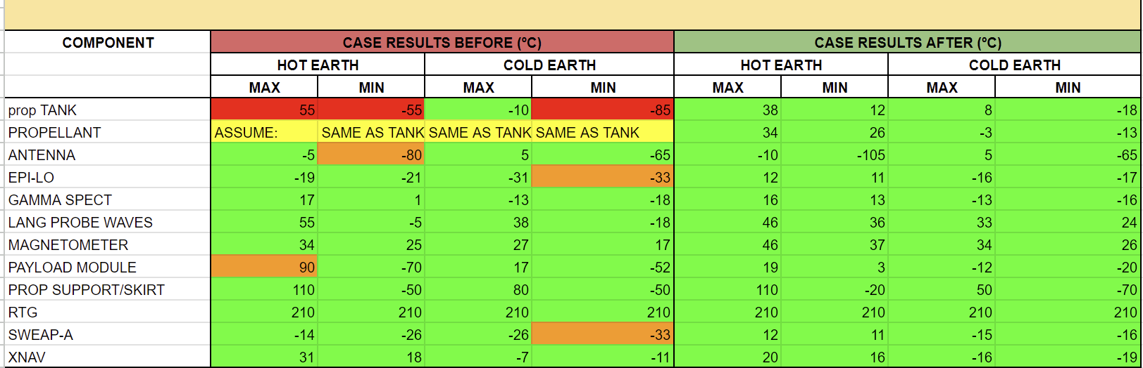
Transient Earth Cases before and after thermal control methods

Slide 68
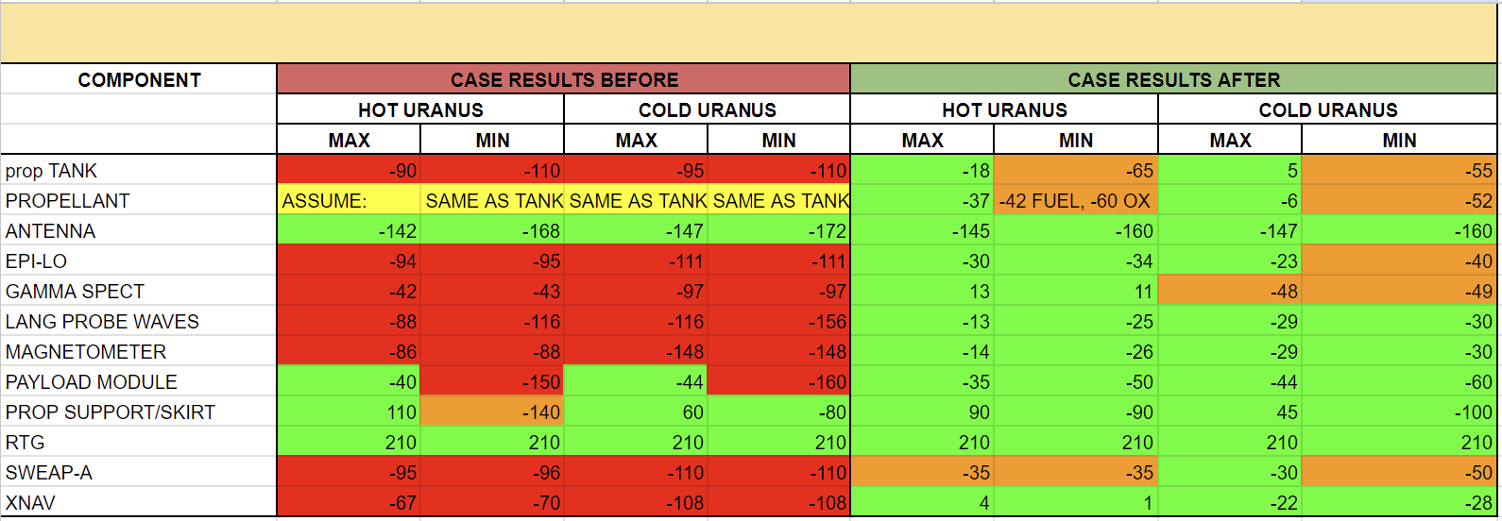
Transient Uranus Cases before and after thermal control methods
Orange would require a higher thermal power allocation during specific instances in the mission

Slide 69
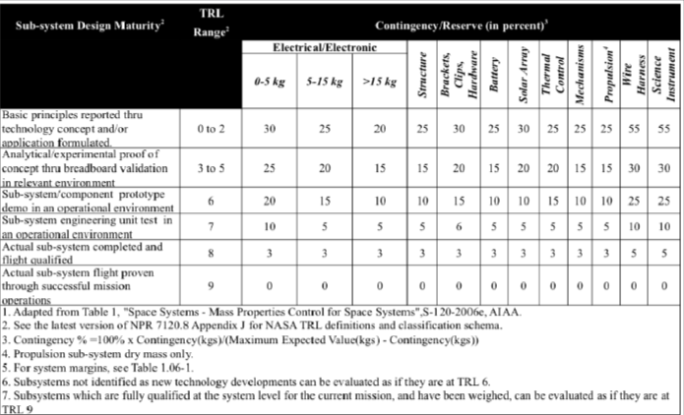
Goddard Gold Standard Guidelines

Slide 70
Power Budget Breakdown - Orbiter
 | Launch | Cruise | Main Engine Burn | Attitude Adjustment | Science Data Collection | Data Transmission | Momentum Dump | Safe Mode | Delta-V Preheat
Orbiter Bus | [W] | [W] | [W] | [W] | [W] | [W] | [W] | [W] | [W]
Propulsion | 0.00 | 0.00 | 376.42 | 0.00 | 0.00 | 0.00 | 0.00 | 0.00 | 0.00
Avionics/On-Board Processing | 29.70 | 29.70 | 29.70 | 29.70 | 29.70 | 29.70 | 29.70 | 29.70 | 29.70
Power | 38.06 | 38.06 | 38.06 | 38.06 | 38.06 | 38.06 | 38.06 | 38.06 | 38.06
Attitude Determination and Control | 0.00 | 60.44 | 233.24 | 60.44 | 60.44 | 60.44 | 233.24 | 60.44 | 60.44
Thermal Control | 54.45 | 54.45 | 54.45 | 54.45 | 54.45 | 54.45 | 54.45 | 54.45 | 87.45
TT&C | 70.18 | 75.24 | 134.31 | 134.31 | 75.24 | 134.97 | 134.31 | 141.24 | 141.24
Science Payload | 0.00 | 45.75 | 0.00 | 0.00 | 60.76 | 0.00 | 0.00 | 0.00 | 0.00
CBE | 192.39 | 303.65 | 866.19 | 316.97 | 318.66 | 317.63 | 489.77 | 323.90 | 356.90
MEV (w/ 30% Margin) | 250.11 | 394.74 | 1126.04 | 412.06 | 414.26 | 412.91 | 636.70 | 421.06 | 463.96

Slide 71
Power Budget Breakdown - Probe
 | Uranus Entry & Descent [W]
Payload/Instruments | 39.08
Avionics/On-Board Processing | 26.22
Power | 15.87
TT&C | 64.72
CBE | 145.89
MEV (w/ 30% Margin) | 189.65

Slide 72
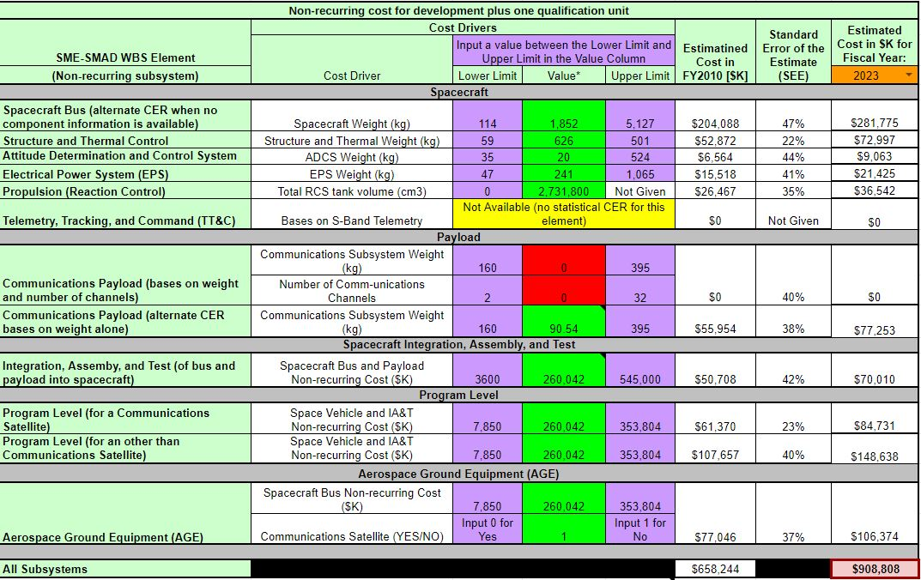
Table 11-8

Slide 73

Table 11-9

Slide 74

Table 11-14

Slide 75

Table 11-28

Slide 76
Cost Estimation Data
Inflation Factors:
2023 → 1
2024 → 1.021290118
2025 → 1.04313632
2026 → 1.065379727
2027 → 1.088179218
2028 → 1.111375914
2029 → 1.135128694
2030 → 1.159358119
2031 → 1.184143629
2032 → 1.209405783
2033 → 1.235224023
2034 → 1.261598348
2035 → 1.28773435
2036 → 1.316094693
2037 → 1.344455037
2038 → 1.37281538
2039 → 1.401175723
2040 → 1.429536066
2041 → 1.457896409
2042 → 1.486256752
2043 → 1.514617096
2044 → 1.542977439
2045 → 1.571337782
2046 → 1.599698125
2047 → 1.628058468
2048 → 1.656418812
2049 → 1.684779155
2050 → 1.713139498
Table 11-8
Low Cost = 758.10 [$M]
Mean Cost = 979.29 [$M]
High Cost = 1201.67 [$M]
Combined Cost
Low Cost = 1349.80 [$M]
Mean Cost = 1578.99 [$M]
High Cost = 1844.80 [$M]
70% Conf Cost = 1619.05 [$M]
Table 11-9
Low Cost = 219.88 [$M]
Mean Cost = 258.01 [$M]
High Cost = 295.89 [$M]
Final Cost (w/ 30% Margin)
Low Cost = 1754.73 [$M]
Mean Cost = 2052.69 [$M]
High Cost = 2398.24 [$M]
70% Conf Cost = 2104.76 [$M]
Table 11-14
Low Cost = 94.11 [$M]
Mean Cost = 136.06 [$M]
High Cost = 176.40 [$M]
Table 11-28
Low Cost = 164.89 [$M]
Mean Cost = 205.63 [$M]
High Cost = 246.36 [$M]

Slide 77
Risk List
# | Risk | Type | L | C | Mitigation
1 | IF the oribter encounters communication outages with the DSN, THEN scientific data could be lost or delayed. | Technical | 2 | 2 | - Storage holds science data - Pre-launch compatibility testing
2 | IF the RPS estimated worst-case power output is lower than anticipated, THEN insufficient power to the flight subsystems may result. | Technical | 1 | 3 | - Look at trade-offs between utilizing an extra RTG versus an extra battery - Preduce pre-launch storage time from 2 to 3 years if possible
3 | IF current knowledge of ring locations and densities is updated, THEN the constraints for capture and tour trajectories may change, possibly with a ΔV cost. | Technical | 2 | 3 | - Attempt additional observations & modeling of Uranus' upper atmosphere and rings early in development to further characterize ring particle risk ad better confirm safe zones
4 | IF the instruments or subsystems with TRL level 5 or lower are not ready by the launch date, THEN launch could be delayed and/or scientific objectives will not be met. | Programmatic (Cost/Schedule) | 2 | 3 | - Look into trade-offs of utilizing other scientific instruments - Ensure all mission-ending subsystems are TRL 6+
5 | IF launch vehicle details are delayed for newer vehicle options, THEN launch could be delayed. | Cost/ Schedule | 2 | 4 | - Select launch vehicle as soon as possible
6 | IF more detailed analysis indicates increased radiation hardness requirements, THEN higher parts cost could be incurred and/or additional shielding could be required. | Technical, Safety | 2 | 3 | - Conduct detailed radiation modeling and analysis - Allocate cost reserves for potential parts increases - increase shielding mass allocations as needed

Slide 78

Risk 5x5 Matrix

Slide 79
N2O
“As of Feb 1 2023, there are 50+ thrusters on orbit on 12 satellites using nitrous bi-propellant and hundreds more on order form 15+ companies and space agencies.” - Dawn aerospace industry update https://www.dawnaerospace.com/latest-news/prevalence-of-nitrous-based-in-space-propellants
“‘Green,’ in this context, does not say anything about the environmental impact or carbon footprint of the propellant. Rather, it imprecisely refers to the idea that you can open a bottle without having to first put on something akin to a spacesuit (a SCAPE suit).” - Dawn industry update
Should nitrous leak, it disperses!!! Very good for rideshare safety!! Provided the payload bay is ventilated, a nitrous leak will not harm any other satellite or cause a pressure rise in the payload bay

Slide 80



Relevant Tweets

Slide 81

Propulsion
TCA/Nozzle will be radiatively cooled
  Least complex - no added weight or volume
  Suitable as method of cooling for deep space missions
TCA: Yttria Stabilized Zirconia (YSZ) Coated Iridium Rhenium (IrRe) Alloy
  Alloy has high melting point (3500 C)
  Excellent strength and durability, resistant to thermal cycling
  YSZ coating provides oxidation and thermal shock resistance
Nozzle: Niobium Alloy
  High melting point (2500 C)
  Good oxidation resistance
  Lightweight
Notes:
Say this:
Our TCA and Nozzle will be radiatively cooled.
It is a reliable and efficient method for cooling spacecraft in deep space missions, especially where weight, volume, and complexity are crucial factors.
For our engine, we want to pick materials that can withstand the thermal loads of our system while also being resistant to oxidation.
For our TCA, we chose to use an Iridium Rhenium Alloy with a Yttria (Yit-tria) Stabilized Zirconia coating.
The alloy has a high melting point, good thermal conductivity, and is resistant to thermal cycling
The coating adds oxidation resistance and additional protection against thermal shock
For our nozzle, we chose to use Niobium Alloy.
Niobium alloy is a commonly used material for rocket nozzles due to its high melting point of 2500 C and it's good oxidation resistance.
If they ask: Picture is of Aerojet Rocketdyne R-4D-15 HiPAT which is a variant of the R-4D. The R-4D was originally developed for the Apollo program and was employed on every mission to the Moon.
Also, Niobium alloy was used on the nozzle of SpaceX’s Merlin vacuum engine

Slide 82




Slide 83



Slide 84



Slide 85

COPV Sizing
COPV sizing is calculated using relation from AIAA Aerospace Research Central
  Mass = (Pb*V) / 1.83e5 Nm/kg
  Pb (burst pressure) = 2 * working pressure
  V = Volume of tank

Slide 86


Slide 87



Slide 88


Mission Design Extra Info (Seq Analysis + ConOps)

Slide 89
Mission Design Extra Info (Orbital Parameters)
Earth Departure: ecc = 2.41 , inc = 31.61 deg, argp = 40.35 deg, raan = 268.78 deg
Jupiter Flyby: 27.39*R_Jupiter
Uranus Capture: ecc = .967, inc = 98.28 deg, 154.04 deg, argp = 256.39 deg

Slide 90

Mission Design Extra Info (Interplanetary Occultations)

Slide 91

Mission Design Extra Info (Moon Tour Occultations)

Slide 92

TT&C Subsystem Block Diagram

