Slide 1
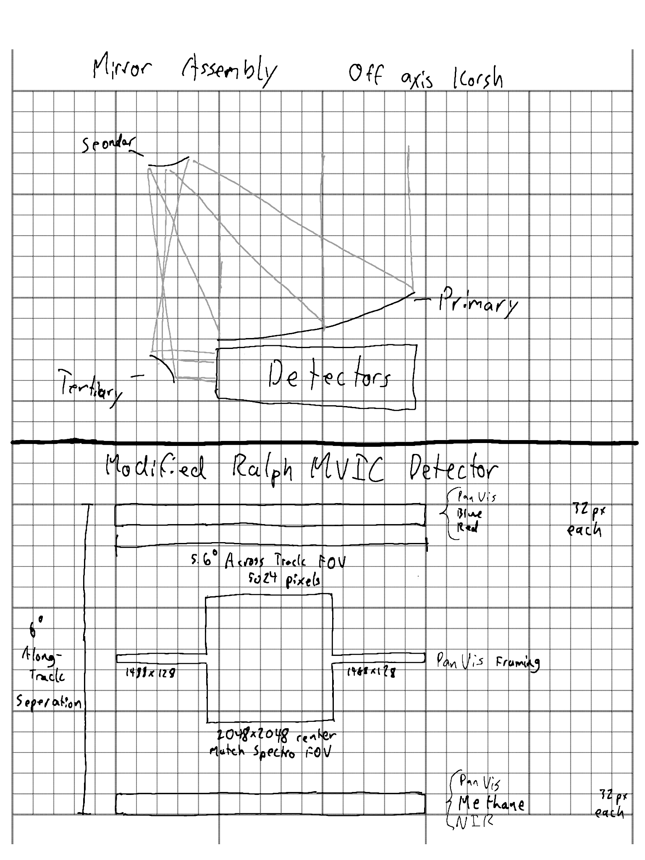
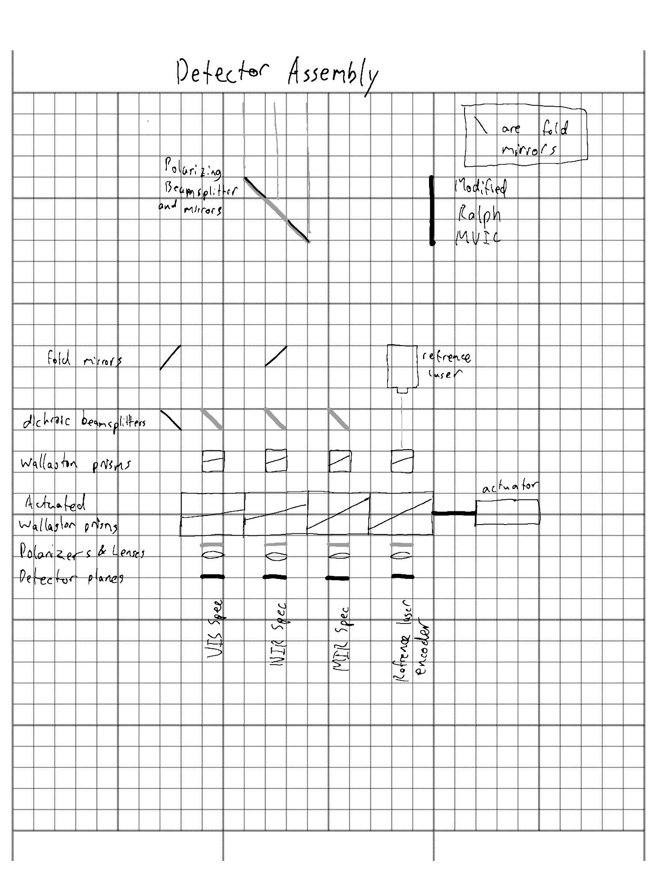
Imaging Science System Engineering Detail
Imaging Science System TRL Assessment
Component | Heritage | Demonstration Level
Strained Layer Superlattice Detector Array | Landsat 9 MWIR | Used on Prior Missions
Visible Light Detector Array (370-950 nm) | Various Missions | Used on Prior Missions
NIR Detector Array (950nm - 2.3 micron) | Various MIssions | Used on Prior Missions
Modified Ralph MVIC | Ralph/L’Ralph | Similar Component on Prior Mission
Birefringent Spectrometer | Commercial Portable FTIR | Comercial Use on Earth
Single Piece off-Axis Korsh Telescope | Ralph/L’Ralph Instruments | Similar Component on Prior Mission
Beralcast Optics | F-35 MIR Telescope Material | Used in Spaceflight Relevant Conditions
Overall TRL Assessment: | TRL 4 | All Components Demonstrated in at Minimum Earth Laboratory Conditions
Wavelength Bands
Component | Range (μm)
VIS Spec | 0.37 - 0.95
NIR Spec | 0.95 - 2.30
MIR Spec | 2.30 - 10.0
PanVIS | 0.37 - 0.95
Blue | 0.40 - 0.55
Red | 0.54 - 0.70
Methane | 0.86 - 0.91
NIR (MVIC) | 0.78 - 0.975
Fourier Transform Spectroscopy: Fourier Transform Spectroscopy is a spectral analysis method common in laboratory equipment and on space missions. An interferogram is produced using an interferometer to sample brightness vs path length difference. This interferogram can then be fourier transformed to produce a power spectrum. Fourier Transform spectroscopy has long integration times compared to other spectroscopy methods, but allows for extremely high spectral resolution with low noise in a small instrument. Fourier Transform spectroscopy can trade lower spectral resolution for lower integration time operationally.
Computational Imaging: Computational Imaging utilizes computational power to surpass the limits of the detector array. It is commonly used both in astronomical imaging and in smartphone cameras, exemplified by the google pixel. One common and important technique is aligning and averaging many short exposures instead of taking a single long exposure to dramatically improve dynamic range and reduce motion blur. Computational Imaging can also be used to mitigate the disadvantages of long exposure times by using object tracking with the PanVIS framing array to reconstruct correct interferograms for objects that are moving against the background between samples.

