Slide 1
Science Payload
Matthew Glimcher

Slide 2
Table of Contents
Instrument List
Descope and Enhancement Options
Technology Demonstration Payload
Onboard Computation

Slide 3
Orbiter Instrument List
Instruments | Mass |  |  | Power
Baseline Instruments | CBE (kg) | % Cont. | MEV (kg) | CBE (W) | % Cont. | MEV (W) | Duty Cycle
Vis-IR Birefirngent Imaging Spectrometer (Low TRL) | 30.00 | 30 | 39.00 | 20.00 | 30 | 26.00 | Variable
Spectrometer MVIC Module Flyby Imaging | 0 | 30 | 0 | 8 | 30 | 10.40 | Flyby
Gamma Ray Spectrometer (MESSENGER) | 9.20 | 10 | 10.12 | 16.50 | 10 | 18.15 | Flyby
Parker Solar Probe FIELDS Electric Antennas | 5.37 | 10 | 5.91 | 4.05 | 10 | 4.46 | Continuous
Fluxgate Magnetometer (MESSENGER) | 1.93 | 10 | 2.12 | 2.00 | 10 | 2.20 | Continuous
Search Coil Magnetometer (TRACERS) | 0.8 | 10 | 0.88 | 0.6 | 10 | 0.66 | Flyby
EPI-low (Parker Solar Probe) | 3.50 | 10 | 3.85 | 2.50 | 10 | 2.75 | Continuous
SWEAP Electrostatic Analyzer (Parker Solar Probe) | 2.50 | 10 | 2.75 | 2.00 | 10 | 2.20 | Continuous
Radio Science Experiment | 0.00 | 0 | 0.00 | 20.00 | 10 | 22.00 | Variable
XNAV Gravity Science (3 CubeX Telescopes) | 17.00 | 20 | 20.40 | 16.67 | 20 | 20.00 | Flyby
Xiphios Q8JS Data Processing Computer | 0.10 | 3 | 0.10 | 25.00 | 3 | 25.75 | Variable
Total | 70.40 | 13 | 85.13 | 117.32 | 14 | 134.57
Total Continuous (if Applicable) |  |  |  |  |  | 11.61
Estimated Peak (if Applicable) |  |  |  |  |  | 60.82

Slide 4
Probe Instrument List
Instruments | Mass |  |  | Power
 | CBE (kg) | % Cont. | MEV (kg) | CBE (W) | % Cont. | MEV (W)
Double focus mass spectrometer (Rosetta) | 16.20 | 10 | 17.82 | 19.00 | 10 | 20.90
Atmospheric Structure Instrument (Huygens) | 2.50 | 10 | 2.75 | 3.50 | 10 | 3.85
Ortho-Para H2 Detector | 1.00 | 30 | 1.30 | 3.50 | 30 | 4.55
Radio Science Experiment | 0.00 | 0 | 0.00 | 0.00 | 0 | 0.00
Subtotal | 19.70 | 13 | 21.87 | 7.00 | 13 | 29.30

Slide 5
Payload Descope Options
Orbiter
Remove Gamma Ray Spectrometer
Replace Vis-IR spectrometer with New Horizons LORRI narrow angle camera and LRO Diviner IR radiometer
Reduce XNAV from three to one X-ray telescopes
Probe
Remove probe ortho-para H2 sensor

Slide 6
Enhanced Payload Options
Orbiter
Juno UV Imaging Spectrometer
Lightweight microwave radiometer using log periodic membrane antennas
Infrared radiometer integrated with Imaging Science System
Diffraction limited framing array(s) integrated with Imaging Science System
Probe
Nephelometer
Net flux radiometer
Helium abundance detector

Slide 7
A Case for a New Spectrometer

Slide 8
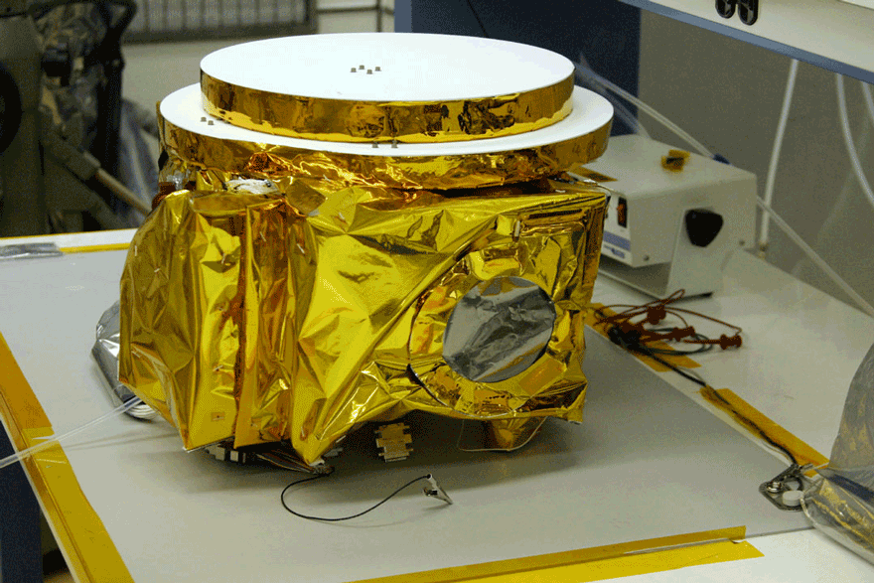
Lucy’s L’Ralph Spectrometer
Image of L’Ralph
Current deep space spectrometer
Optimized for flybys and low orbits
Color visible light images
1.25-2.5 micron infrared spectrometer
Image Credit: NASA

Slide 9
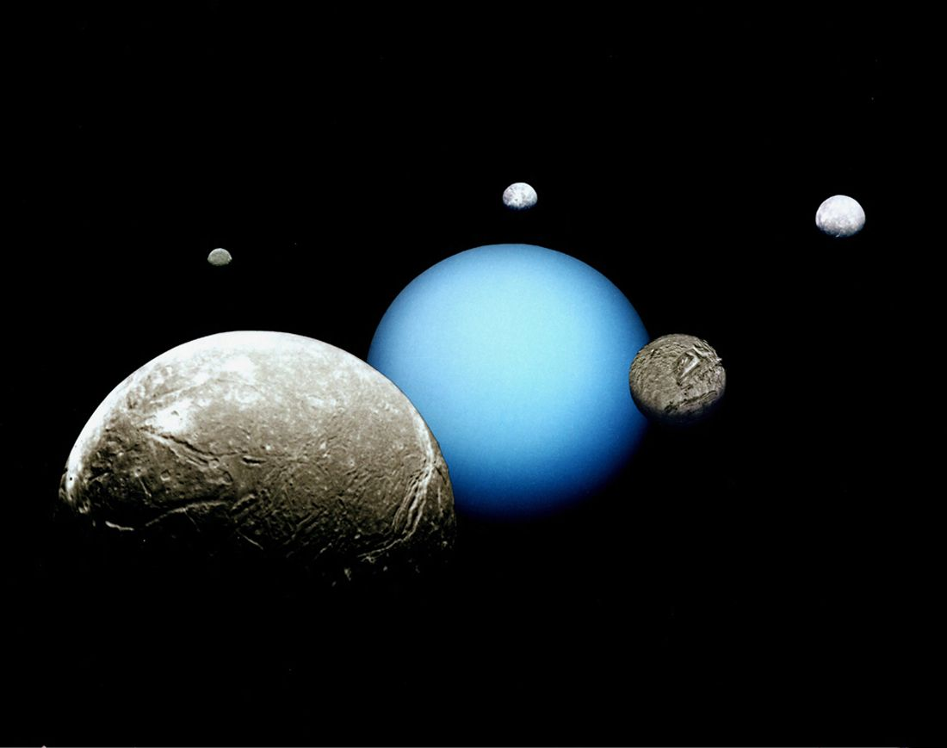
Our Mission is Different
Image of Uranus System
Lots of opportunities for long range images
Can’t make close passes of most moons
Solar and stellar occultations
Mapping uranus’ atmosphere
Image Credit: NASA/JPL

Slide 10
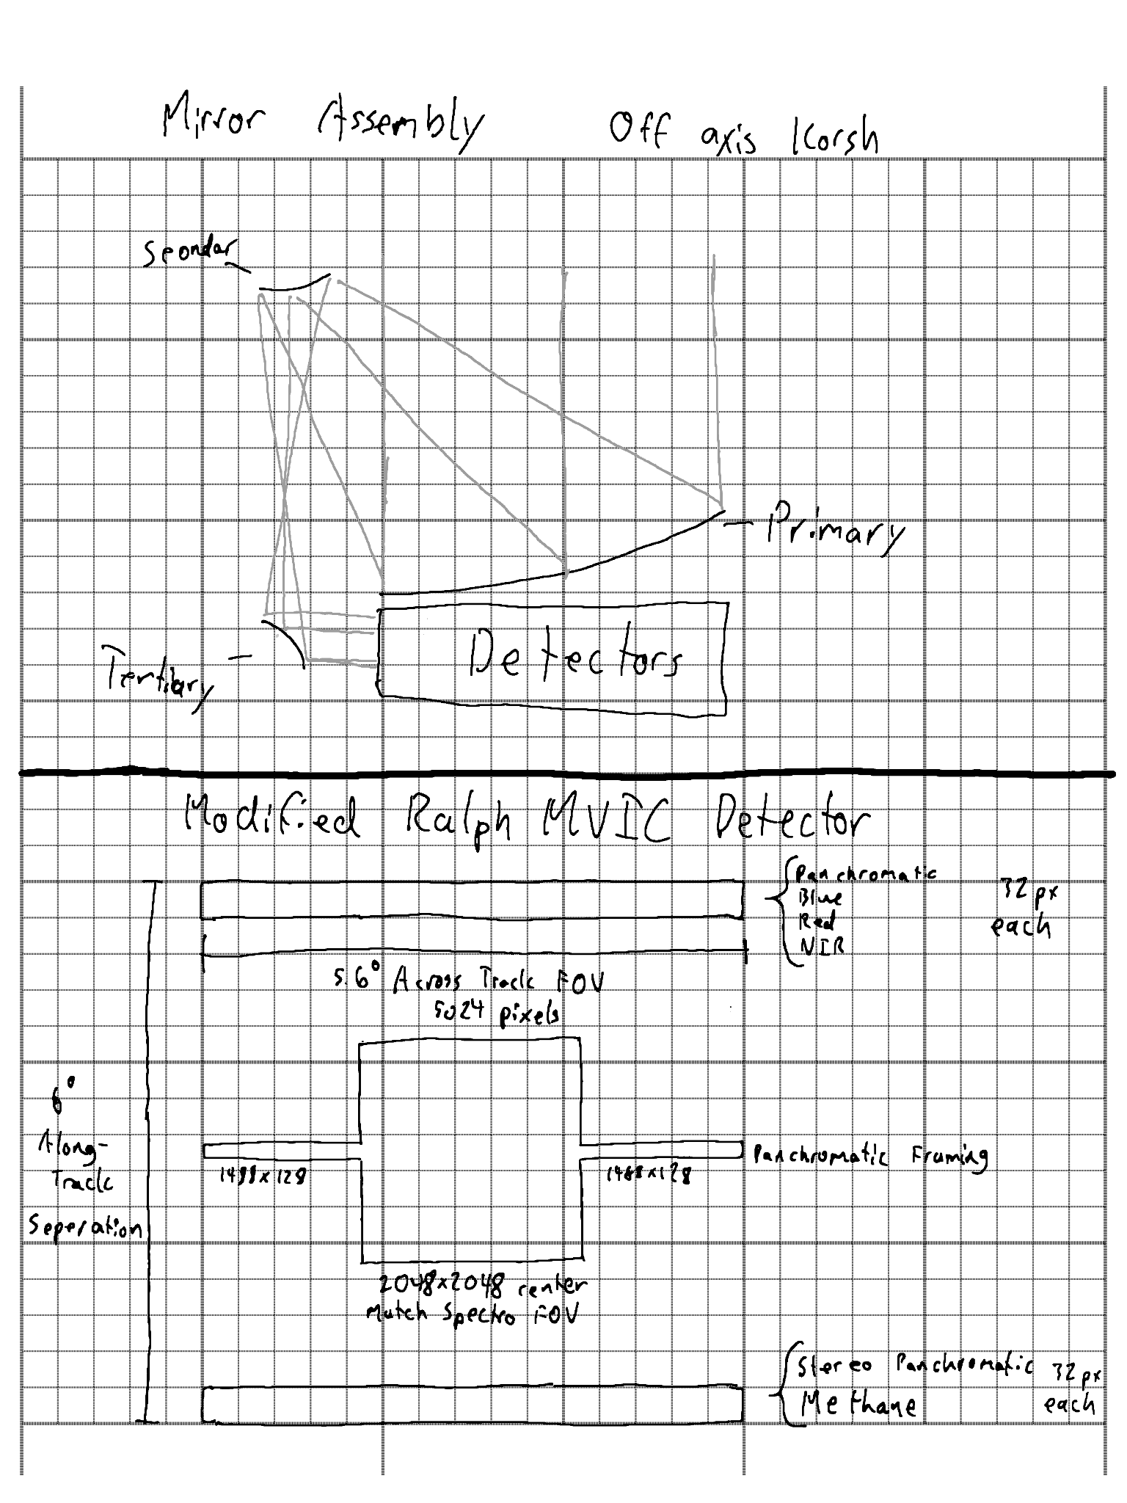
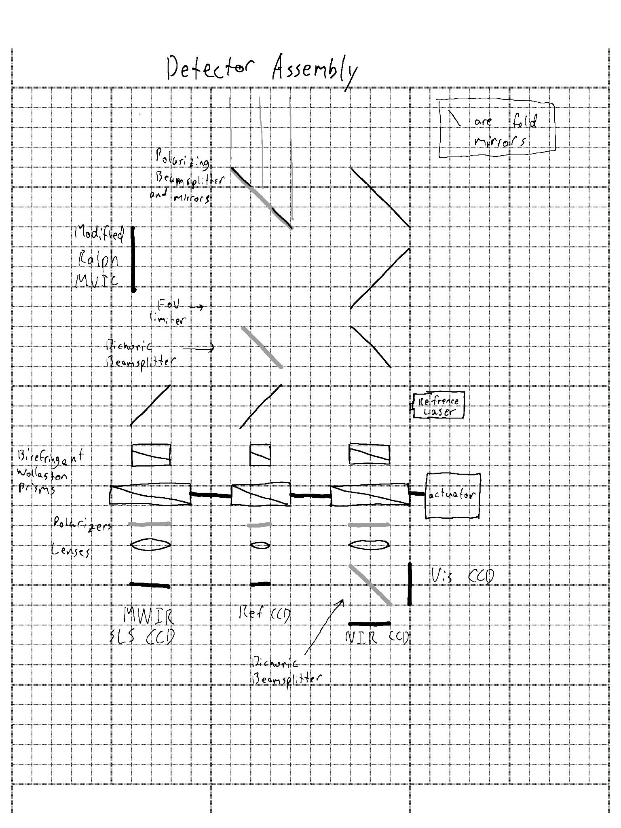
A New Spectrometer for a New Mission
Capabilities
370-2300 nm Vis-NIR
2.3 - 10 micron Mid IR
75 km per pixel at apoapsis (Vis-NIR)
High Spectral Resolution

Slide 11
Component TRL Levels
Component | TRL Level | Source/Heritage
Strained Layer Superlattice Detector Array | 9 | Landsat 9 MWIR
Visible Light Detector Array (370-950 nm) | 9 | Various Missions
NIR Detector Array (950nm - 2.3 micron) | 9 | Various MIssions
Modified Ralph MVIC | 7 | Ralph/L’Ralph
Birefringent Spectrometer | 4 | Commercial Portable FTIR
Single Piece off-Axis Korsh Telescope | 8 | Ralph/L’Ralph Instruments
Beralcast Optics | 5 | F-35 MIR Telescope Material

Slide 12
Reliability and Redundancy
The Modified Ralph MVIC functions Independently as a Camera
Birefringent Spectrometers are >100 Times Less Vibration Sensitive Than Cassini’s CIRS
Cheap, Light, and Reliable Commercial Field Spectrometers use Birefringent systems

Slide 13
Overlapping Legacy Instrument Capabilities
Instruments | Legacy Science Capability
Ralph/L’Ralph Spectrometer | Visible Light Images and Mapping Ices
Juno Jovian Infrared Auroral Mapper (JIRAM) | Atmosphere Structure to 5-7 bar depth and Auroral structure
Cassini Visible and Infrared Mapping Spectrometer (VIMS) | Temperature, Composition, and Atmospheric cloud structure and dynamics

Slide 14
New Scientific Capabilities
Instruments | New Science Capability
Doppler Seismology | Measure Spherical Harmonics of Uranus
Lab Grade FTIR Spectroscopy | Measure the Concentration of Minerals and Organic Functional Groups
5-10 Micron Atmosphere Observations | Atmospheric Structure Deeper than 10 Bar
Notes:
100px map at 500 body radii

Slide 15
A Bigger Computer

Slide 16
Computing Enabled Capabilities
Advanced Data Compression
Feature Extraction
Anomaly Detection
Deep Space Challenges
Radiation Protection
100 krad Chips are old and slow
>10:1 Compression
vs.
2:1 for Legacy Systems

Slide 17
Radiation Hardening in Software
The ISS Space Born Computer
COTS Server hardware in LEO
Mitigate Damage in Software
0.03% degradation after 1 year
SBC-2 Currently Supporting ISS Science
How it Works
Radiation damage isn’t instant
Depowering gates aneals the structure
Modern fault detection can detect charges before they damage the gate

Slide 18
General Science Payload References
IMAGE (spacecraft) - Wikipedia
Integrated Science Investigation of the Sun - Wikipedia
THEMIS - ELECTROSTATIC ANALYZER (ESA) | NASA
Lucy (spacecraft) - Wikipedia
Ralph (New Horizons) - Wikipedia
Innovations In Plasma Sensors
MESSENGER - Wikipedia
Mass spectrometry - Thermal ionization | Britannica
Speed of sound and ortho:para hydrogen ratio in outer planet atmospheres
The Radio Plasma Imager investigation on the IMAGE spacecraft | SpringerLink
Galileo Probe Archive Page
Cassini Orbiter - Radar
CubeX: A Compact X-ray Telescope Enables Both X-ray Fluorescence Imaging Spectroscopy and Pulsar Timing Based Navigation (usu.edu)
Ultra-Stable Oscillators For Probe Radio Science Investigations
MESSENGER > About > Spacecraft and-Instruments Johns Hopkins APL Website
The MESSENGER Gamma-Ray Spectrometer: Calibration and operations - ScienceDirect

Slide 19
Spectrometer and Computer References
Cassini CIRS: Composite Infrared Spectrometer - CERTIFIED
Cassini CIRS User Guide
Fabry–Pérot interferometer - Wikipedia
Optical Configurations for Imaging Spectrometers | SpringerLink
Birefringent Fourier-transform imaging spectrometer
IRC906SLS BROADBAND INFRARED CAMERA
Fourier-transform spectroscopy - Wikipedia
Space grade electronics: How NASA's Juno survives near Jupiter
Honeywell Spacecraft On-Board Computer (OBC)
High Performance Commercial Off-The-Shelf (COTS) Computer System on the ISS
On the Edge of the Edge: Taking Supercomputing to Space
Products - Xiphos Technologies
Q8J Processor - Xiphos Technologies
Total Ionizing Dose (TID) Effects
Cassini's Processor
2023 UOP selected main processor

Slide 20
Questions

Slide 21
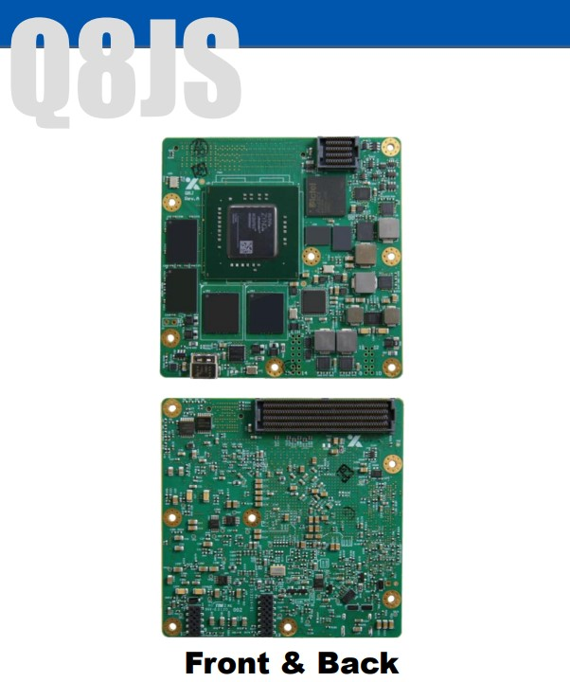
The Xiphios Q8JS
Picture of Chip
1.2 GHz Quad Core CPU
600 MHz GPU
Massive FPGA
25W Peak Power
30 krad Total Ionizing Dose
Image Credit: Xiphios

