Slide 1
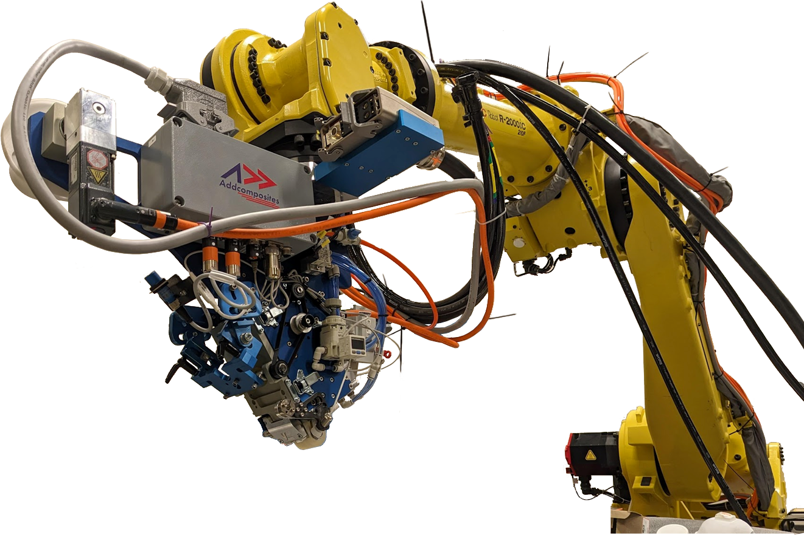
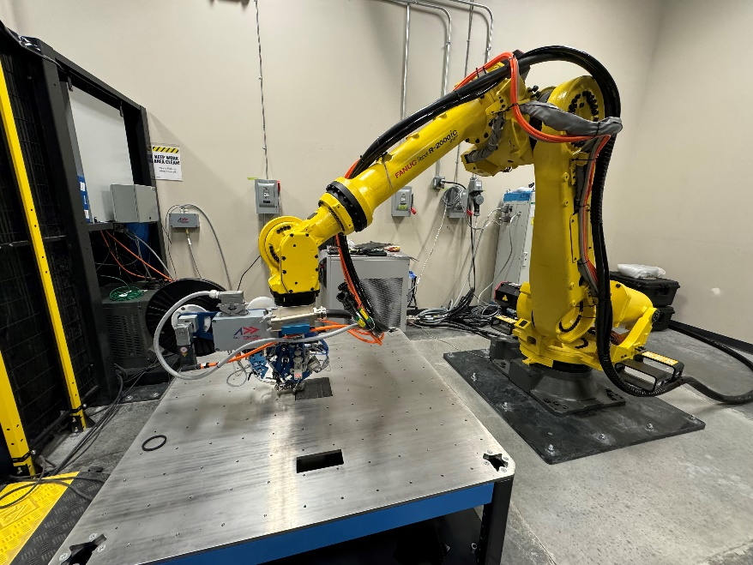
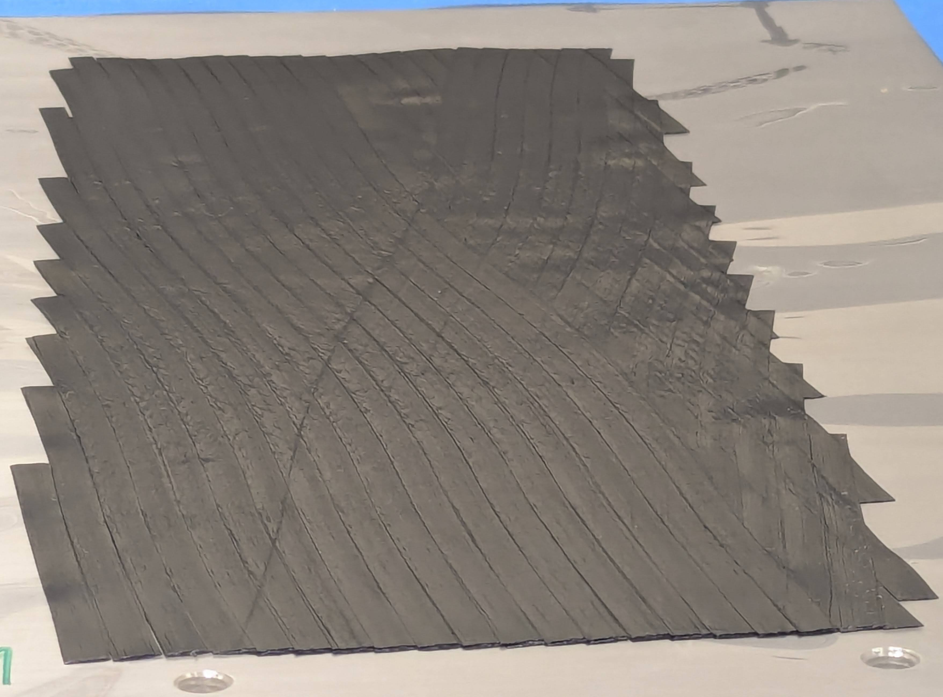
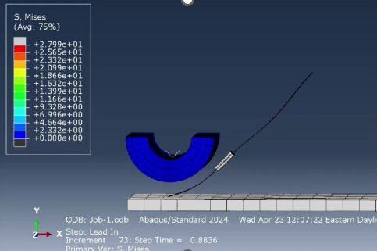
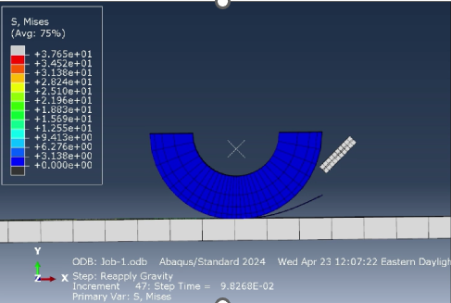
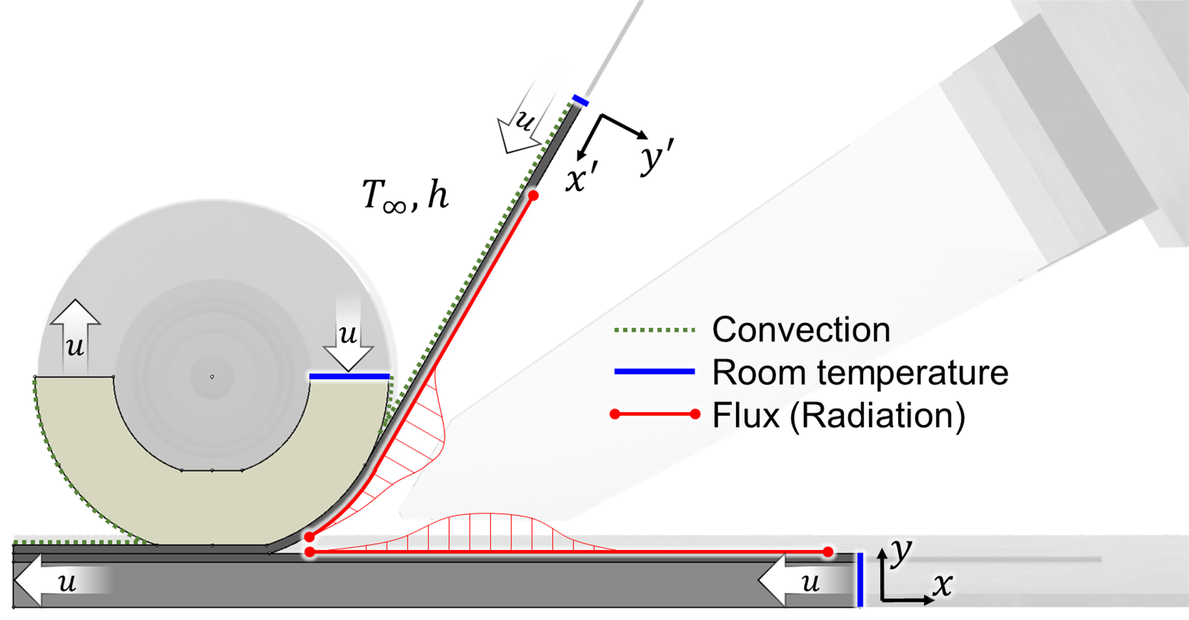
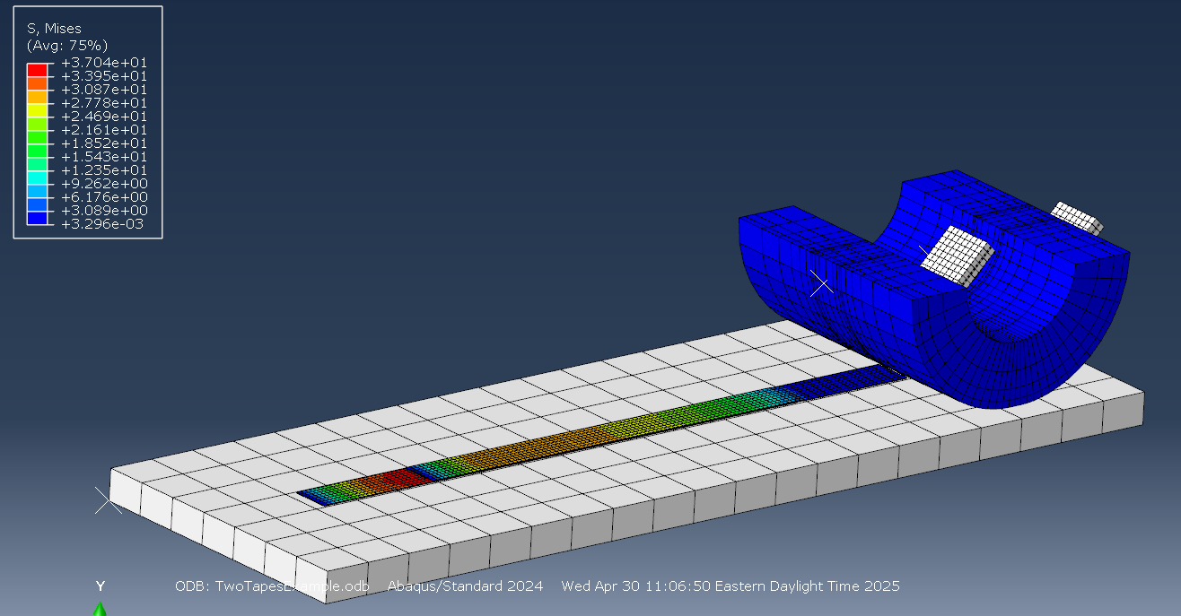
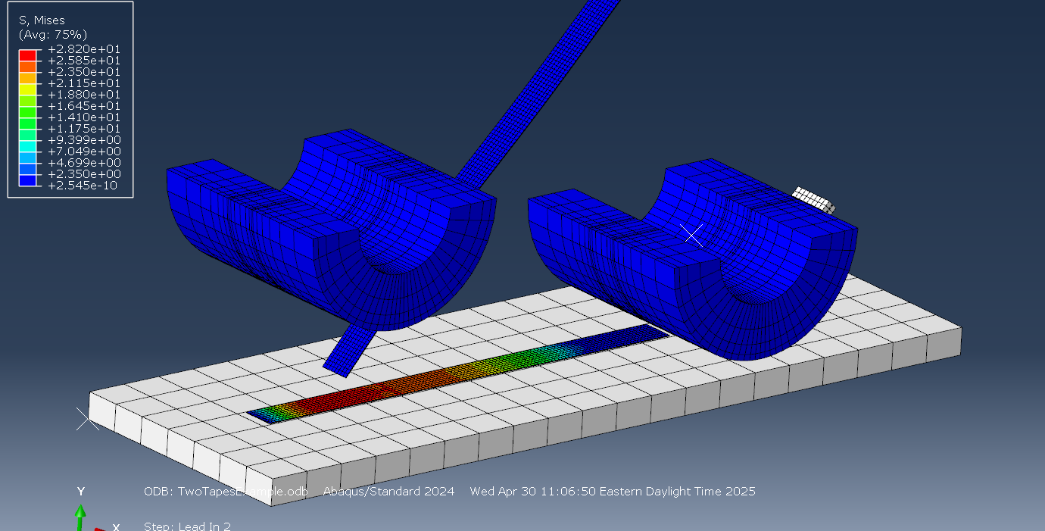
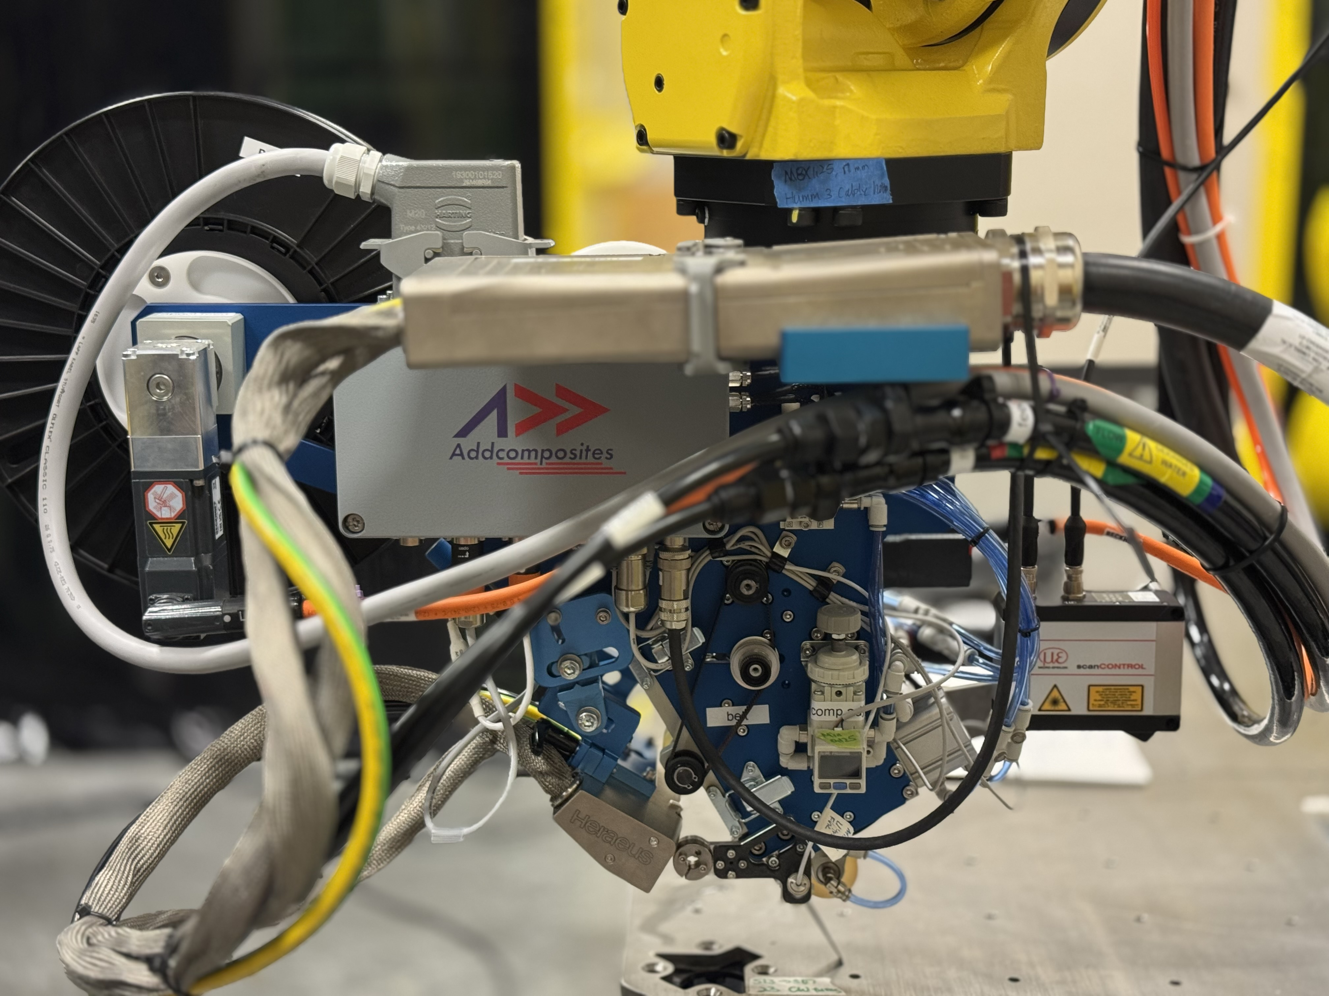
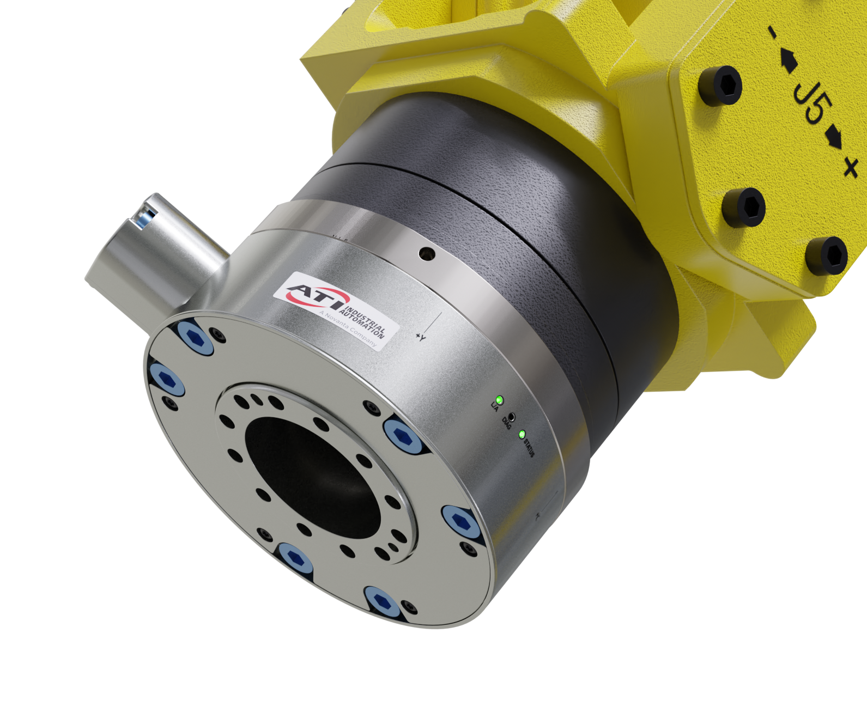
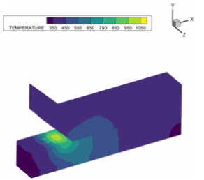
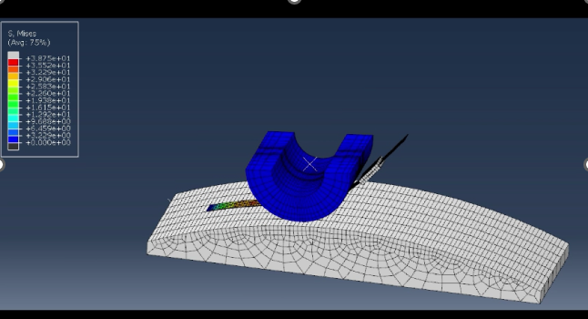
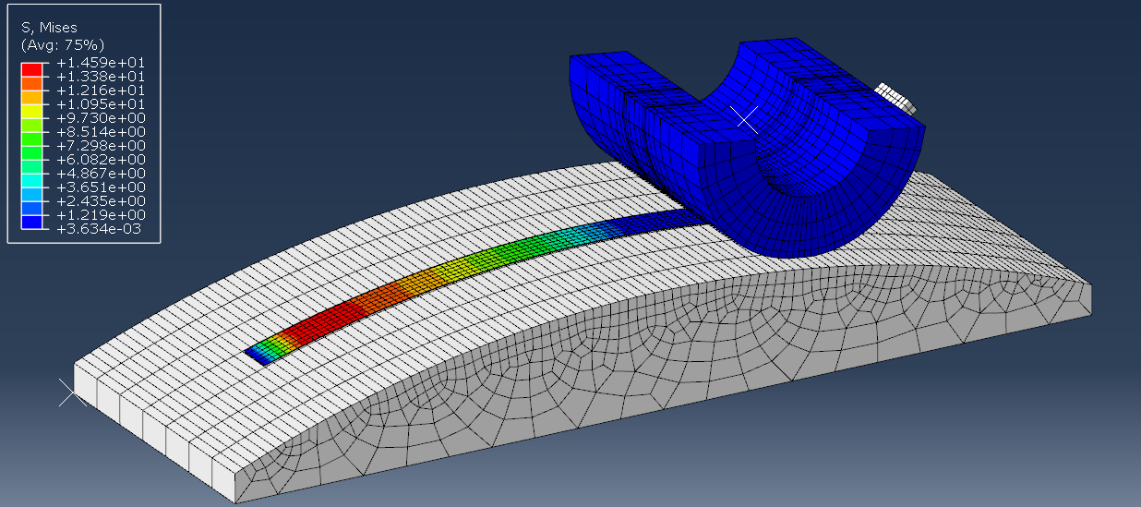
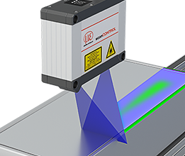
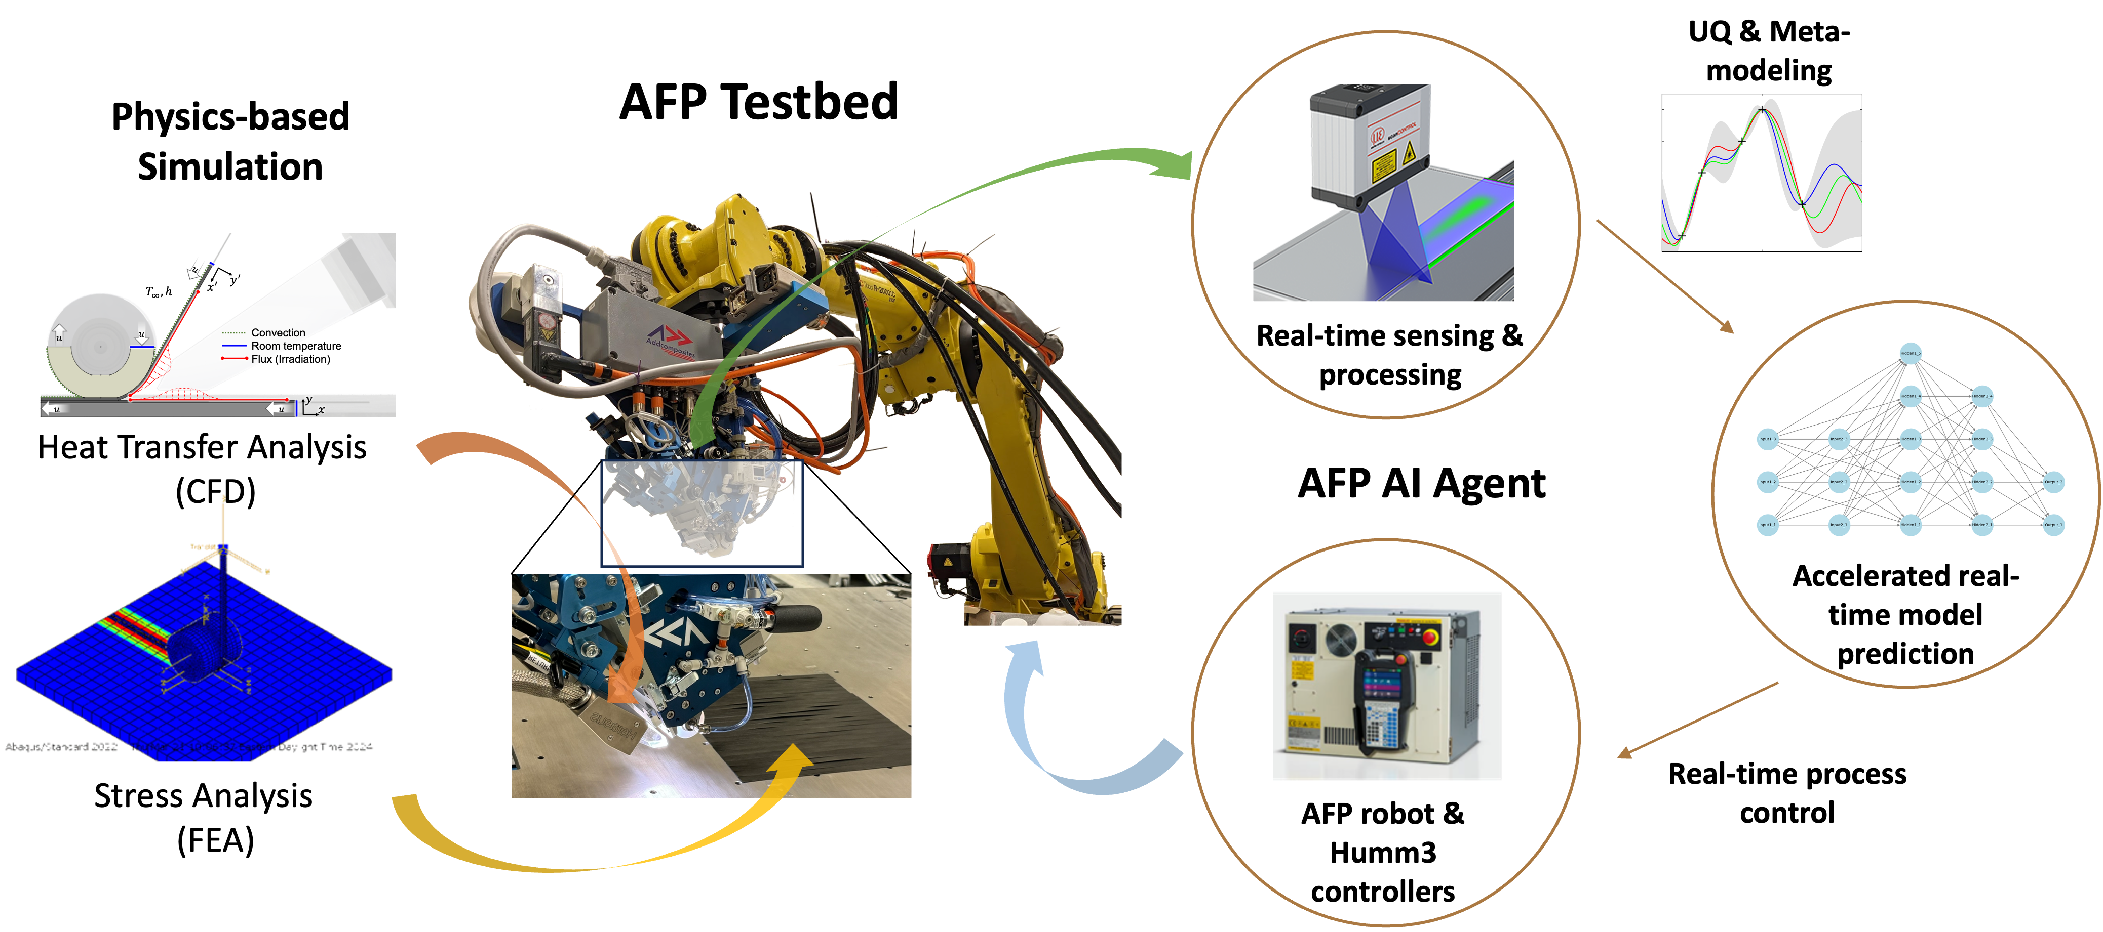
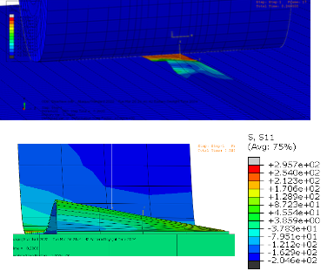
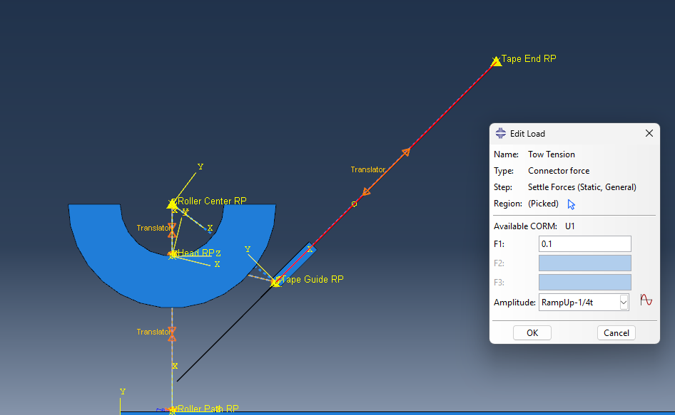

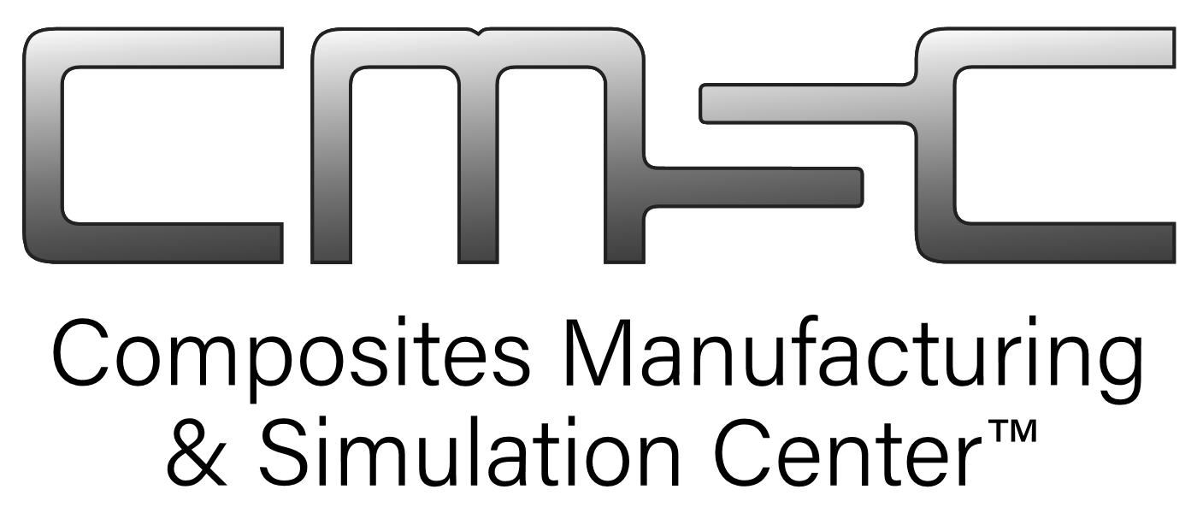
Matthew Glimcher, Yao Sun, Ryan Enos,
Tianxia Zhan, Dianyun Zhang
Automated Fiber Placement (AFP) Multi-Physics Digital Twin
AFP System & Sensors
Tape Placement Thermal Modeling
Stress Analysis Modeling Capabilities
AFP System
Temperature Dependent Tape Properties
Lead in and Tape Cutting
Tack is maximized at a specific temperature
  Balance of degree of intimate contact increasing with temperature and resin strength decreasing with temperature
Stiffness decreases with temperature as resin viscosity decreases, allowing fibers to slide past each other
Improves on previous models by simulating initial placement and tape cutting where many defects occur
Heat Flow Mechanisms
Small robot arm for pilot scale development
6 degree of freedom capability for complex laminates
Thermoset and thermoplastic tape laying
Conduction
  Tape, substrate, table, roller
Convection
  Tape to ambient air at fixed T
Radiation
  Input from heat source
Placement of Multiple Tapes
Online Sensors
Measure force on the AFP head
Monitor temperature and compaction pressure
Hight profile of the placed tape just behind the compaction roller
Computational efficiency improvements allow the simulation of sequential tape placement
ConvergeCFD Simulation
Force/torque transducer
Full energy transport equation
  Includes internal energy, pressure, thermal conductivity, viscous stress, diffusivity, specific enthalpy, and source terms
User Defined Field used to prescribe moving boundaries
  Allows the use of a much smaller simulation domain
Tape Placement on Curved Surfaces
Laser scanner
Temperature sensor
Pressure sensor
iTwin Process for AFP
Using the head’s moving reference frame allows the simulation of tape placement on curved surfaces
Stress Analysis Model
Tape Wrinkling
AFP Head Setup
Translator
Apply tape tension to this point
Demonstrated capability to predict tape wrinkling on curved tow paths
Kinematic coupling
Apply compaction pressure to this point
Summary
Kinematic coupling
Tape
Purdue CMSC’s AFP system provides high density data for iTwin feedback and validation
Thermal modeling predicts tape properties and tack during the placement process
Stress analysis modeling predicts tape behavior and defect formation
The modeling results are used to better understand and refine the process
Model based closed loop control can be implemented to mitigate defect formation
Roller
Thermal and stress analyses modeling feedback optimizes process design
Real time sensing allows for prediction based closed loop control to mitigate defects before they occur
High density data is used to refine and validate thermal and stress models for further optimization
Developed systems can be deployed commercially to improve part quality and yield
Translator
Apply motion path to this point
The head components are fixed together using connectors
Constrained relative to a point along the tow path that can be moved with 6 degrees of freedom
Connector forces are used to apply compression and tape tension in the moving reference frame of the AFP head
Can simulate tape placement with any tow path
NSF ERC for Intelligent Digital Twins (iTwin) for Advanced Manufacturing

