Slide 1
Critical Design Review
2021-2022 Season

Slide 2
CDR Schedule
9:50 -10:00: Arrival time
10:00 - 10:40: Ex-Dep presentation
10:40 - 10:55: Ex-Dep questions
11:00 - 11:40: Software presentation
11:40 - 11:55: Software Questions
12:00 - 1:10: Lunch
1:15 - 1:55: Drivetrain presentation
1:55 - 2:10: Drivetrain Questions
2:15 - 2:55: P&H presentation
2:55 - 3:10: P&H questions
3:10 - 3:30: Debrief with sub-teams

Slide 3
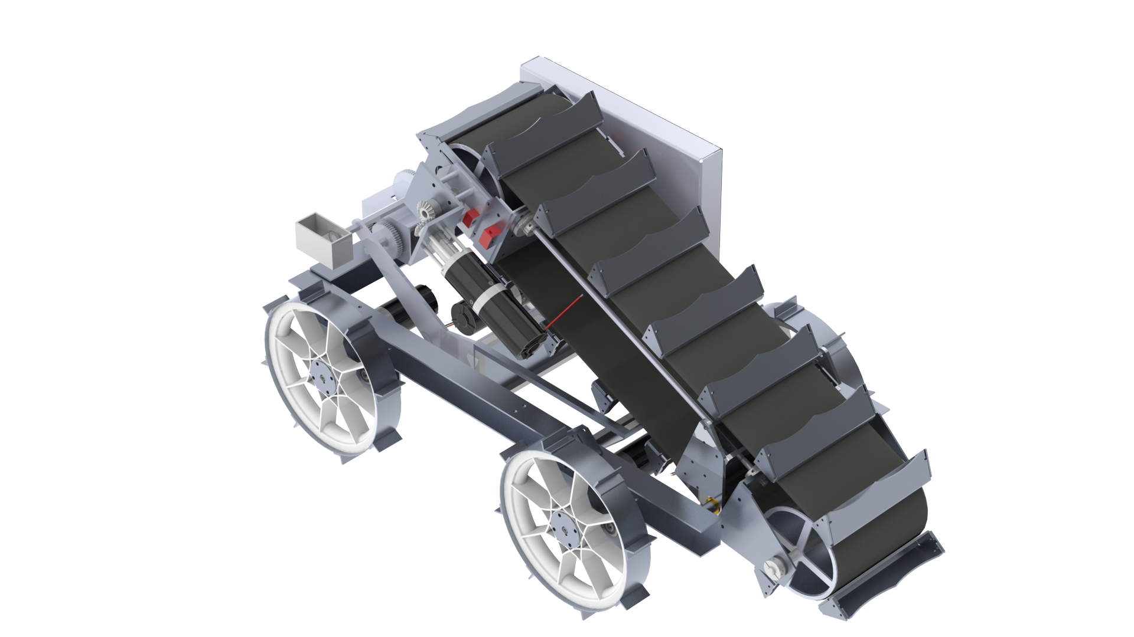
Overall System (Name: TBD)
Starting Configuration

Slide 4
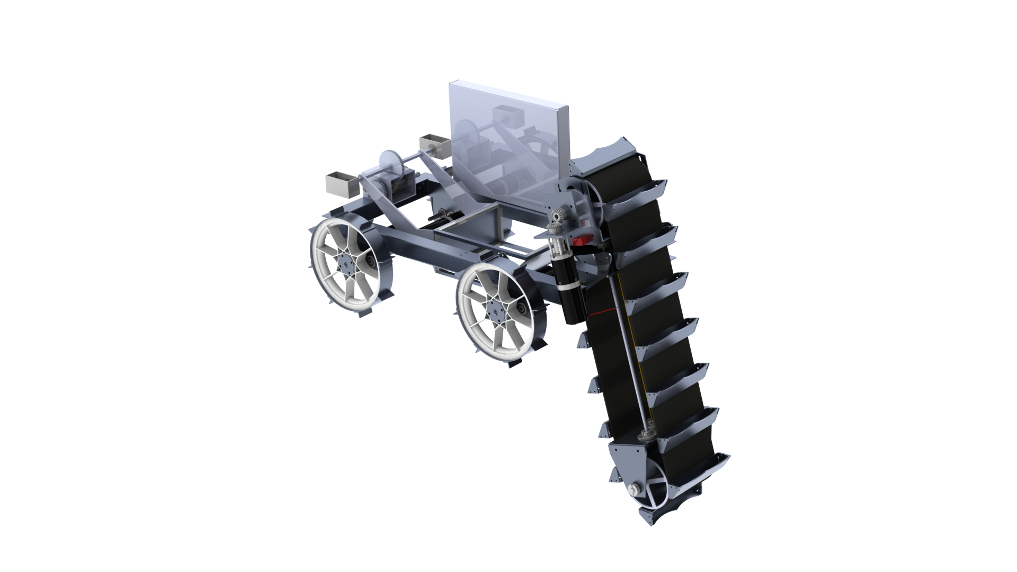
Overall System (Name: TBD) Cont.
Digging Configuration

Slide 5
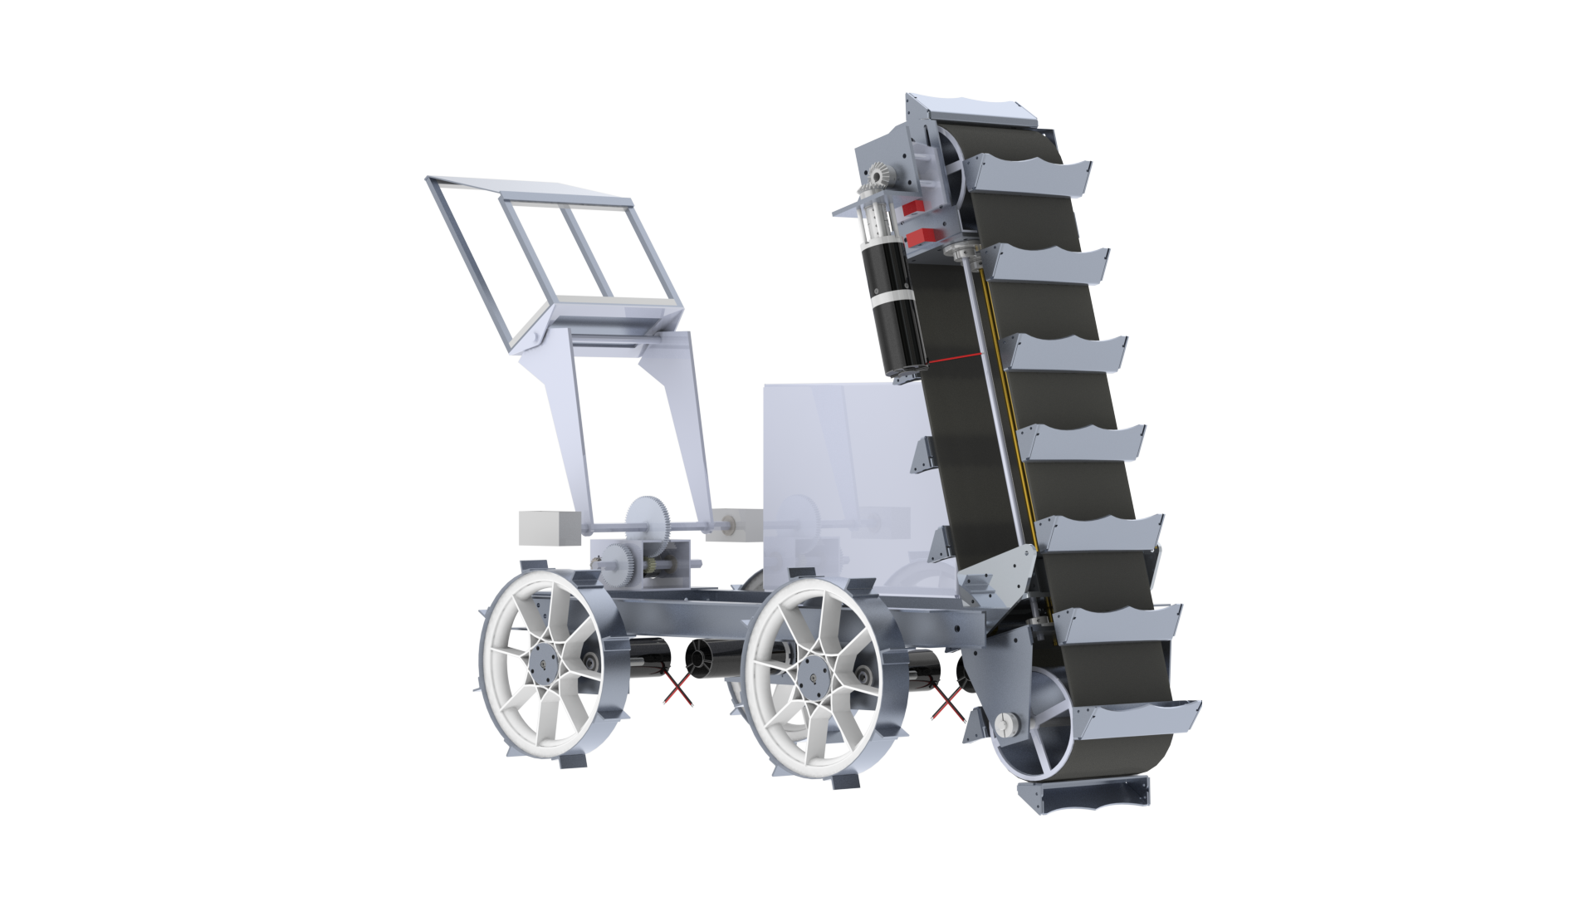
Overall System (Name: TBD) Cont.
Deposit Configuration
Next Steps
Remove a bucket to be well below 110 cm length requirement
  Current = 111.4 cm
Same case for 60 cm height requirement
  Current = 62 cm
Make minor changes/improvements with Ex-dep and Frame

Slide 6
Ex-Dep

Slide 7
System Requirements Overview
The Ex-Dep System will have a mass of no more than 30 kg.
Mining Tool (Excavation)
  The mining tool shall effectively penetrate the regolith and gravel layers.
  The mining tool should be able to reach the gravel layer within 30 s.
  The mining tool shall consume no more than 3 A while mining.
Gravel Depositing System (Deposition)
  The deposition system shall be able to hold 7 kg of gravel
  The deposition system should be able to deposit all stored gravel within 30 s.
  The deposition system shall consume no more than 1 A while depositing.
Tool Positioning System (Actuation)
  The tool positioning system shall be able to move the mining tool from its stored to mining configuration within 30 s.
  The tool positioning system shall be able to lower the mining tool into the ground at a variable speed.
Notes:
Josh

Slide 8
Design Goals
Increase functionality
  Mining speed
  Extension length and speed
  Storage capacity
Improve reliability
  Fewer instances of jamming or other issues
Reduce weight
Improve manufacturability
  Manufacturing speed
  Machine and operation complexity
Notes:
Josh

Slide 9
Design Plan (Overarching)
Excavation - Bucket Elevator
  Switching from chain and sprocket to belt and drum
  Mostly hollow system to accommodate Actuation
  Moving parts are concentrated at the ends
  New bucket shapes are being explored
Actuation - Internal to Excavation
  Uses a lead screw centered laterally in Excavation
  Lead nut fixed to the chassis rotates around a translating lead screw
  Uses two non-threaded guide rails as stabilization and support
  Side-mounted linear actuators used for rotation
Deposition - Counter-rotating Fixed Arm
  Sticking with a bin pivoting off the back of the robot
  Bin is attached to the arms by a passive, secondary pivot point
  Allows the bin to remain horizontal until the moment of dumping
  Hard stops prevent over rotation in either direction
Notes:
Josh

Slide 10
Excavation

Slide 11
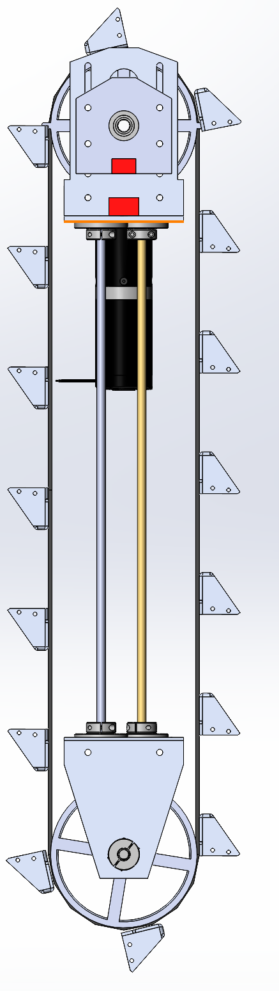
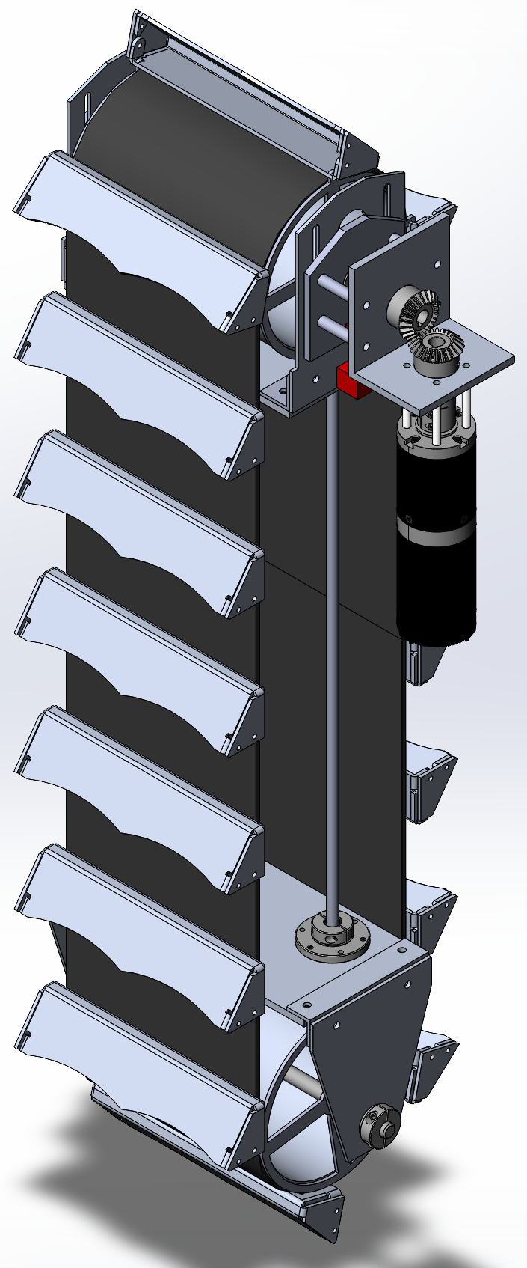
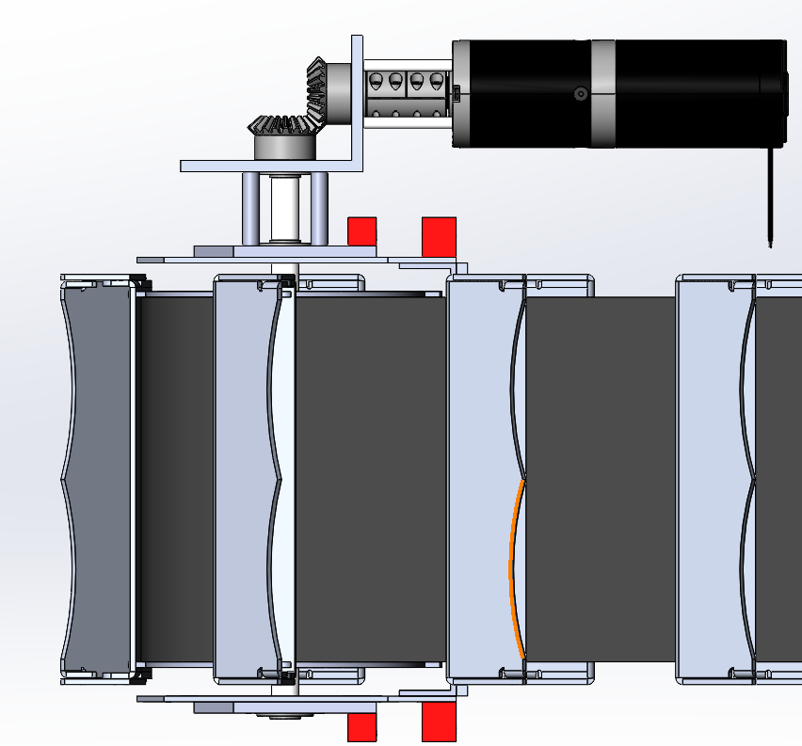
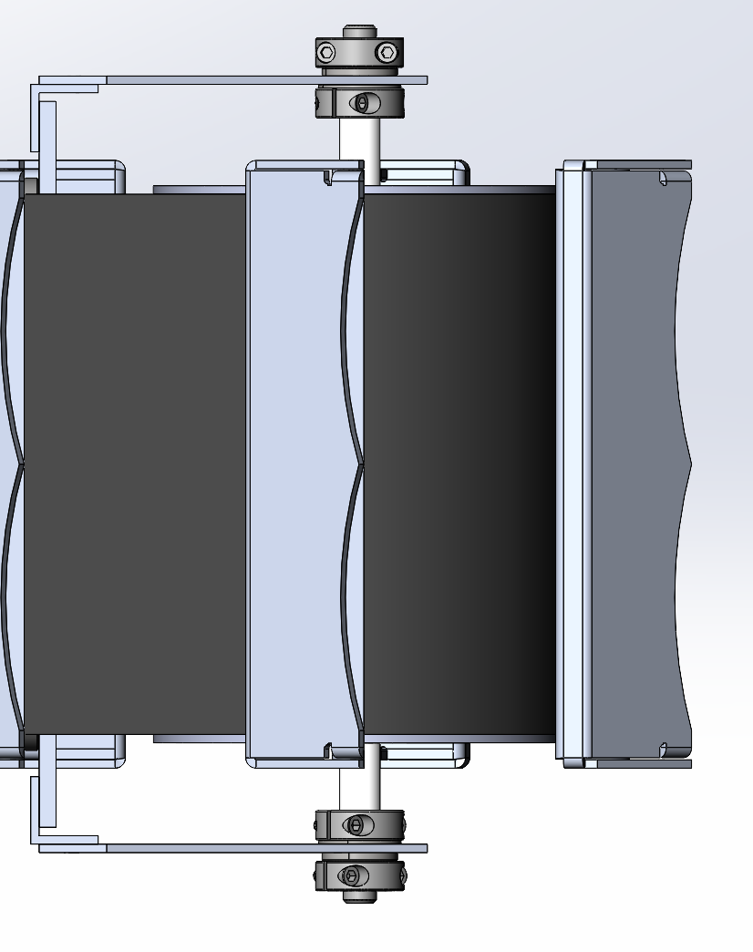
Overall Structure
Top Drum
Bottom Drum
*Note: The motor will be rotated 180 degrees from the orientation shown here.

Slide 12
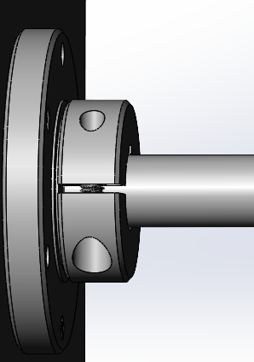
Attachment Mechanism of Rod and Lead Screw
Both will be attached to the base plates with a flanged shaft collar as shown
Due to actuation switching to use the NEMA Motor the lead screw no longer rotates and there for a bearing is unnecessary
The flanged shaft collar allow for part reduction as it removes the need for a shaft collar on the opposite side of the plate
All rods will be compressed by the drum mount plates

Slide 13
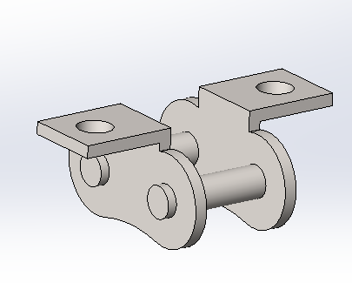
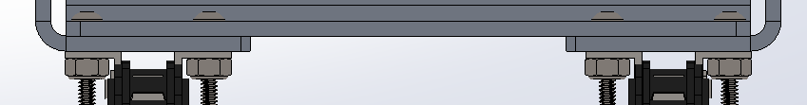
Problems With Chain
Problems encountered last year
  Chain attachment was complex requiring replacing chain links with attachment links
  Compounding manufacturing errors resulted in the misalignment of the sprockets causing the chain attachments to also be misaligned
  Assembly process was time consuming
  Added a significant amount of weight to the system
Notes:
John B.

Slide 14
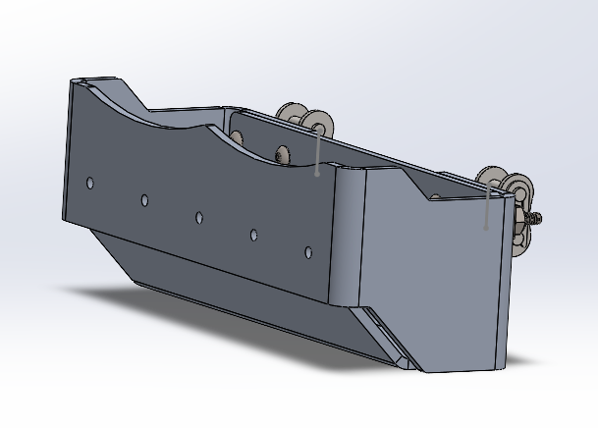
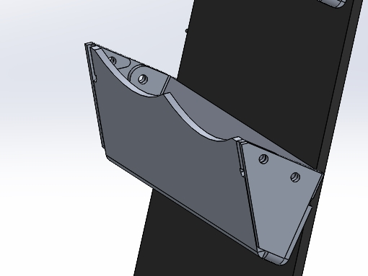
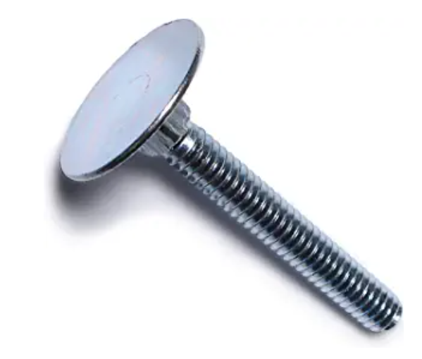
Bucket Re-Design
Problems with Old Design
  2 piece design requires high precision in angles for hole alignment
  Due to the inherent inaccuracies of bending the two halves did not fit together well
Benefits of New Design:
  Made of a single piece of ⅛” 3003 Aluminum
  All bending errors can be remedied during the initial bending process to force alignment
  The holes in the interior tabs will be drilled after the bending process to guarantee alignment
  The attachment holes will only be through a single layer therefore the alignment of the holes to the belt is not dependent on bending accuracy
  Will use Elevator Bolts to attach to belt
Old Design
Interior Tab
New Design
Notes:
John B.

Slide 15
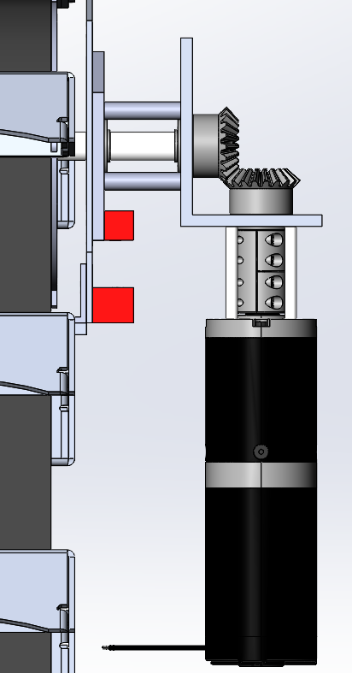
Motor Used and Placement
Motor
  BDPG-60-110-24V-3000-R47
  Anaheim Automation 24 V DC
  Brushed Planetary Motor
  Max Continuous Torque: 29.4 N-m
  Rated Speed: 53 RPM
Placement
  Using Bevel Gears to place at a 90 deg angle from shaft
  Spacers and L-Chanel used to provide clearance between other systems
Old Design
New Design

Slide 16
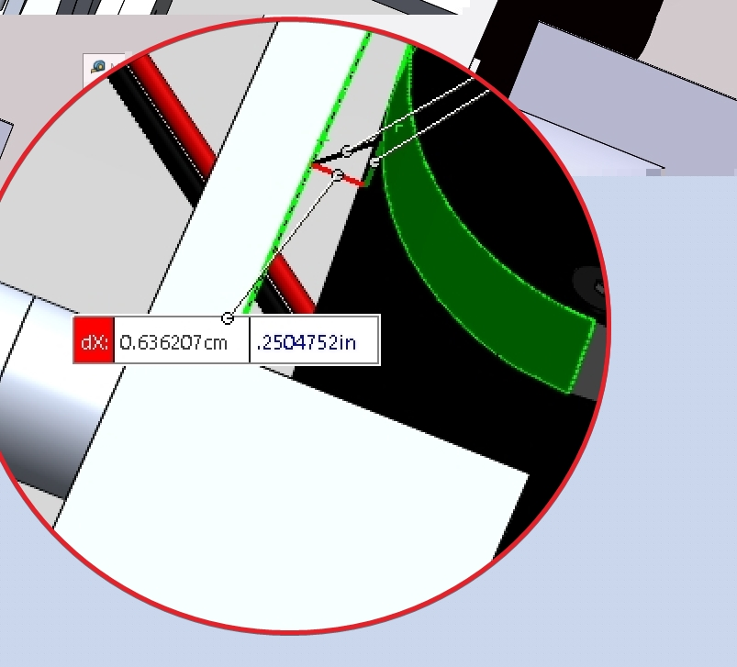
Motor Integration
Motor would hit the right chassis of the robot at the front
  Cut-out made to fix the issue
  Approx 1.5” x 2.5” from the front
Will contact Frame team to re-do worst case digging force FEA to see the uneven load distribution

Slide 17
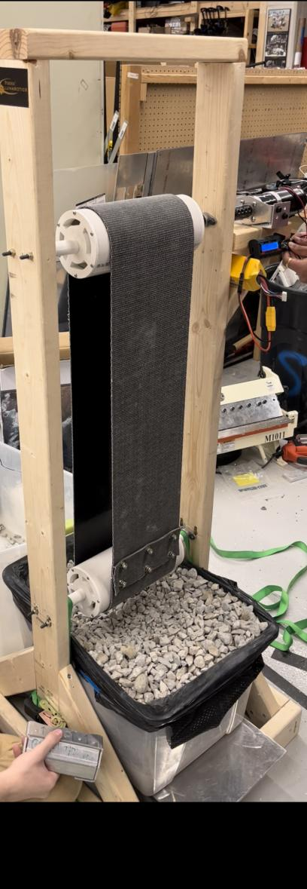

Bucket Elevator Test Stand in Y (BETSY)
Built a test stand to learn the sigfigance of slipping effects between the belt and the drum and the amount of force needed to tension the belt properly
Roughly Approximates final Excavation system
Differences to Note:
  Mining angle will be approximately 15 degrees not vertical
  Drums in test stand are 4in PVC real system will be Aluminum pipe

Slide 18
Main Results
Minimum Belt Tension: 3,829 N (860.7 lbf)
Torque at Slip under Min Tension: 3.97-4.52 Nm
Peak Torque (After Slip): 14.66 Nm
Rated Motor Torque: 4.71 Nm
Motor Stall Torque: 29.42 Nm

Slide 19
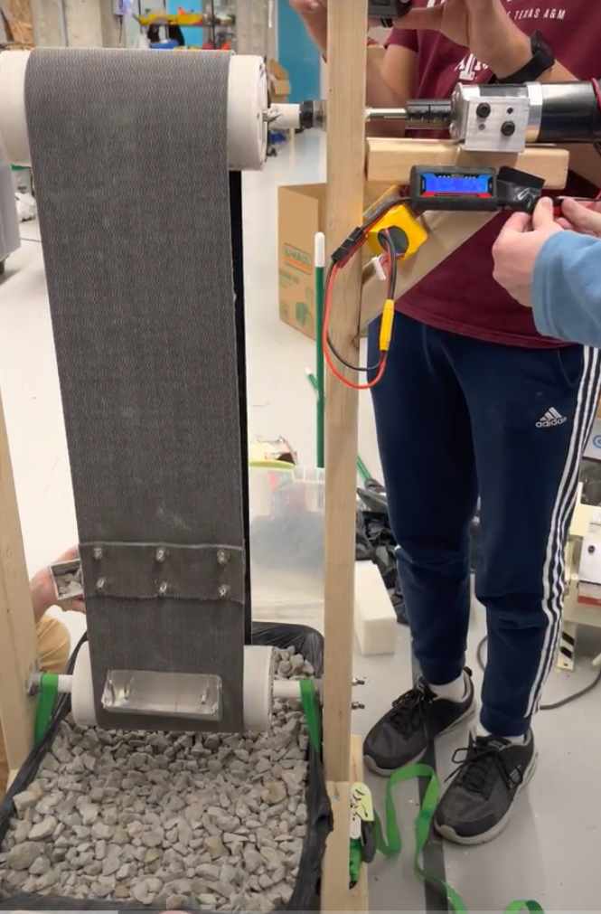
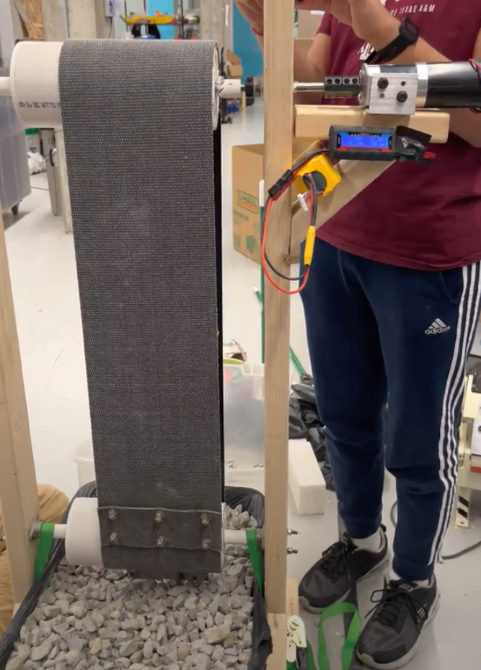
Belt Slipping Issues
Old Design
Horizontal Slipping
  Over time the belt would shift to the edges of the drum
  We believe this is due to shaft not being straight but is ultimately inevitable
  Distance slipped horizontally was proportional to time
Belt shifted right
Belt Centered
Test Approx 1 min
Before Test
After Test
Notes:
Min Thaw Ko (Danny)

Slide 20
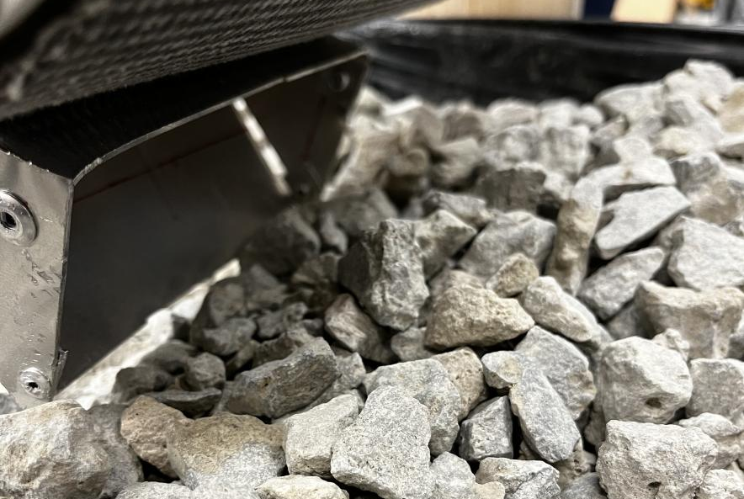

Issues we faced (cont)
Trial 1 Belt slipping
Old Design
Belt Completely Slipping from Drum
  When encountered large amounts of gravel the belt would stop moving forward but the drum would continue to rotate
  In other words the limiting factor during these test was not the motor, it was the friction between the drum and the belt
  Sometimes it wasn't the amount of gravel but the arrangement of the gravel that caused the stoping
Notes:
Min Thaw Ko (Danny)

Slide 21
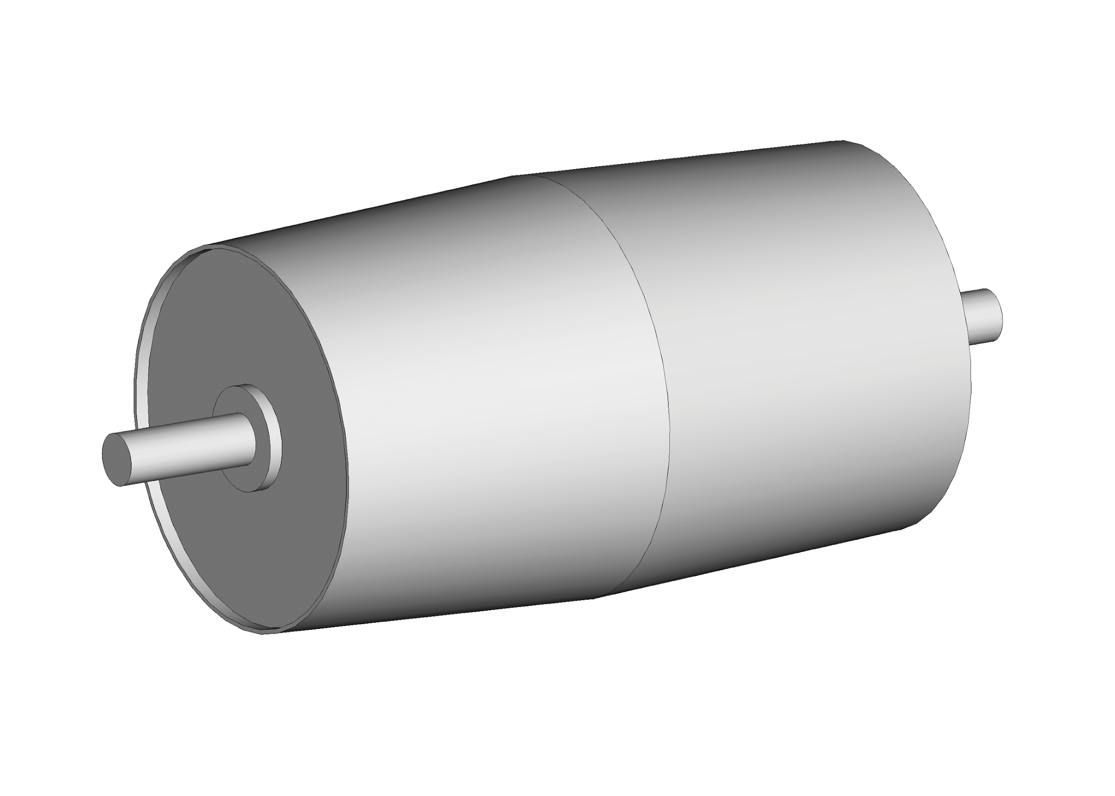
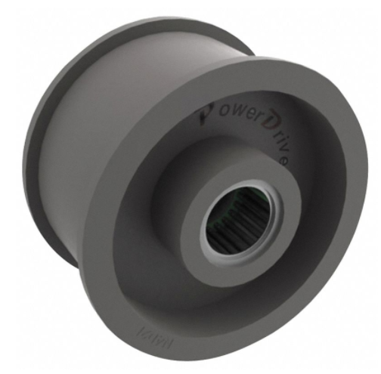
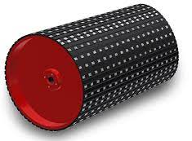
Possible Methods to Resolve Belt Mining Issues
Slipping
  Horizontal Slipping
    Convex crowning
    Flanges on the hubs of the drums
  Total Belt slippage
    Adding lagging to increase the friction between the belt and the drum
    Providing an additional mechanism to drive the belt that is not dependent on friction
Convex crowning
Flanged Drum
Lagging
Notes:
Min Thaw Ko (Danny)

Slide 22
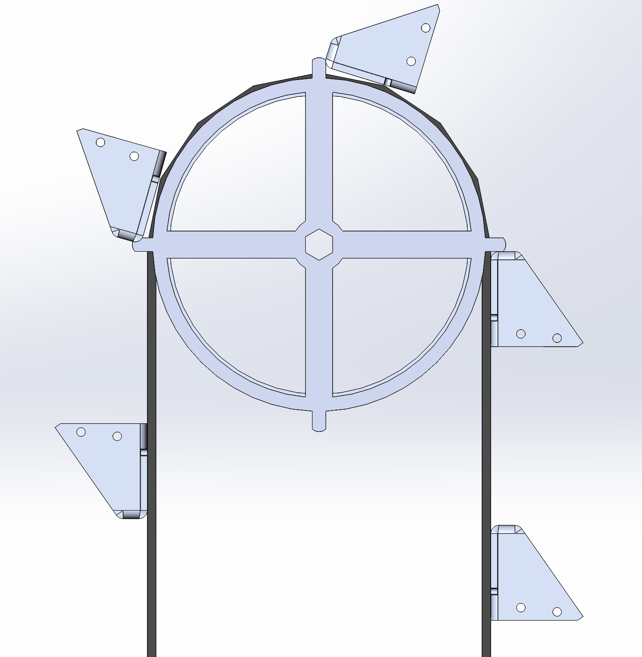
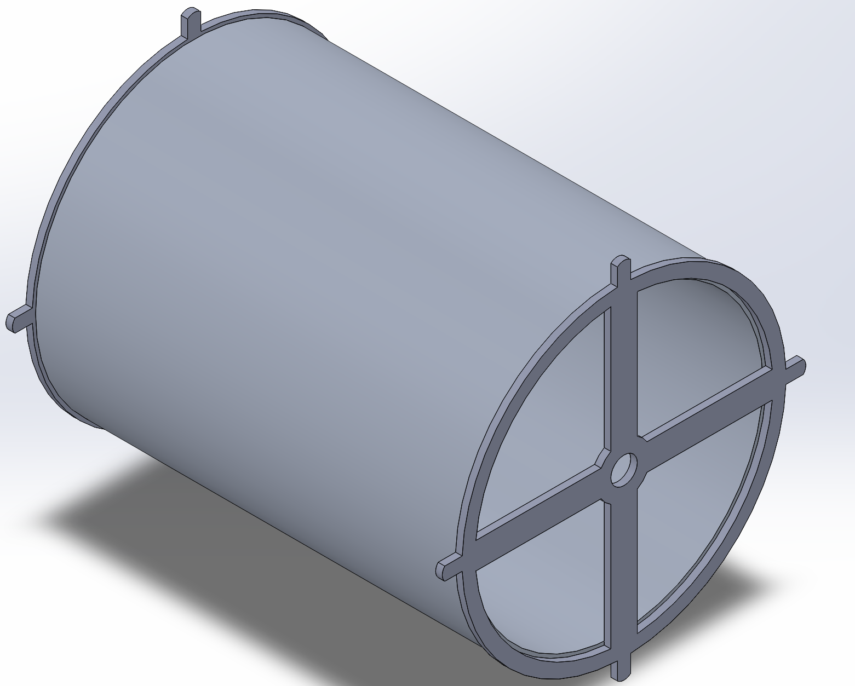
Drum Design
Drums
  will be made of 6” OD ¼” thick 6061 aluminum pipe
Hubs
  Made of ⅛” 6061 aluminum will be welded to the side to the pulley
  Features a ⅛” flange to stop horizontal motion of the belt
  Spokes provide a secondary method of pushing the belt forward by pushing on the back of the buckets to move the belt forward
    Similar to if you were to push the buckets around with your hands
Spoke

Slide 23
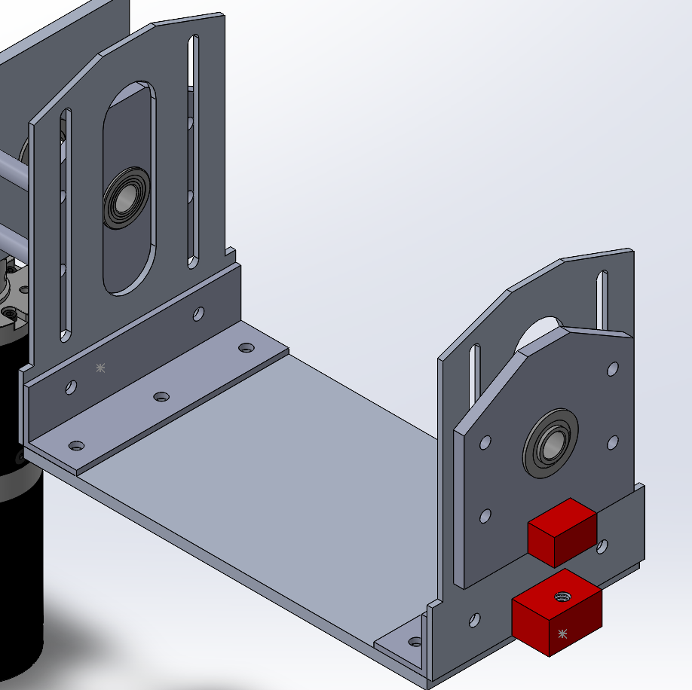
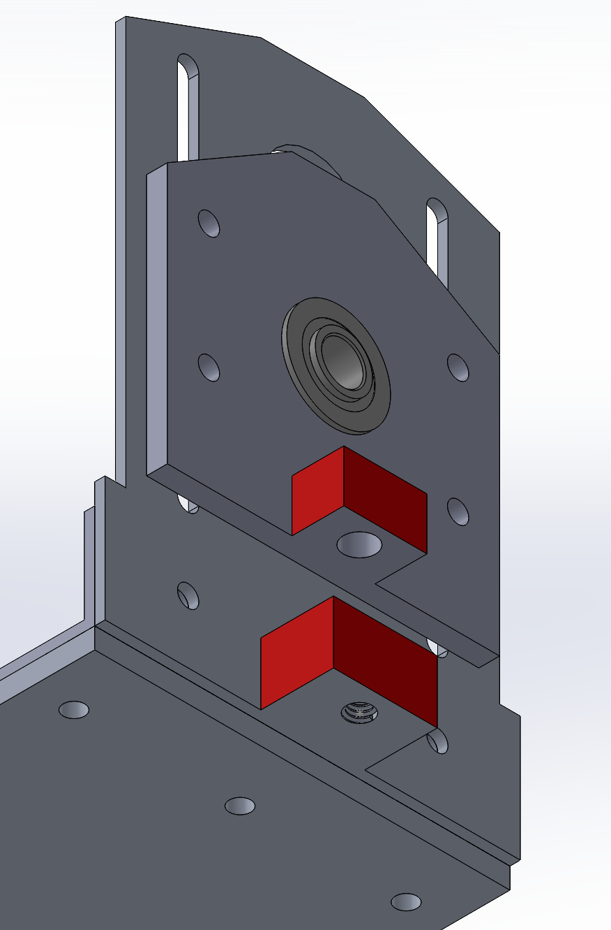
Tensioning System
This system is used to adjust the tension of the belt via bolts
  Two bolts are used, one on each side of the system
  Each bolt is screwed into the outer sides of the plates (marked in red) with the top facing down.
  As the bolt is tightened, the plate is pushed up on the system which adds tension to the belt

Slide 24
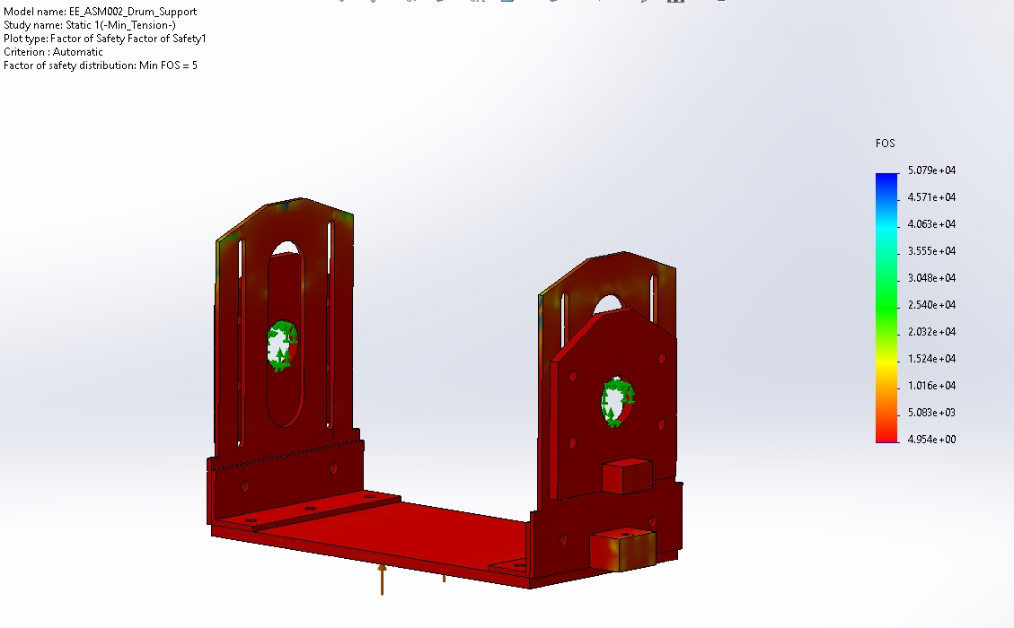
Drum Tensioning System FEA (FOS)
450N applied (absolute maximum)
FOS 5
450N

Slide 25
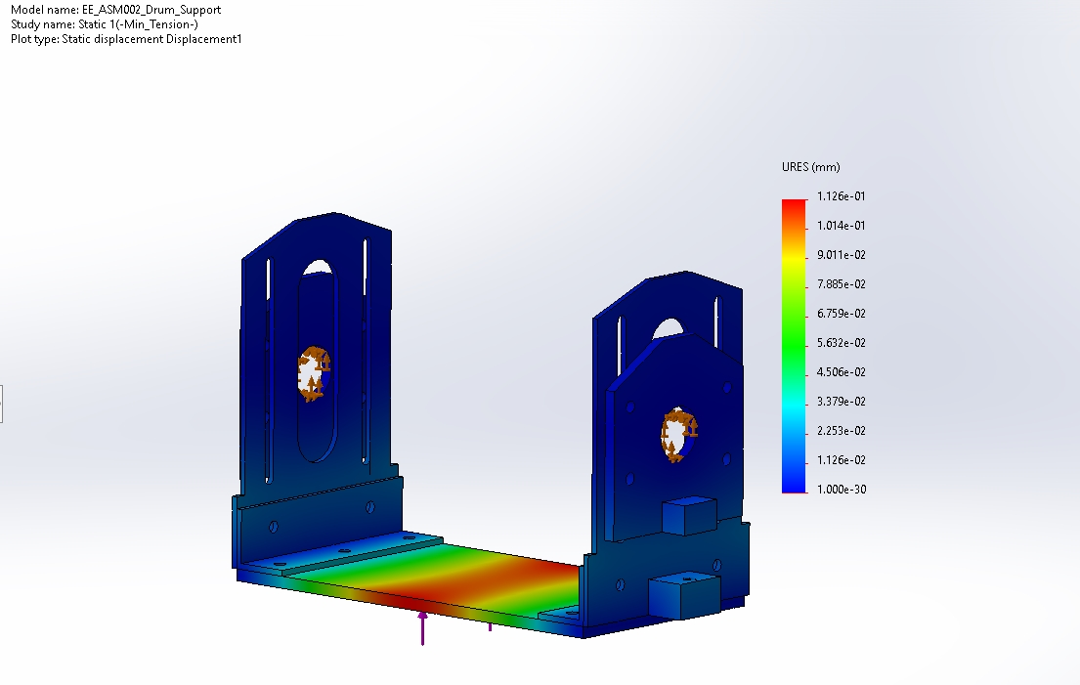
Drum Tensioning System FEA (Displacement)
450N applied (absolute maximum)
FOS 5
< 1mm deformation
450N

Slide 26
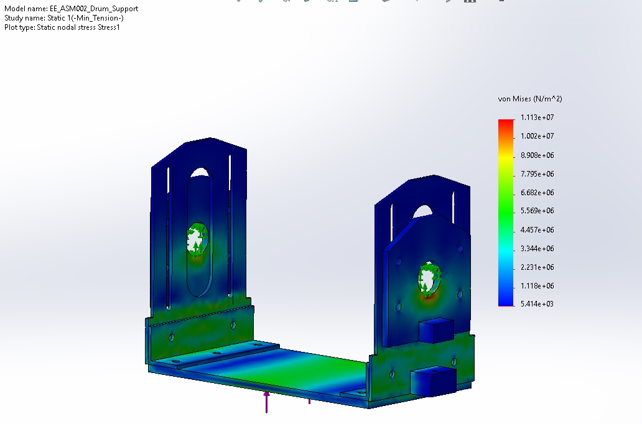
Drum Tensioning System FEA (Von Mises)
450N applied (absolute maximum)
FOS 5
< 1mm deformation
Large stresses near holes
  Normal behavior
450N

Slide 27
Actuation

Slide 28
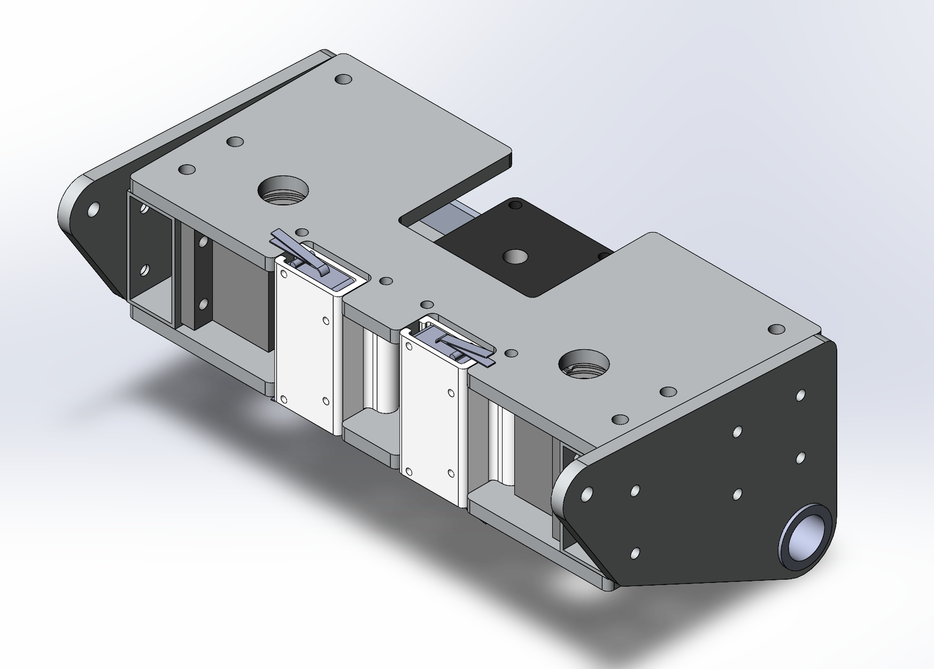
Box Structure
Steel tubing for the side structure
1/4” 6061 plates
3D printed limit switch mounts
Final motor choice: NEMA

Slide 29
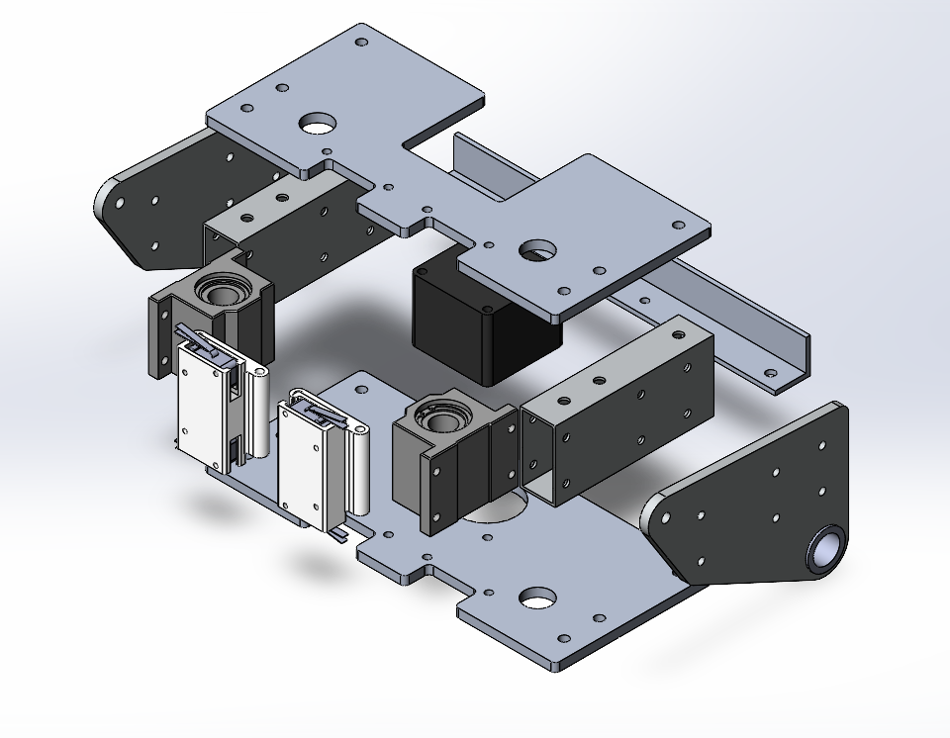
Exploded View of the System

Slide 30
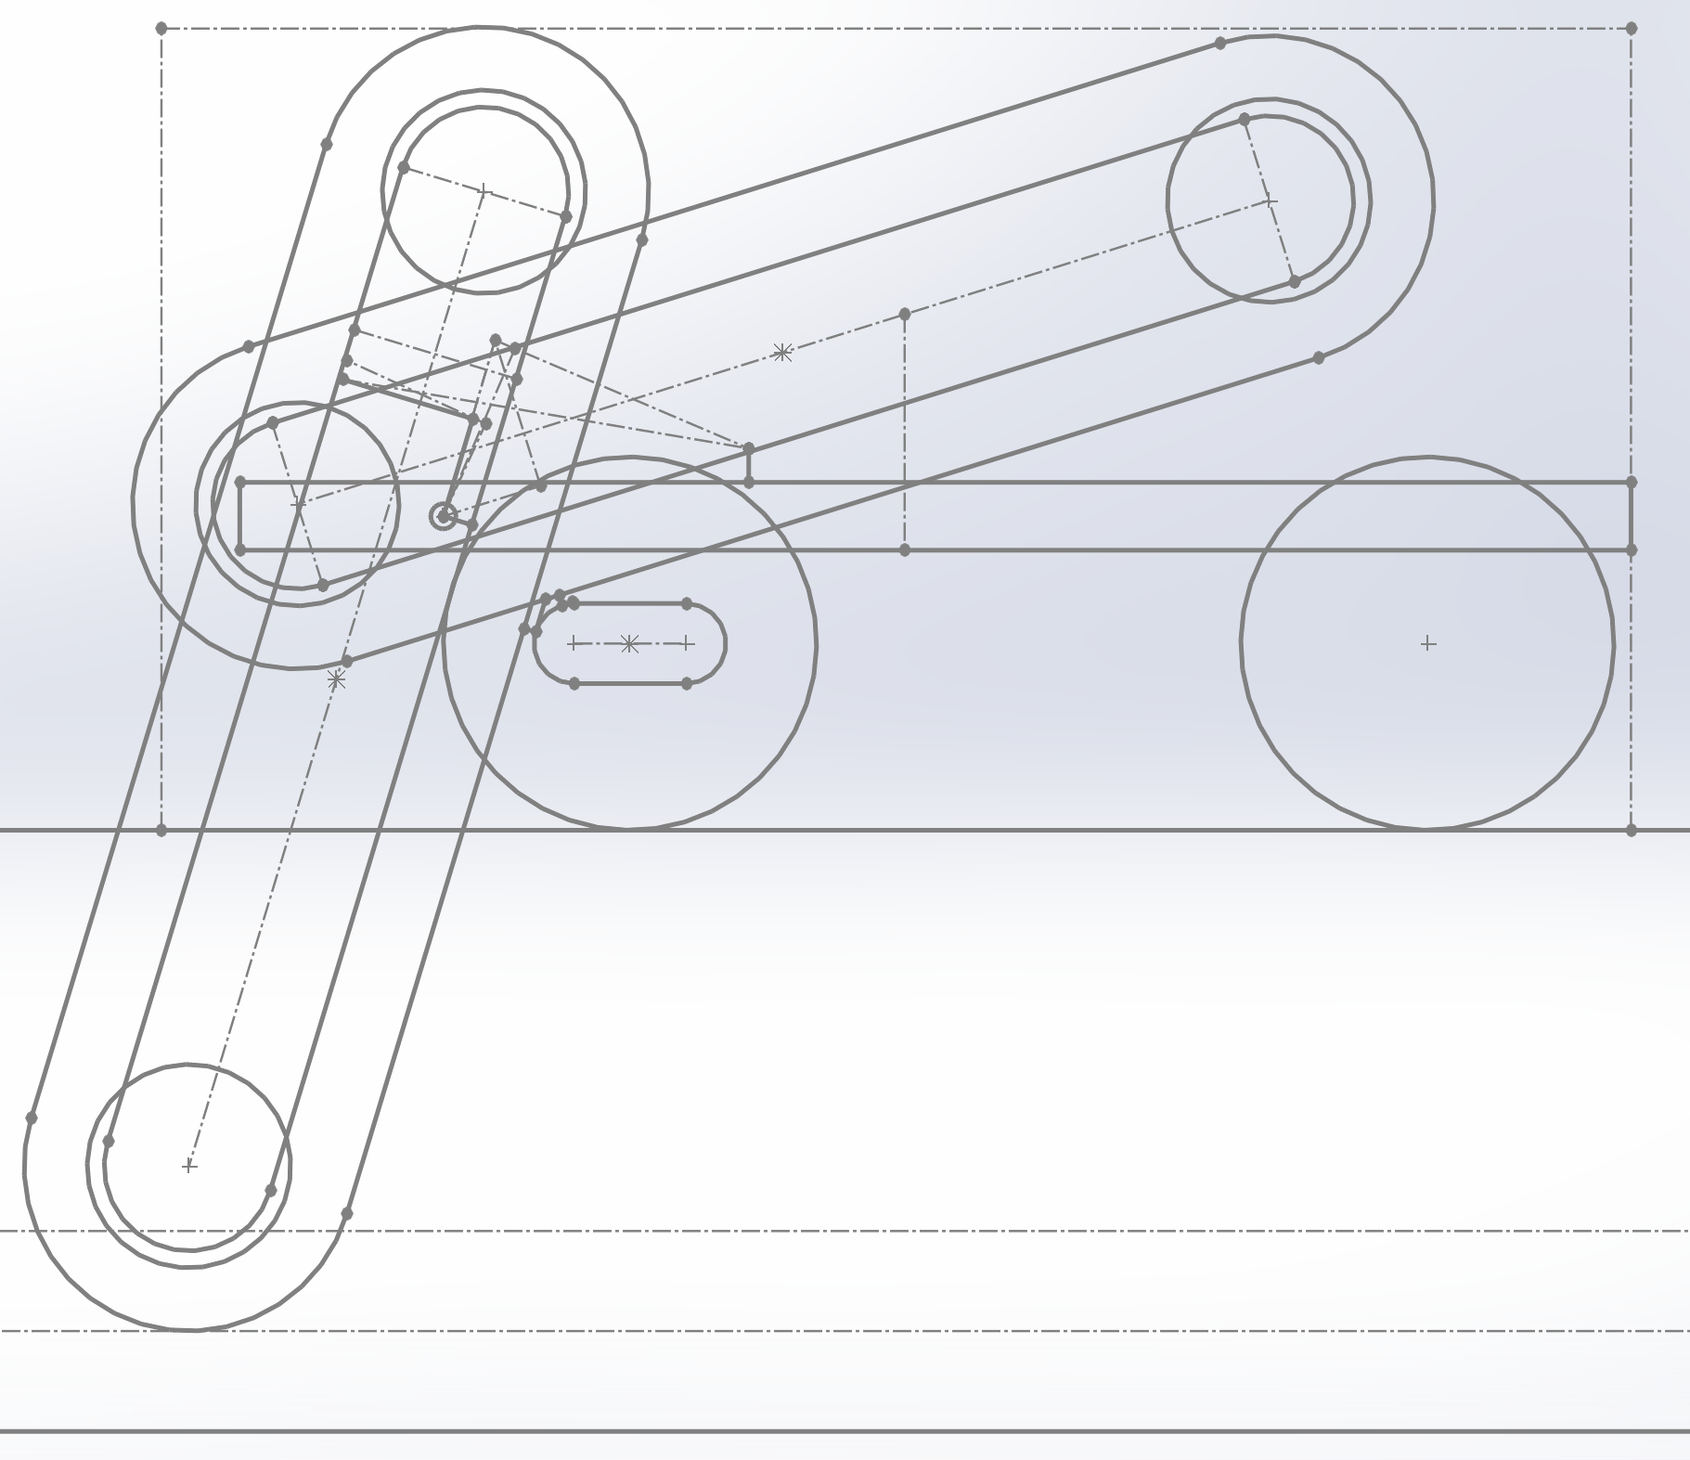
Mount Placement Models
Took a variety of inputs to geometrically validate design decisions
Calculated the required force needed to move the system from storage position
Max force of 370N needed from each linear actuator

Slide 31
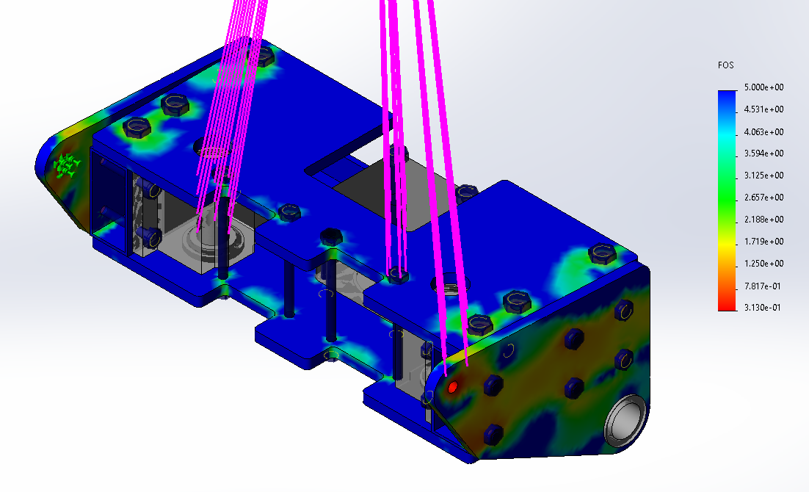
FEA
FOS diagram with a 17 kg load in the storage configuration direction
Minor design changes are needed

Slide 32
System Specifications
Motor - LM23 NEMA 23 3.0 A 1.8° Non-captive Linear Stepper Motor with ⅜” lead screw
PA-14-4-150 4 inch linear actuator
5 kg (11 lb) approximate mass
Mining depth: 44cm
Minimum deploy time: about 10 seconds

Slide 33
Deposition

Slide 34
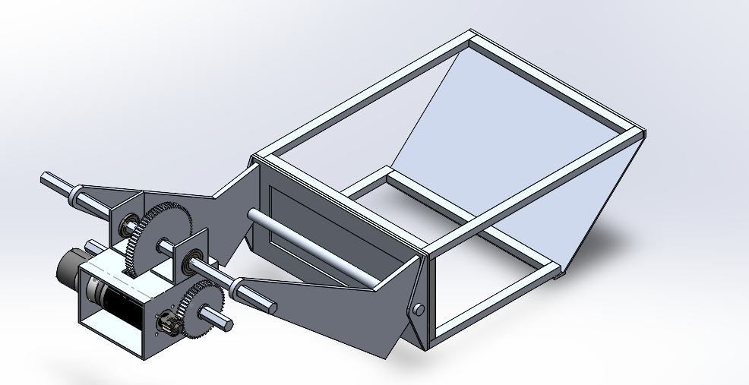
Changes since PDR and Overview
No more translate/rotate rail system!
Moving back to a fixed pivot point system
Problem of bin dumping too early now solved by adding pivot point between arms and bin
Same motor since PDR
System Mass so far: 3.3 kg (not including shaft collars, spacers, brackets, bearings, motor)
Cost so far: $302.60

Slide 35
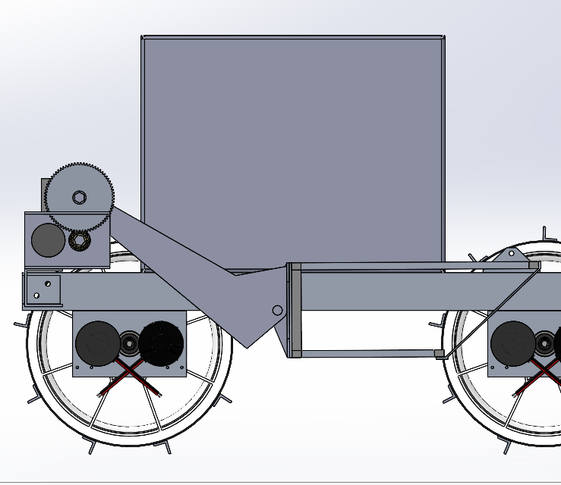
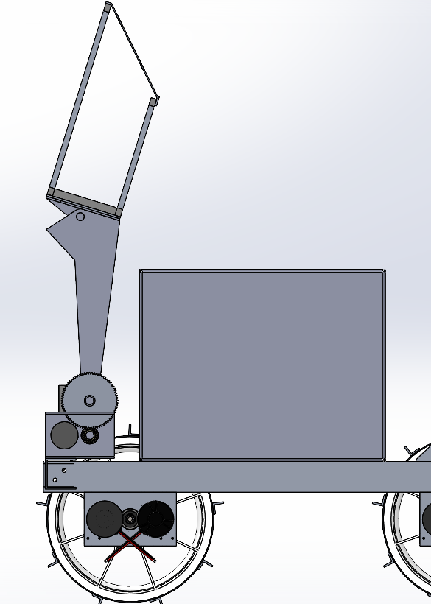
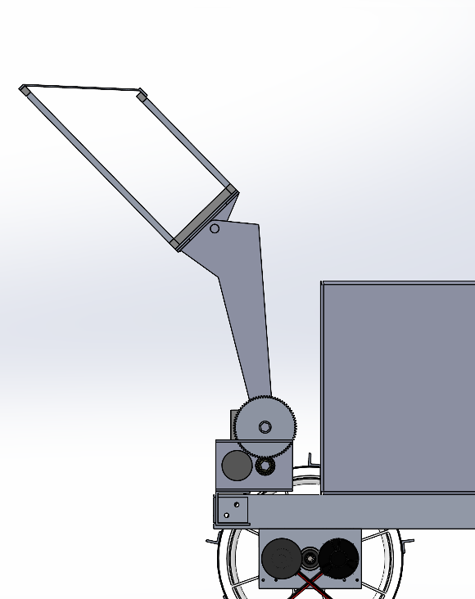
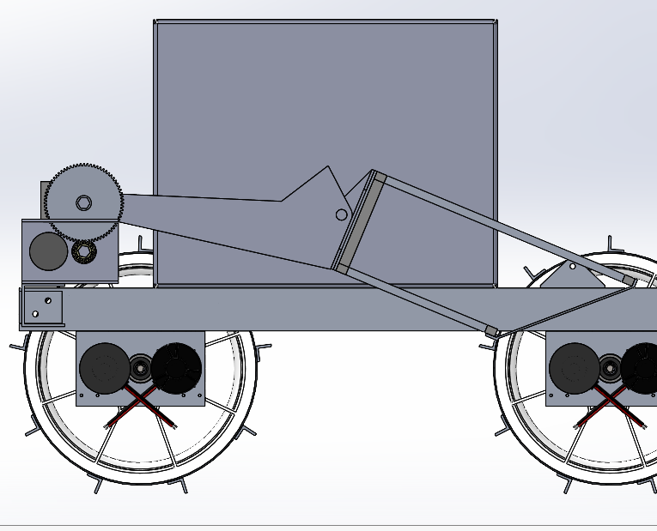
Design Overview - Counter-Rotating Fixed Arm

Slide 36
Motor Torque Calculations
10 kg load at bin center of mass
Gravity = 9.8 m/s^2
Distance from center of mass to pivot point is ≈ 0.46 meters
Gearbox with 12.5 reduction
  (16:50 connected to 18:72)
Motor max torque = 6.3 N-m
Bin torque at pivot = 10 * 9.8 * 0.46 = 45.08 N-m
Motor torque at pivot = 6.3 * 12.5 = 78.75 N-m
Max motor torque / load = 78.75 / 45.08 ≈ 1.75
Torsion spring could balance out bin weight and further improve factor of safety

Slide 37
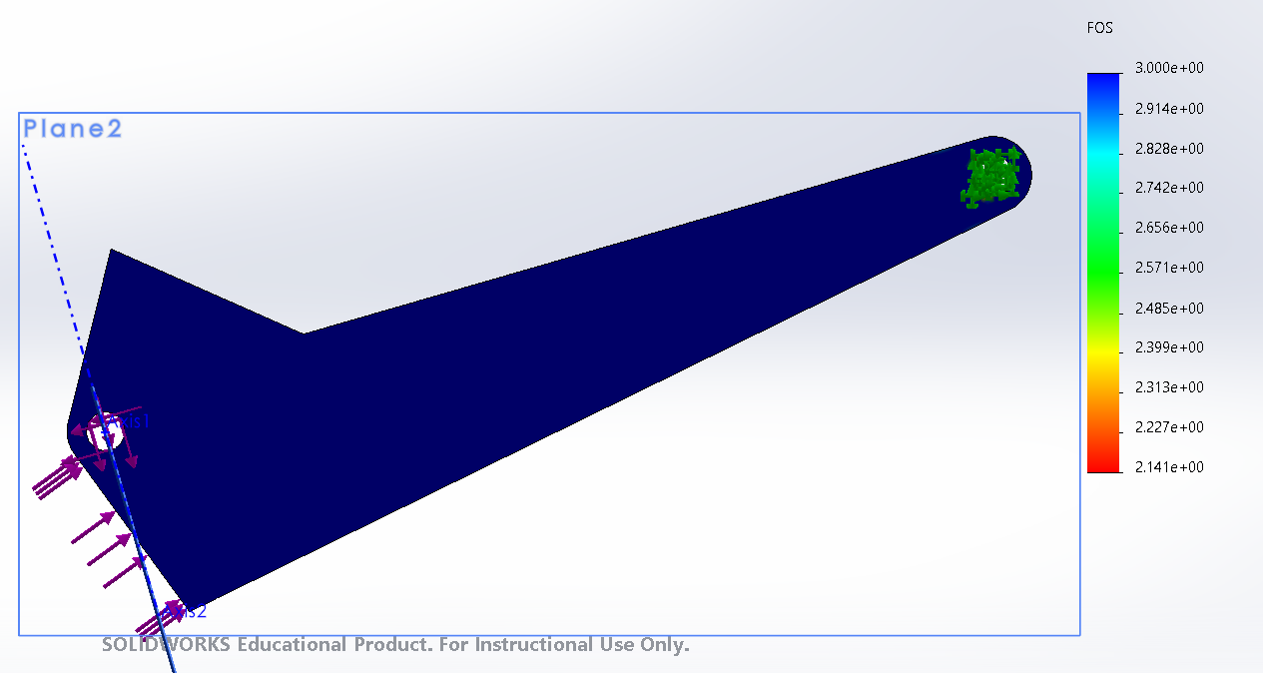
Arm Forces

Slide 38
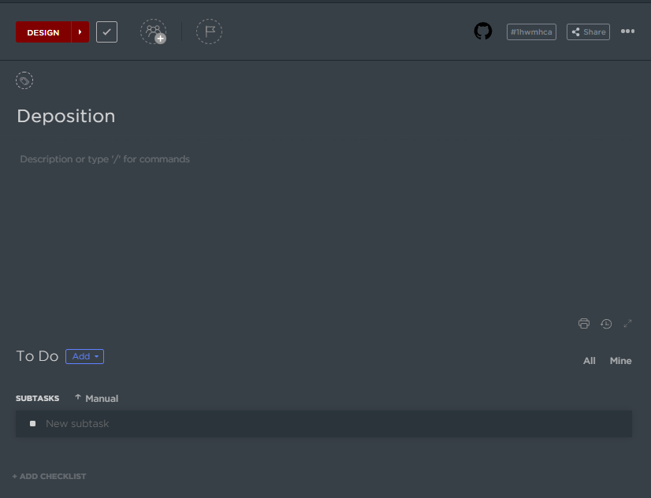
Things To Finish Up
Add mounting holes for Drivetrain
Add spacers and shaft collars
Add brackets
Shorten shafts
Use Clickup
Add parts to BOM
Modify the bin to catch gravel better

Slide 39

Future Considerations
Discuss with Excavation and Software on removing a bucket to prevent bin from hitting while depositing
Designing bracket to hold bin and measure weight using load cells
Optimizing a torsion spring to reduce motor stress while still working with load cells
Sensor placements

Slide 40
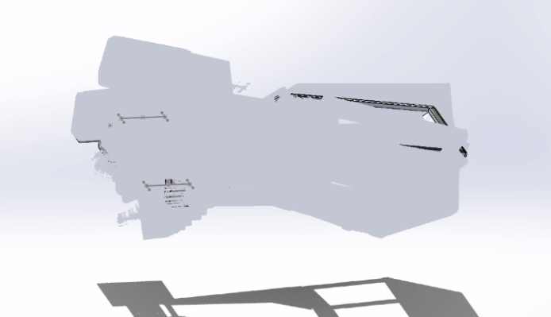


Communication
Thanks for keeping up with communicating with us about what you need from us and your changes!
We will try to get back to you as soon as we can!

Slide 41

QR Code (Scan for ipod shuffle raffle!!!)

Slide 42

Software

Slide 43
System Requirements Overview
Localization
  Shall be able to localize its position
  Shall be able to traverse the field autonomously
    Accuracy should be within ~0.8 m at all points (upper bound)
  Shall be able to perform autonomous obstacle detection and avoidance
  Shall only proceed mining process in the mining area
Navigation
  Shall localize obstacles within 0.05 m with > 70% accuracy (dependent on drivetrain)
  Shall plan a collision-free path to target location
Communication
  Shall provide robot health information to operators
  Shall use less than 2 MB / second when in manual control
  Shall use less than 200 KB / second when in autonomous

Slide 44
Sensors / Feedback
Drivetrain
  Encoders (4 total):
    1 for each drivetrain motor to control wheel velocity
Excavation
  Current Feedback on Digging Motor:
    For preventing motor stalling and determining if we should move
Actuation
  Limit Switches (6 total):
    2 for stopping left linear actuator (full extension and halfway)
    2 for stopping right linear actuator (full extension and halfway)
    2 for lead screw actuation (full extension and zero extension)
Deposition
  Limit Switches (2 total):
    2 for stopping deposition movement
  Weight Sensor:
    For determining when enough gravel has been mined

Slide 45
Sensors / Feedback (cont.)
General Sensors
  T265 Camera:
    Purpose to implement intrinsic localization and apriltag detection (extrinsic localization)
  D435 Camera (2 total):
    Used for obstacle detection and apriltag detection (extrinsic localization)
  Lidar:
    Utilizing for obstacle detection
  Bluetooth Sensor (4 total):
    For extrinsic localization

Slide 46
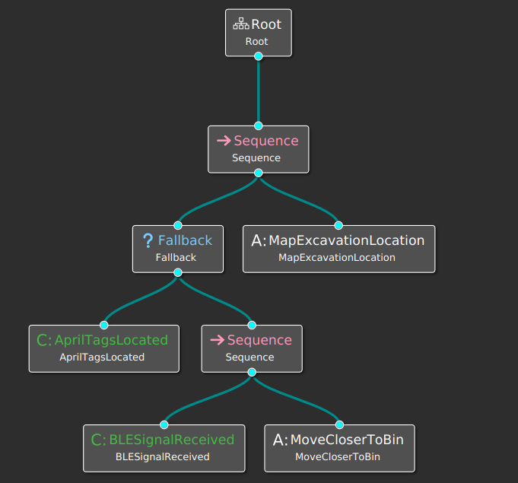
High-Level
Behavior Tree:
  Coded in C++:
    Able to do more than Groot
    Slower to complete and edit the tree
  Built in Groot:
    Quick changes can be made and good for collaboration
    Faster and easier to understand than C++
    Does not have as many features
Edge Cases:
  Including Unplanned Possibilities:
    Prevents robot from getting stuck at common points of failure
  Hard Coding Routines:
    Easier way to get out of complex situations
    Useful to get unstuck when there are repeated failures

Slide 47
Mid-level
Localization:
  Extrinsic Localization (robot -> bin (pose), accurate, lower-frequency data source)
    Utilization of Apriltags to detect bin position
    Utilization of bluetooth signals for rover navigation (trilateration)
  Intrinsic Localization (starting location -> robot (pose + twist), unreliable in long term due to drift over time, high-frequency data source)
    T265 Localization camera
    Encoders
  Each final output is the sensor fusion of multiple sensor inputs, adding robustness
  Positive and negatives of each localization system cancel each other out
Notes:
Need to see if camera for optical flow can be added to design

Slide 48
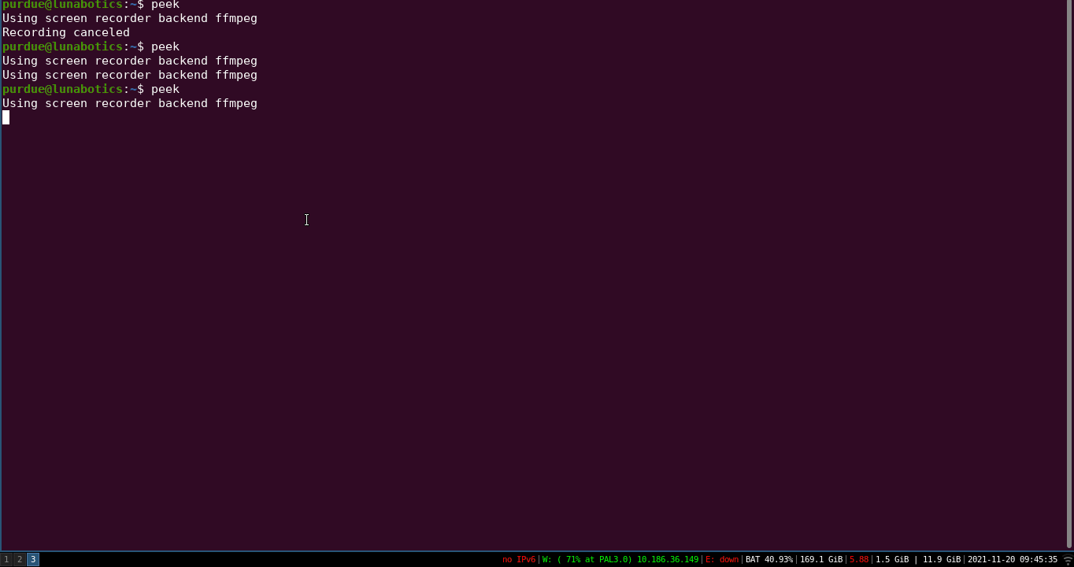
Intrinsic + Extrinsic Localization

Slide 49
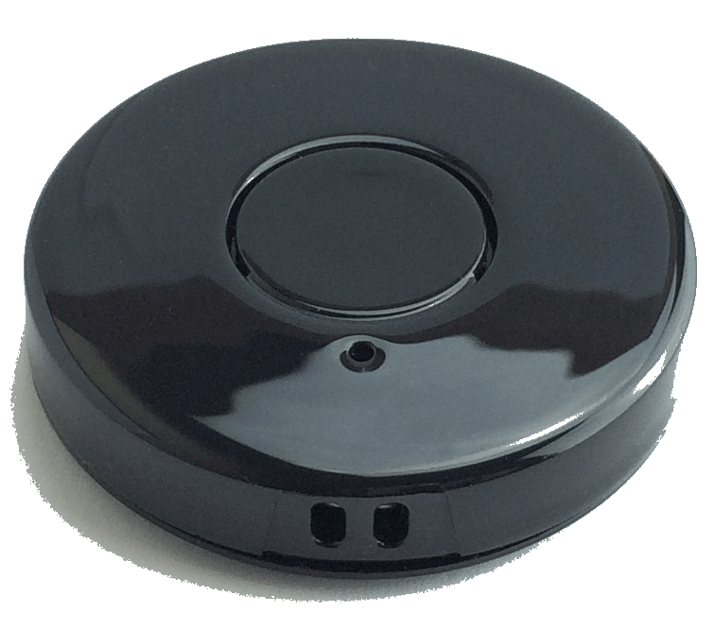

Localization: Bluetooth Beacons
Specifications:
  Model:
    iBeacon BC037S BLE 5.0
  Information Provided by Bluetooth Beacon:
    UUID (Universally Unique Identifier)
    TX Signal Strength (-23 ~ 4 dBm
      (max 2.5 mW and NASA limit is 2.5 mW EIRP)
    Broadcast Intervals (Manual/Continuous)
    Transmit Distance (Up to 50 m)
  Customizable via Eddystone App:
    Beacon Name
    Signal Detection Strength
    TX Signal Output
  Placement and Implementation:
    3 located around collection bin to enhance extrinsic location detection with Apriltags
    Compatible with ROS Software

Slide 50
Mid-level: Obstacle Detection
Lidar:
  Scans give distances from obstacles at different angles, based on current location can be used to determine what part of the map has a rock / crater
  Monte Carlo simulation used to show different strengths and ranges of Lidar at different heights and angles
Depth Camera:
  Filter out rock / crater using computer vision methods (TBD)
  Use depth from camera and image to determine the distance and angle object is from robot
Logic:
  Using Occupancy Grid to store a “grid” of probabilities
  Grid updated continuously through Lidar and Depth Camera information
  Probability in each grid tells us if it’s safe or not to travel through a specified grid spot

Slide 51
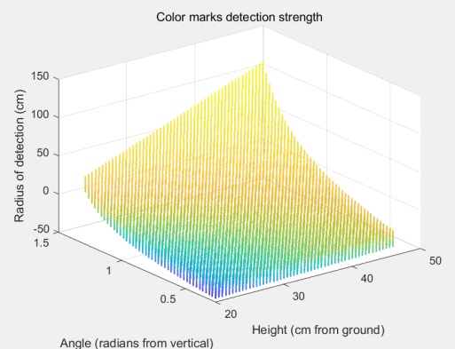
Lidar Placement

Slide 52
Mid-level: Navigation (yet to be validated)
Path Planning:
  A* Algorithm to Create a Path for Robot to Follow:
    Works well with our code since we already create a grid
    Slower but more optimal than an RRT algorithm
    Potentially look at D* (probably unnecessary since rocks don’t move)
  RRT Algorithm:
    Runs faster than A*, but doesn’t usually find the optimal path
Path Following:
  Pure Pursuit Controller:
    Easier to program and tune
    Less accurate and precise when tuned
  Linear Quadratic Regulator:
    Harder to program and tune
    More accurate and precise when tuned
Notes:
Note: Need to test RRT & A* with path following implementation to see if faster generation time outweighs an optimized algorithm or not.

Slide 53
Problems that need to be addressed
Detecting belt slippage
What happens if most cameras get occluded (need to find a way to add camera protection from regolith)
Startup time of jetson is like 1.2 min (needs to be around 10s)

Slide 54
Plan After CDR
Finalize API for low-level controls
Transition from cartbot to dummybot (95% done!)
  Validate drivetrain trajectory controller
Add bluetooth to localization system, so far just have drivers working within ROS
Finetune + optimize localization system and move it to the jetson

Slide 55
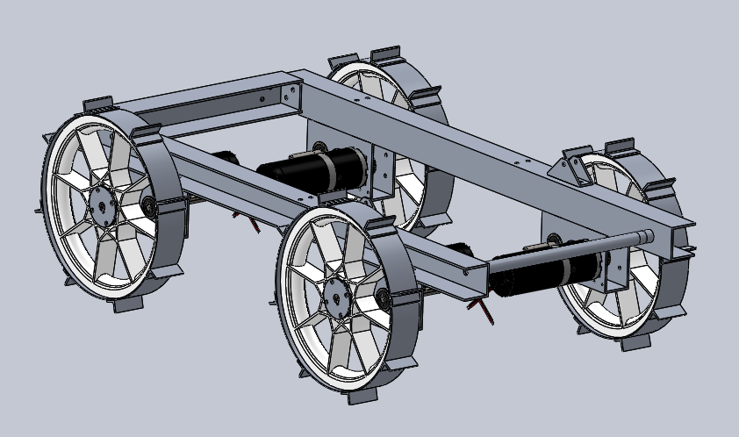
Drivetrain

Slide 56
Relevant System Requirements
The Drivetrain system shall weigh no more than 25 kg
Drive:
Shall be able to traverse over around boulders and craters of 30 cm - 50 cm
Wheels shall have traction with regolith
Motors and gearboxes shall support and cause system to move
Shall be designed in a manner that does not predispose it to regolith accumulation
Frame:
System shall not exceed dimensions of 1.1m length x 0.6m width x 0.37m height at wheels, and 0.34m height inside the wheels
Must be capable of structurally withstanding multiple competition runs
The system shall have a kill switch in an area that is easily accessible on the exterior of the robot

Slide 57
Changes since PDR
Drive:
Will be 3D printing wheel hubs
Added encoders into the drive system for software
  Using third gear and extra wheel shaft
Changed wheel rim thickness to 1/16” sheet metal
Frame:
Shortened frame dimensions
Using C-channels over box tubes
  Found stock C-channel!!
Changed the back box tube into C-channel
Suspension:
No suspension

Slide 58
What is being Reused vs. What is new
Bought new wheels with the same dimensions as last year (11.75 in diameter and rated for 150 lbs each)
Same motors from old robot
Manufacturing a new frame

Slide 59
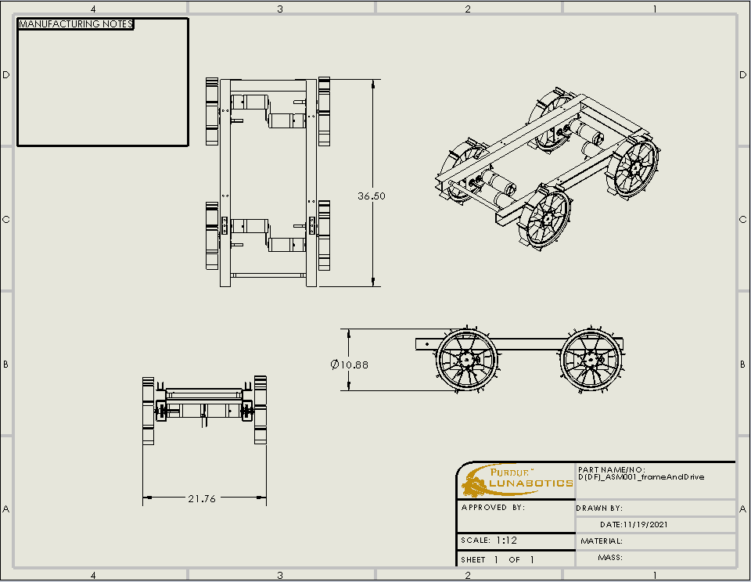
System Dimensions

Slide 60
System Specifications
Specification | Target Value | Current Value
Mass | < 25 kg (55 lbs) | 16.9 kg (37.28 lbs)
Wheel Height | < 14.6 in (37 cm) | 10.88 in (27.6 cm)
Frame Height | < 13.4 in (34 cm) | 9.36 in (23.78 cm)
Width | < 23.6 in (60 cm) | 21.76 in (54.3 cm)
Length | < 43.3 in (110 cm) | 36.5 in (92.71 cm)

Slide 61
Frame System Requirements
System shall support other systems
System shall maintain mounting points for Power & Hardware boxes
System shall not exceed dimensions of 1.1 m length x 0.6 m width x 0.37m height inside the wheels
Robot shall be capable of structurally withstanding multiple competition runs
Electrical components should be sealed against regolith dust
Frame should be designed in a manner that does not predispose it to regolith accumulation (i.e. minimal steep edges/corners, slope frame, etc..).

Slide 62
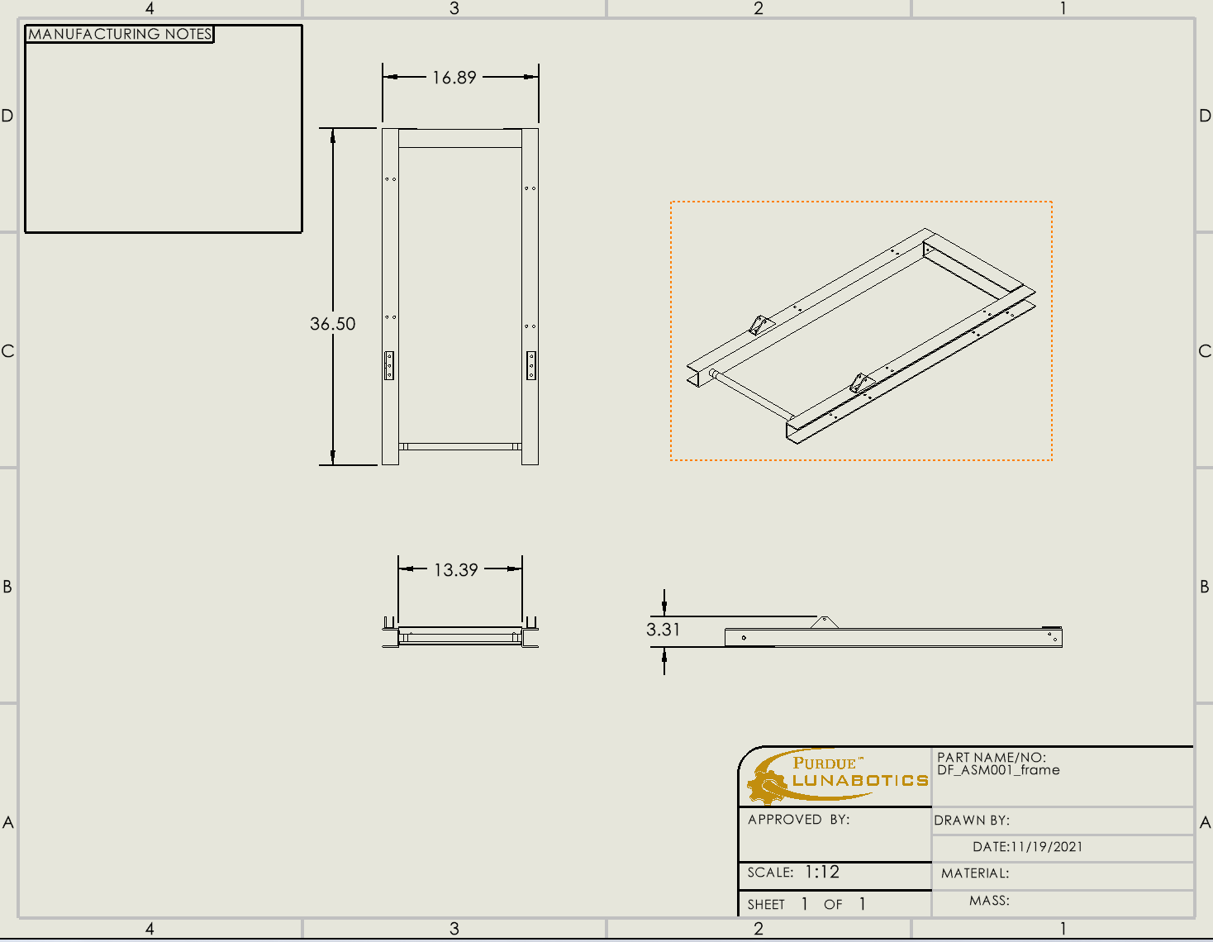
Frame Dimensions
Mass of frame assembly is 6.587 pounds (2.988 kg)

Slide 63
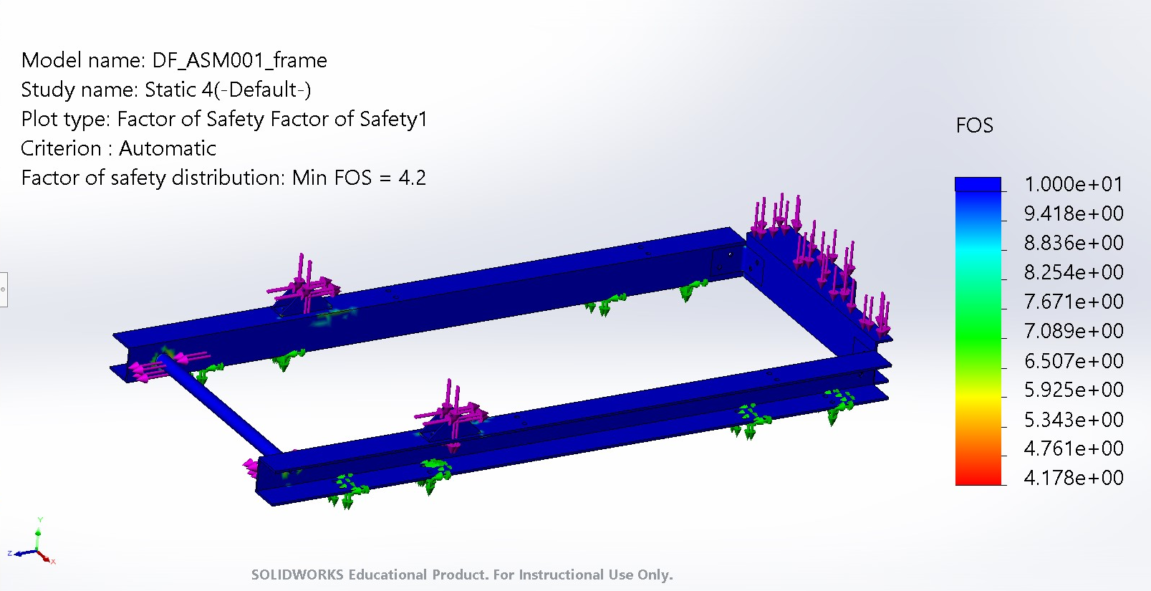
Frame Safety
Frame FEA

Slide 64
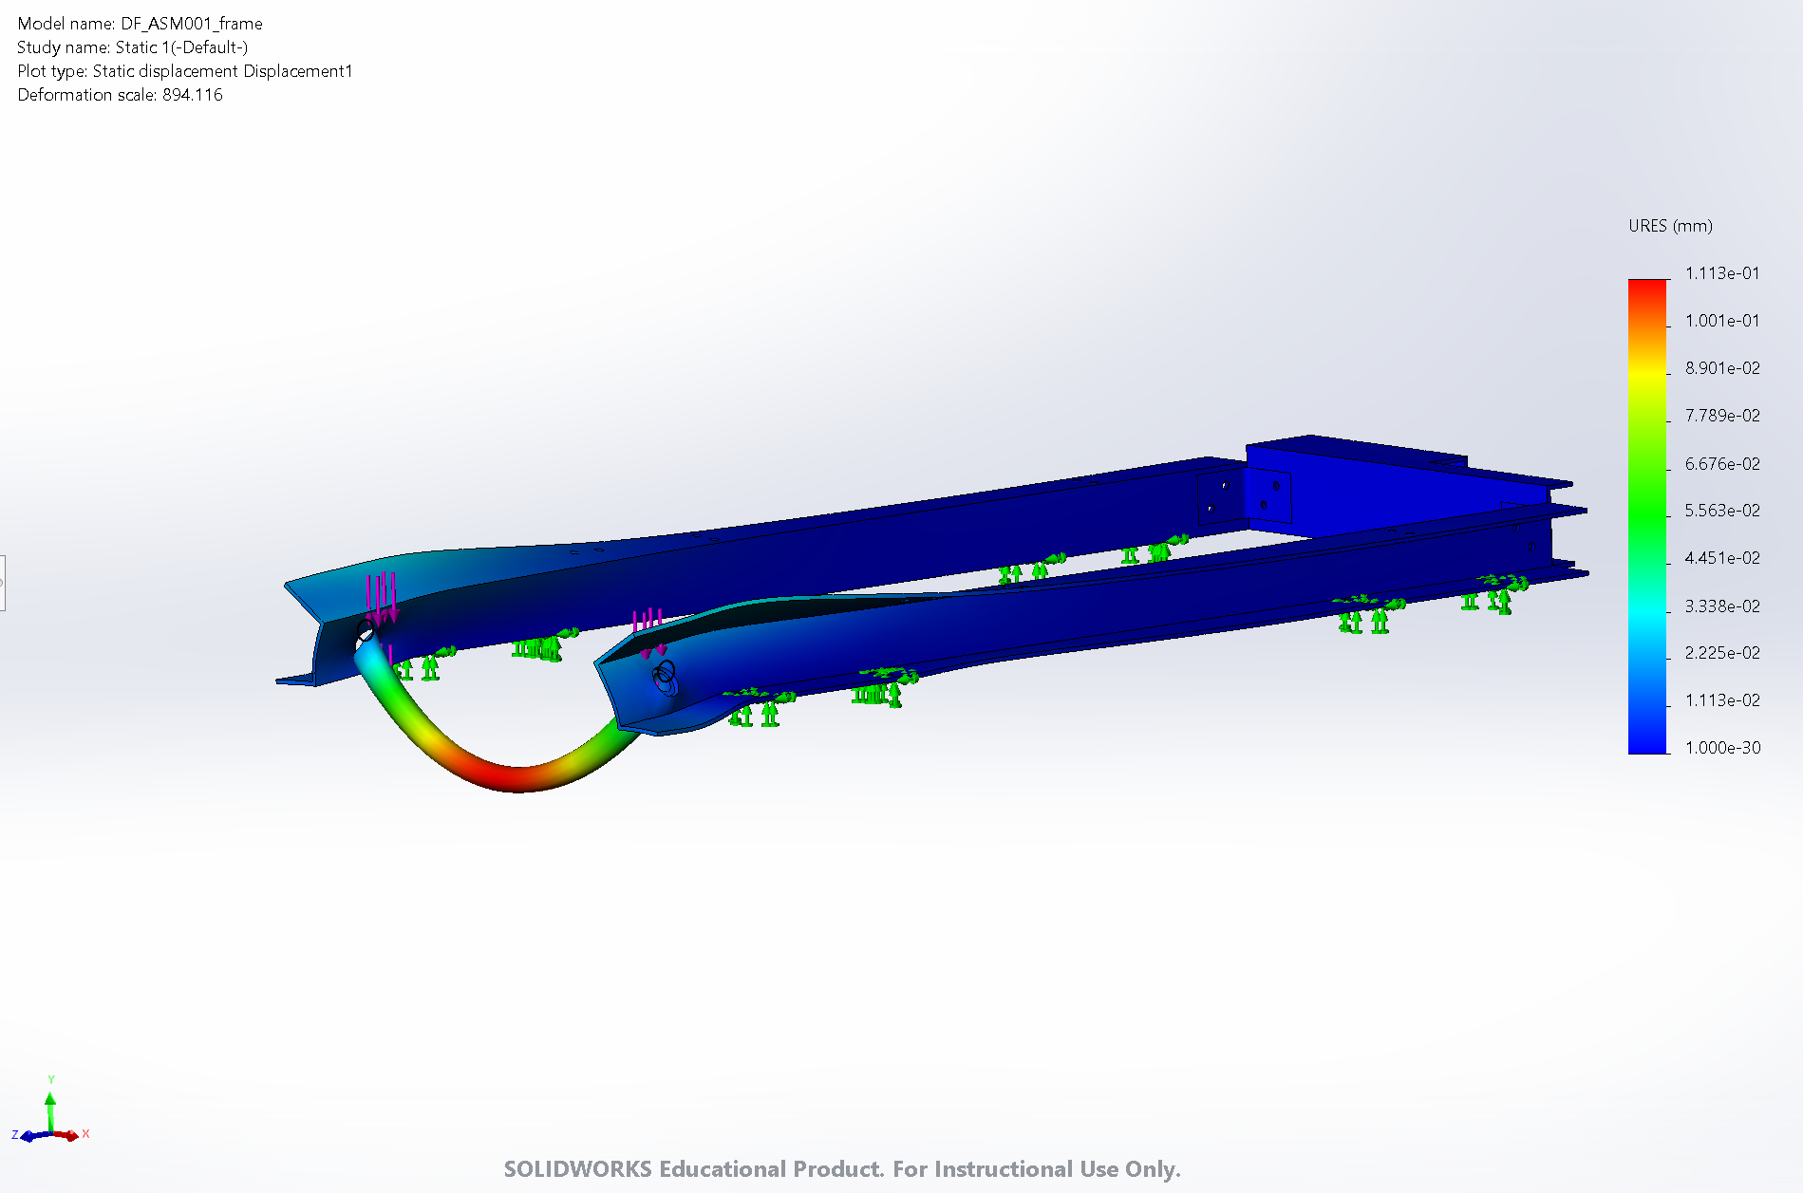

Ex-dep mounting rod
Mounting rod FEA (deployed configuration)
Displacement (900:1 scale)
Stress (1:1 scale)

Slide 65
Drive System Requirements
Shall be able to traverse over around boulders and craters of 30 cm - 50 cm
Wheels shall have traction with regolith
Motors and gearboxes shall support and cause system to move
Shall be designed in a manner that does not predispose it to regolith accumulation

Slide 66

Drive System Dimensions
Mass of each assembly is 7.74 pounds (3.51 kg)

Slide 67

Drive Shafts
FEA of the drive shaft with 800N of force (maximum weight of the robot)

Slide 68
Drive Specifications
Motor:
  BDPG-60-110-24V-3000-R47
  2:1 gear ratio
    KHK 56 tooth hubless gear
    KHK 28 tooth hub and set screw
  Rated Torque Output of 1334 oz-in (9.42 N-m)
    Required is 798.15 oz-in (5.64 N-m)
  Travel Speed of 1.168 ft/s (.3504 m/s)
    Required is 1 ft/s (0.30 m/s)
Wheels
  10.75 in diameter LAPP Wheels (Same as last year)

Slide 69
Plan After CDR
November 20 - December 4: Review CDR comments and finalize design
December 4 - 18: Begin manufacturing while keeping in mind possible design changes around other systems
Spring Semester: Continue manufacturing with a goal of finishing by the end of February

Slide 70
Power & Hardware

Slide 71

Block Diagram (Same as PDR)

Slide 72

Spacing
Will have 1 box on side opposite of deposition motor this year
  16” x 12.5” x 2.36”
Positioned similarly on the robot to last year
Due to increased size:
  The battery and power meter will be internal

Slide 75

P&H Box CAD
Folded sheet metal
Bolted on lid with rubber seal
Will be putting epoxy in the gaps

Slide 76

Teensy Breakout Board

Slide 77


Teensy Board Design
4 layer board
Uses PCB tail bulkhead
Support for 10 motor controllers, 1 with current feedback
4 encoders
8 limit switches
2 load sensors averaged together

Slide 78


Motor Controller Test Board
Board assembly in progress
Will continue with testing and assembly after break

Slide 79


Updated Motor Controller

Slide 80
Motor Controller Changes
Adapted connectors to fit into power board
  20A orthogonal board-board connectors
Added current sense resistors
  10 10mΩ resistors in parallel, 1mΩ total
  100V/V Op-amp
  Can sense up to 30A (well above any predicted draw)
General board layout changes to allow for better assembly
Minor part changes

Slide 81

Power Board and Step Down Converter
Step-down converter module for MOSFET drivers

Slide 82


Power Board and Step Down Converter
Step-down converter voltage setting

Slide 83
QR Code

Slide 84
OPERATIONS!!!
(you should be concerned)
Notes:
https://www.youtube.com/watch?v=LDU_Txk06tM

Slide 85














THANK YOU, you all did a really good job and we appreciate the hard work
Notes:
Frog

Slide 86



Memes brought to you by
A swamp monster
A boba fiend
Tetris fanatic
The other systems person
The other other systems person
That one specific admin (that never shows up)

Slide 87
This has been the Systems/Fab OPs Frog Review. Thank you.

Slide 88

QR Code/Questions

